Slide 1
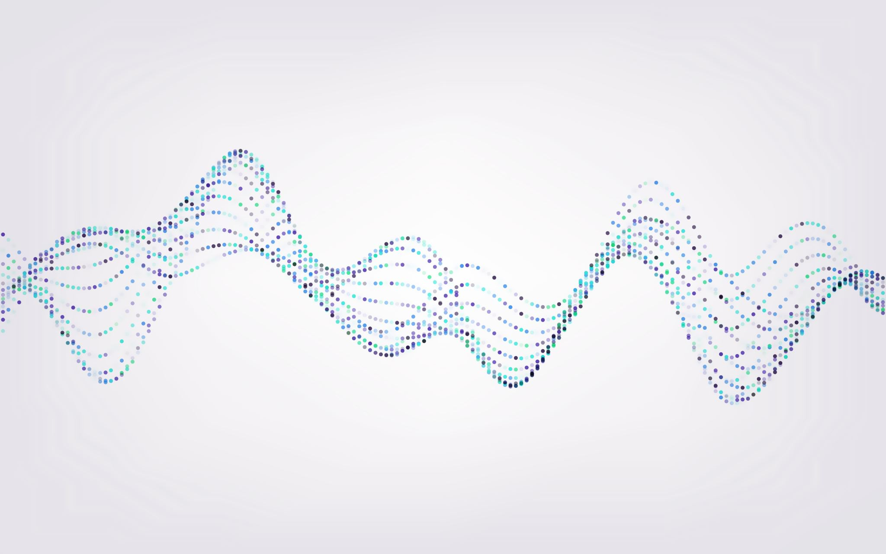
Living things and their enviroment
Celina akkawi , talin yassin ,
yasmine abuhadba,salma hantoush 6f

Slide 2
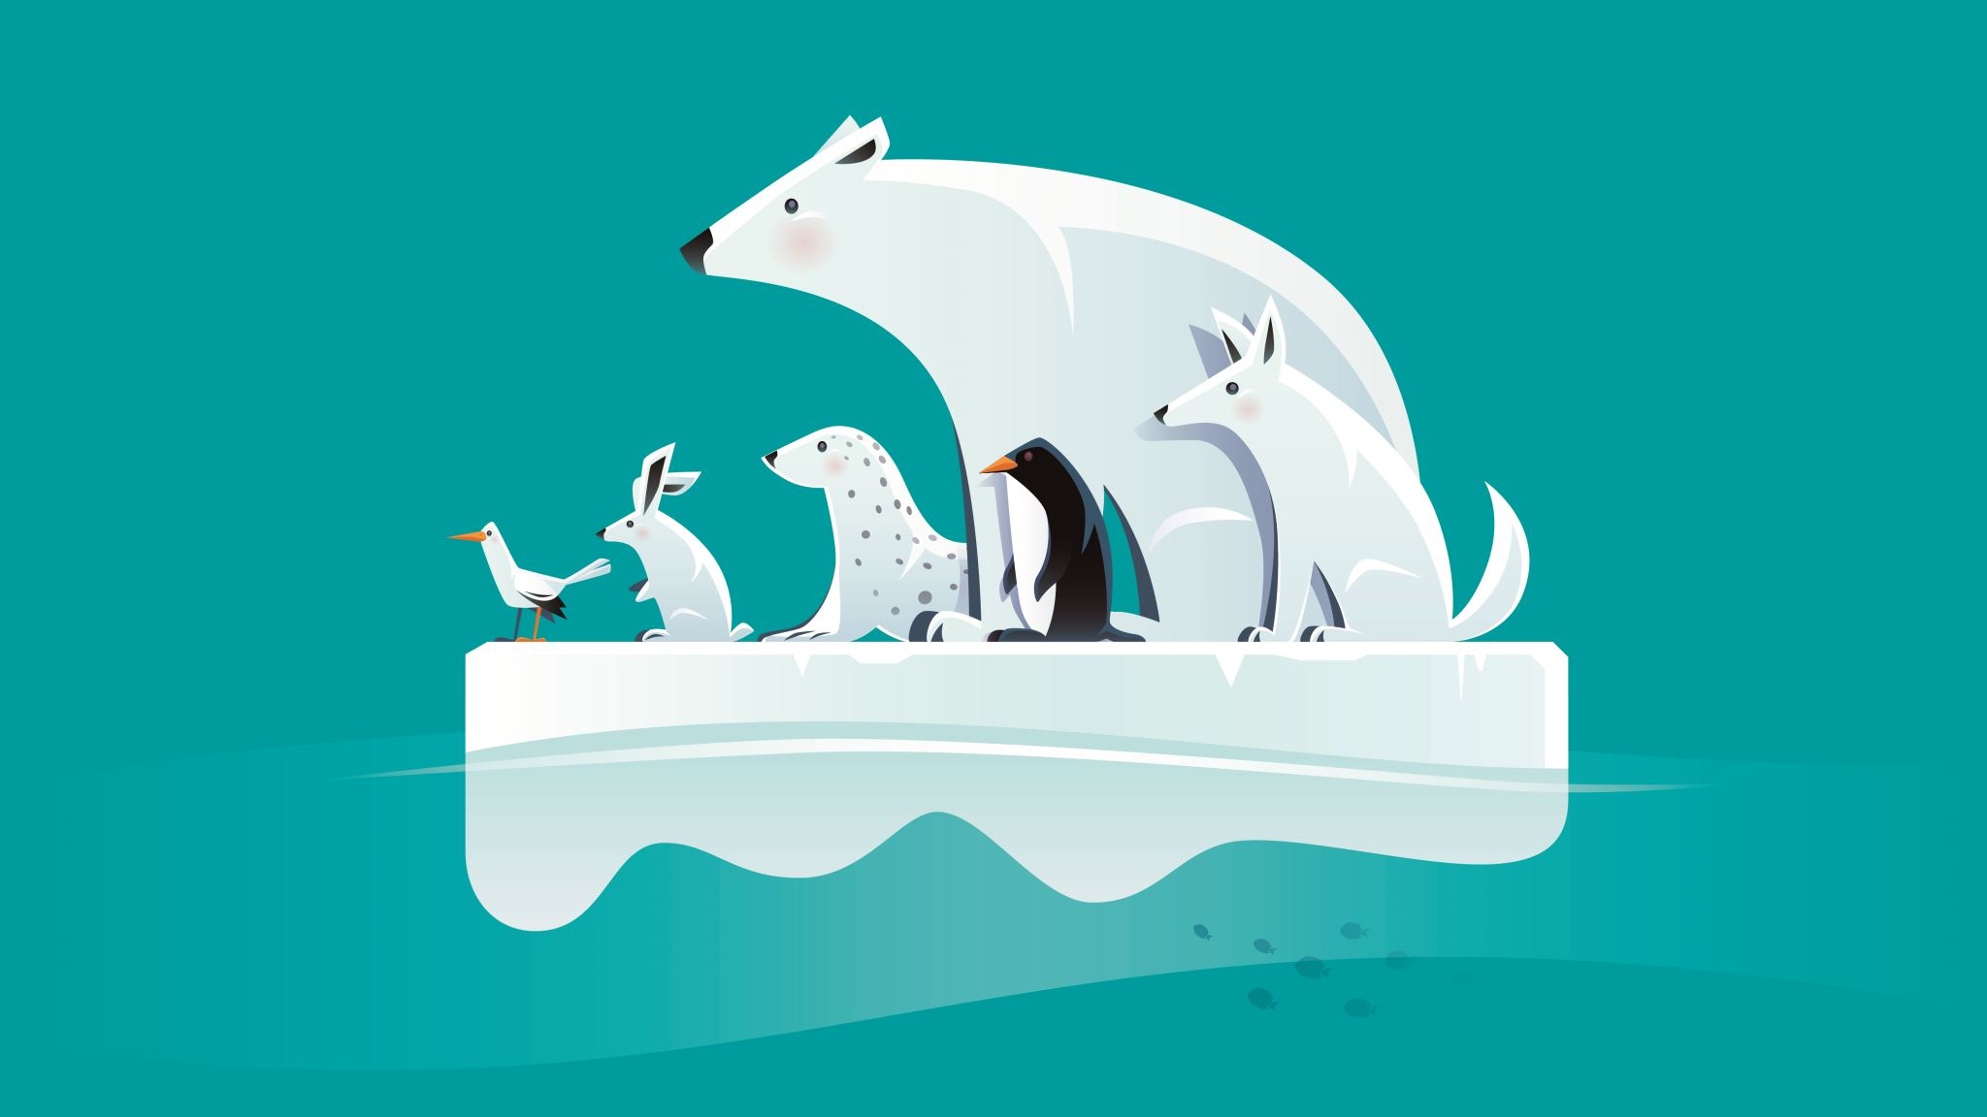
Arctic habitats

Slide 3
arctic
Yasmine Abuhadba
The arctic is a polar region located at the northern of earth. The arctic consists of the arctic ocean, adjacent seas,danish realm,finland,norway

Slide 4
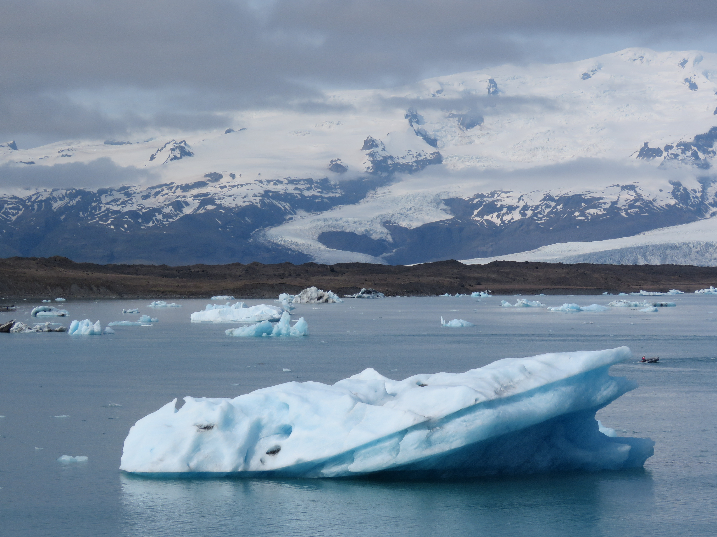
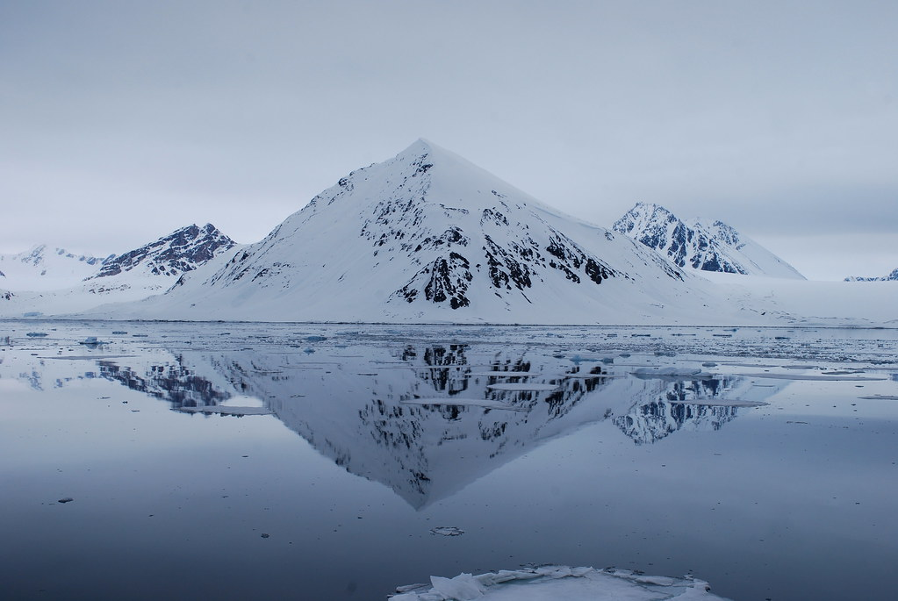
Arctic animals
Yasmine Abuhadba
Polar bears
whales
polar bears are warm blooded that is why they have a think layer of fat and they are covered up by fur
Whales are widely distributed and diverse group of fully aquatic placental marine mammals
Arctic fox
Arctic fox also known as the white fox ,polar fox and snow fox is a small fox native to the arctic regions of the nothern hemisphere
This Photo by Unknown Author is licensed under CC BY-SA-NC

Slide 5
The main reason why animals are extinct
Arctic animals are getting extinct because of all the heat and melting ice and snow that is occurring in the arctic lands.
The seas are rising because of all the terrifying amounts of melting ice caused by global warming
Many animals in Arctic lands are barely surviving from all the acidifying oceans that are threatening the arctic ecosystem
In conclusion all of the arctic animals are endangered and getting extinctic because of their habitat loss and the habitat loss is happening mostly from global warming
When animals have an environment that is getting unhealthy and that usually causes death or suffocation and because of that animals can’t reproduce anymore so that causes extinction
Celina akkawi

Slide 6
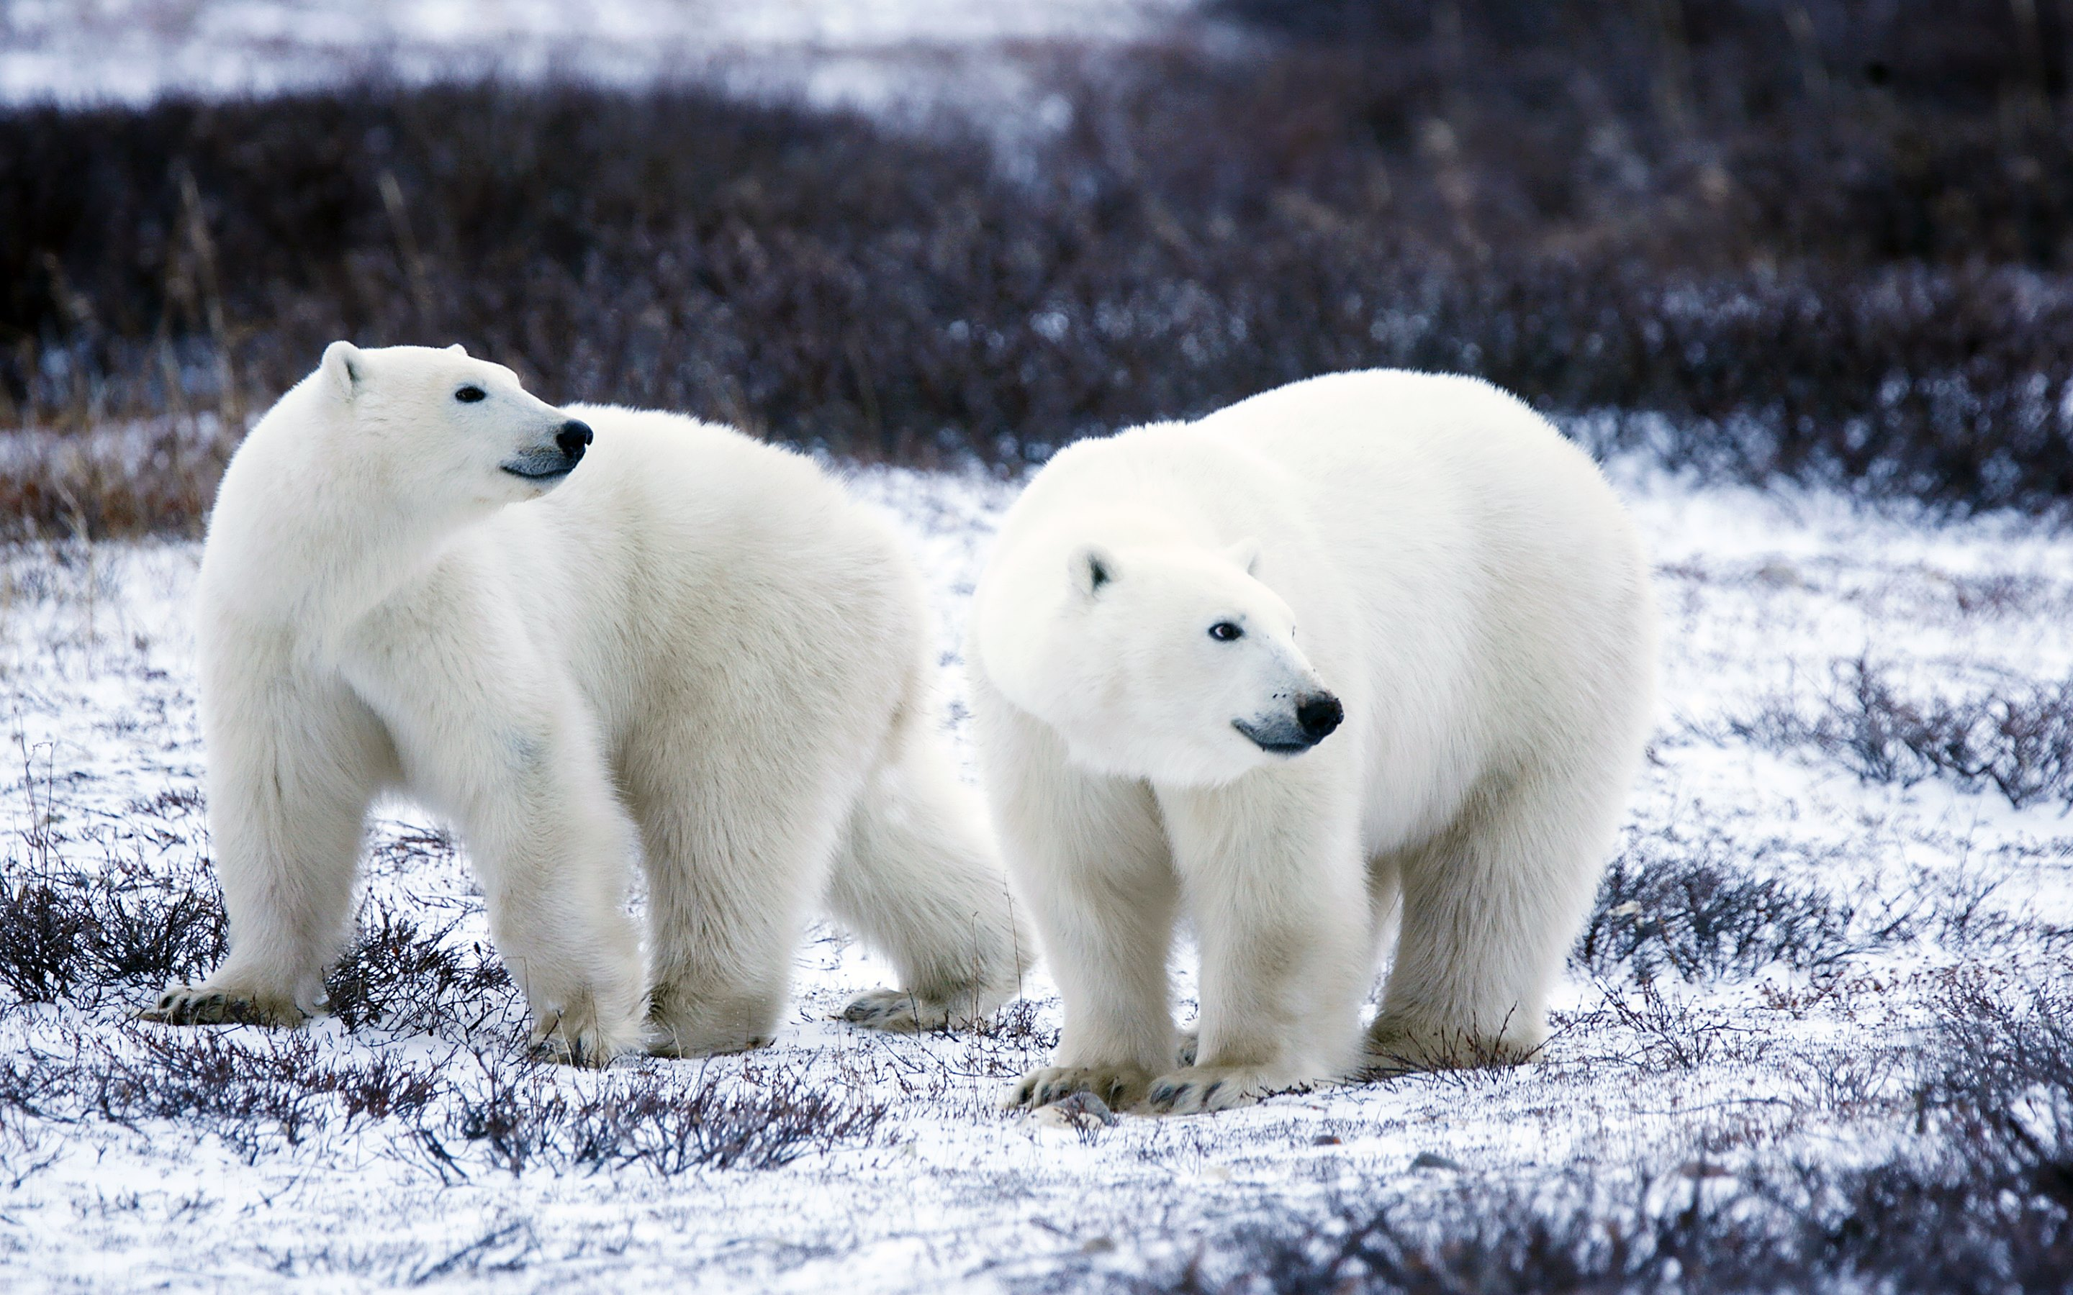
How are scientists preventing these arctic animals in antarctica from getting extinct?
Talin Yassin
CONCLUSION
From teaching captive and breeding new variants to deploying dogs and drones and scientists also aim to nurture different types of species in the arctic.
With protecting and restoring and connecting the habitats that are endangered species and other wildlife-friendly land management practices.
In conclusion, all scientists are trying to do is discover new species, but people are still causing combustion, littering and polluting
This Photo by Unknown Author is licensed under CC BY

Slide 7
Statistics of the arctic
How much ice is left on the arctic?
There is about 14.0 million km2 ice left on the arctic
How much animals are left in the Arctic?
There are over 5,000 species
How much water is left in the arctic ocean ?
The total volume of the Arctic Ocean is 18,750,000km3
Area of arctic
14.06 million km²
Height: 6,000
The coldest temperature ever was
69.6°C (-93.3°F)
Salma hantoush

Slide 8
Detailed information
Salma hantoush
The October 2022 average Arctic sea ice extent was 6.61 million square kilometers (2.55 million square miles). This is the eighth lowest in the satellite record (Figure 1a). Extent was 1.74 million square kilometers (672,000 square miles) below the 1981 to 2010 average of 8.35 million square kilometers (3.22 million square miles) and 1.28 million square kilometers (494,000 square miles) above the record minimum set in 2020 of 5.33 million square kilometers (2.06 million square miles).

