Slide 1
James Bond
By Fuad Qubain

Slide 2
Who is james bond
James bond is a well known actor for the film ‘NO TIME TO DIE’.
His real name is Daniel Craig, in full Daniel Wroughton Craig, (born March 2, 1968, Chester, Cheshire, England), English actor known for his restrained seriousness and for having handsome features.
He is often known as a superior spy, and a masculine icon. He is also designated as agent 007 (always articulated as “double-oh-seven”) in the British Secret Intelligence Service, or MI6.

Slide 3
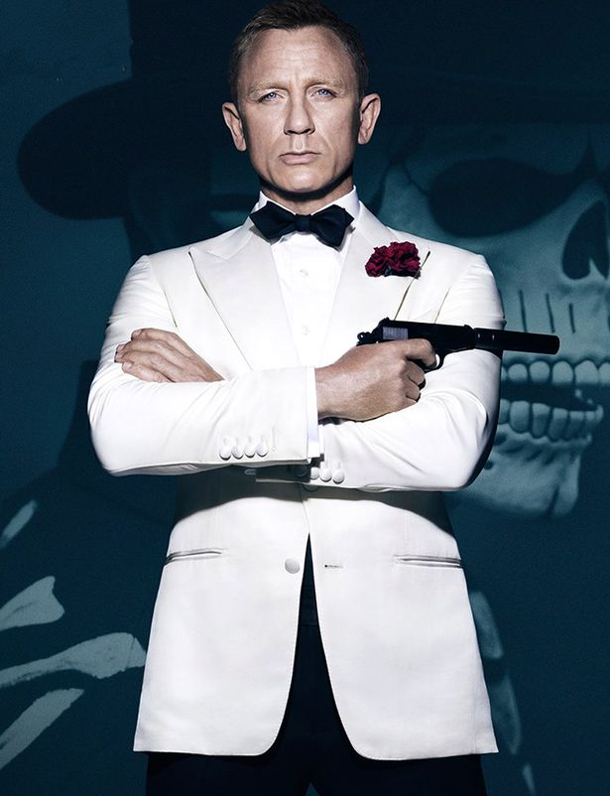
12 actors, and 27 movies in 60 years
The first Bond movie, Dr. No, premiered on October 5th, 1962.
The release of the most recent Bond movie, ‘No time to die’, was originally scheduled for March 31st, 2020, but got postponed a couple of times because of the coronavirus/COVID-19, and it was eventually released on September 28th 2021.

Slide 4
In the past 60 years, a total of 27 James Bond films has been made:
title | year | actor
Dr. No | 1962 | Sean Connery
From Russia with Love | 1963
Goldfinger | 1964
Thunderball | 1965
Casino Royale | 1967 | David Niven
You Only Live Twice | 1967 | Sean Connery
On Her Majesty's Secret Service | 1969 | George Lazenby
Diamonds are Forever | 1971 | Sean Connery

Slide 5
Live and Let Die | 1973 | Roger Moore
The Man with the Golden Gun | 1974
The Spy Who Loved Me | 1977
Moonraker | 1979
For your eyes only | 1981
Never say never again | 1983 | Sean Connery
Octopussy | 1983 | Roger Moore
A view to a kill | 1985
The living daylights | 1987 | Timothy Dalton

Slide 6
License to kill | 1989
GoldenEye | 1995 | Pierce Brosnan
Tomorrow never dies | 1997
The world is not enough | 1999
Die another day | 2002
Casino Royale | 2006 | Daniel Craig
Quantum of solace | 2008
Skyfall | 2012
Spectre | 2015
No time to die | 2021

Slide 7
My favourite movie
Although I haven’t watched all James Bond movies yet, but by far, “No Time to Die” is my favourite movie. This is because I always prefer action movies and this film in specific is full of action and suspense.
If you are looking for a movie that will definitely attract you attention, then “No Time to Die” should be on your list. From car chases, hand-to-hand combat, and gunplay, each order was beautifully created and performed..

Slide 8
12 actors
And no less than 12 actors have portrayed James Bond in the media. In chronological order: Barry Nelson, Bob Holness, Sean Connery, Roger Moore, David Niven, George Lazenby, Christopher Cazenove, Timothy Dalton, Michael Jayston, Pierce Brosnan, Daniel Craig & Toby Stephens.

Slide 9
Did you know?
James Bond movies are the longest continually running and the second highest film that earns money.
The code ‘007’ comes from the fact that agents are given numbers.
The ‘00’ means that they have a license to kill.
James Bond was originally a novel.
Bond has been shot over 4000 times.
Thunderball is the most successful Bond Movie.
Bond likes the colour Gold the most.

Slide 10
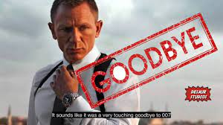
Thank you for Listening!

Slide 11
Resources:
https://evert.meulie.net/various/media/all-james-bond-movies/
https://www.slideshare.net/piersjohnmidwinter/james-bond-22500503
https://www.cbr.com/no-time-to-die-vs-skyfall-best-james-bond-movie/#:~:text=No%20Time%20to%20Die%20exceeded,with%20John%20Wick's%20action%20stylings.

