Slide 1
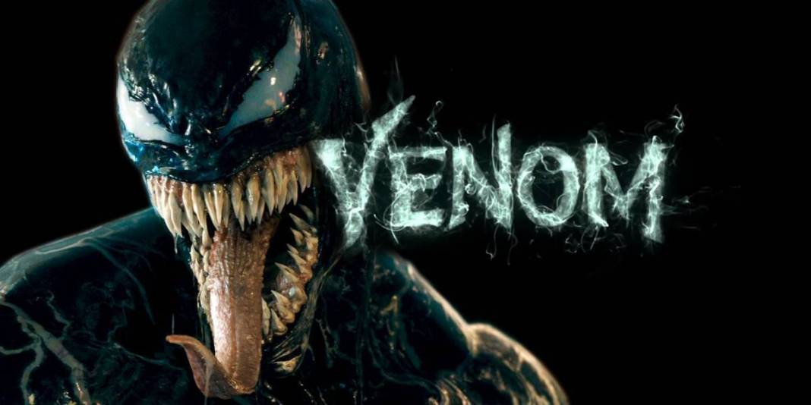
By Joseph 6E

Slide 2
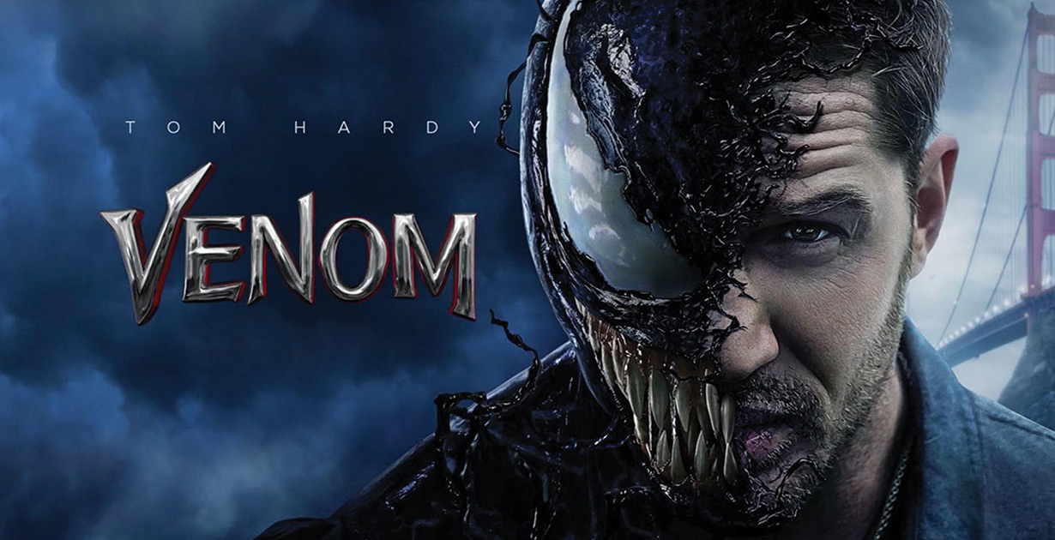
Who are the main characters in this movie?

Slide 3
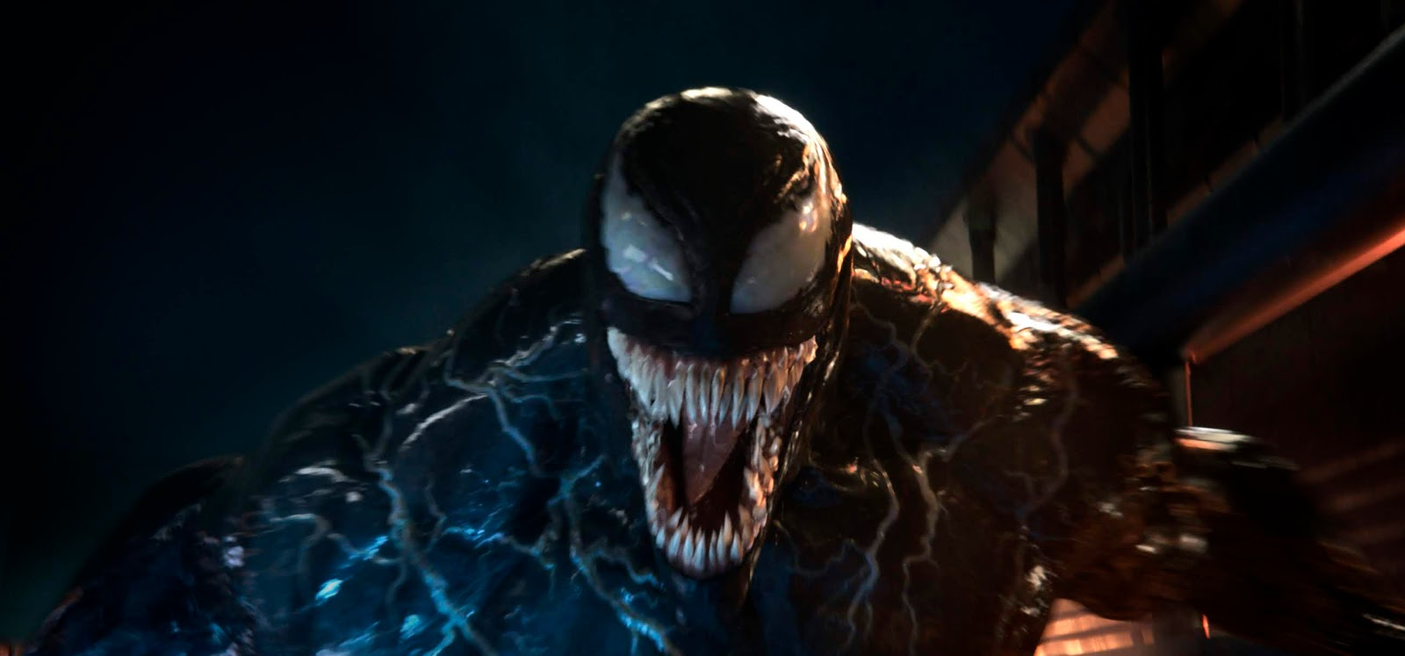
What happened in the movie?
There was a flying space ship looking thing then they had an error then the space ship crashed and it was all shattered and then people in yellow suits with masks came and a lot of ambulance there were a lot of dead bodies and the flying space ship had weird looking symbiots and there was an organization that was trying to discover the symbiots and the leader in the organization secretly had a symbiot inside him called riot.

Slide 4
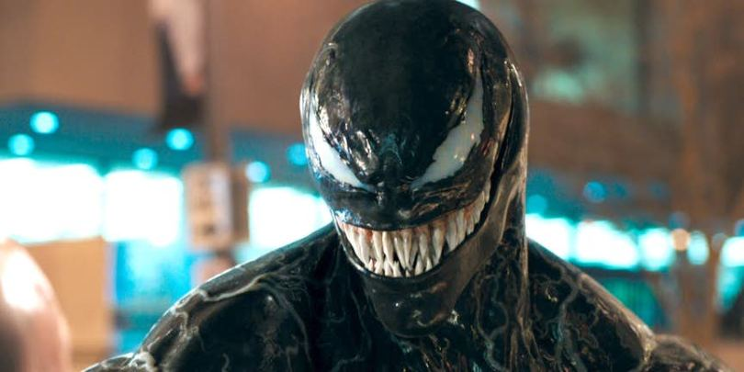
Who was my favorite character?
Venom

Slide 5
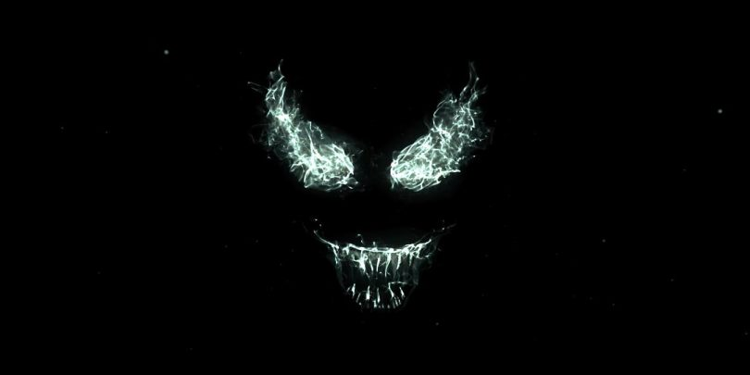
Why is Venom my favorite character?
He is scary
He looks cool
When Venom takes over Tom Hardy (Eddie) it is cool when he morphs his hand into a sword

Slide 6
Thank you For listening!

