Slide 1
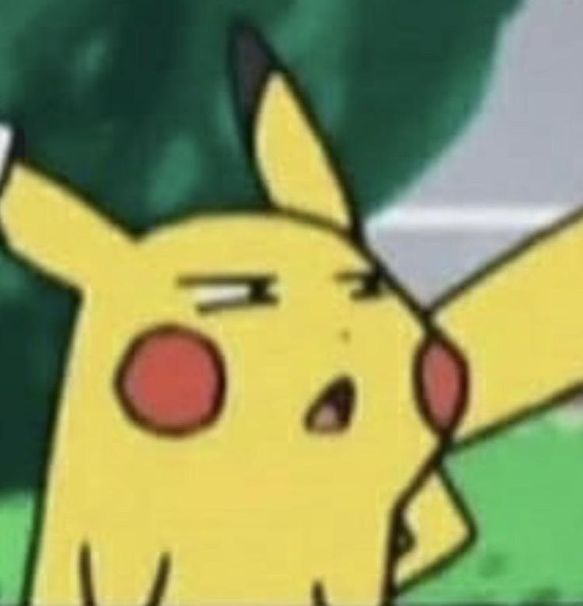
Jad’s Power Point
Grade 6B

Slide 2
Pokémon Adventures Vol 1
This book starts off by introducing the main character Red. You see Red doesn’t just want to train Pokémon he wants to be their friend too. His goal is to catch every Pokémon with the help of Pikachu. What's a Pikachu you may ask well a Pikachu is a electric starter Pokémon. After introducing Red him and Pikachu go into the forest to try to catch new Pokémon, but all of a sudden he meats blue. Wait did I mention Red’s enemy is Blue. Well back to the story Rad and Blue were about to have a battle but the they here something in the bushes. A small little Pokémon popes out of the bushes.

Slide 3
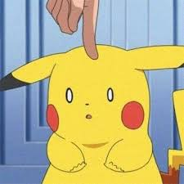
Small But Strong
When the Pokémon slowly creeps out it makes Red and Blue’s faces freeze it wasn't just a Pokémon it was the rarest Pokémon of them all mew. Mew is a mythical and there is only one in the hole world. Blue try's to catch it but it zaps him and his Pokémon, while Red just stares at what happened, then a evil group called team rocket sneaks behind mew and try’s to catch it but Mew just teleports away.

Slide 4
My favorite character, and the theme of the story
My favorite character is Red because he is kind smart and brave and sometimes dumb and he never settles for less.
The them of this story is team work and to never judge a book by its cover.

