Slide 1
Endangered animals
By Alba Lara

Slide 2
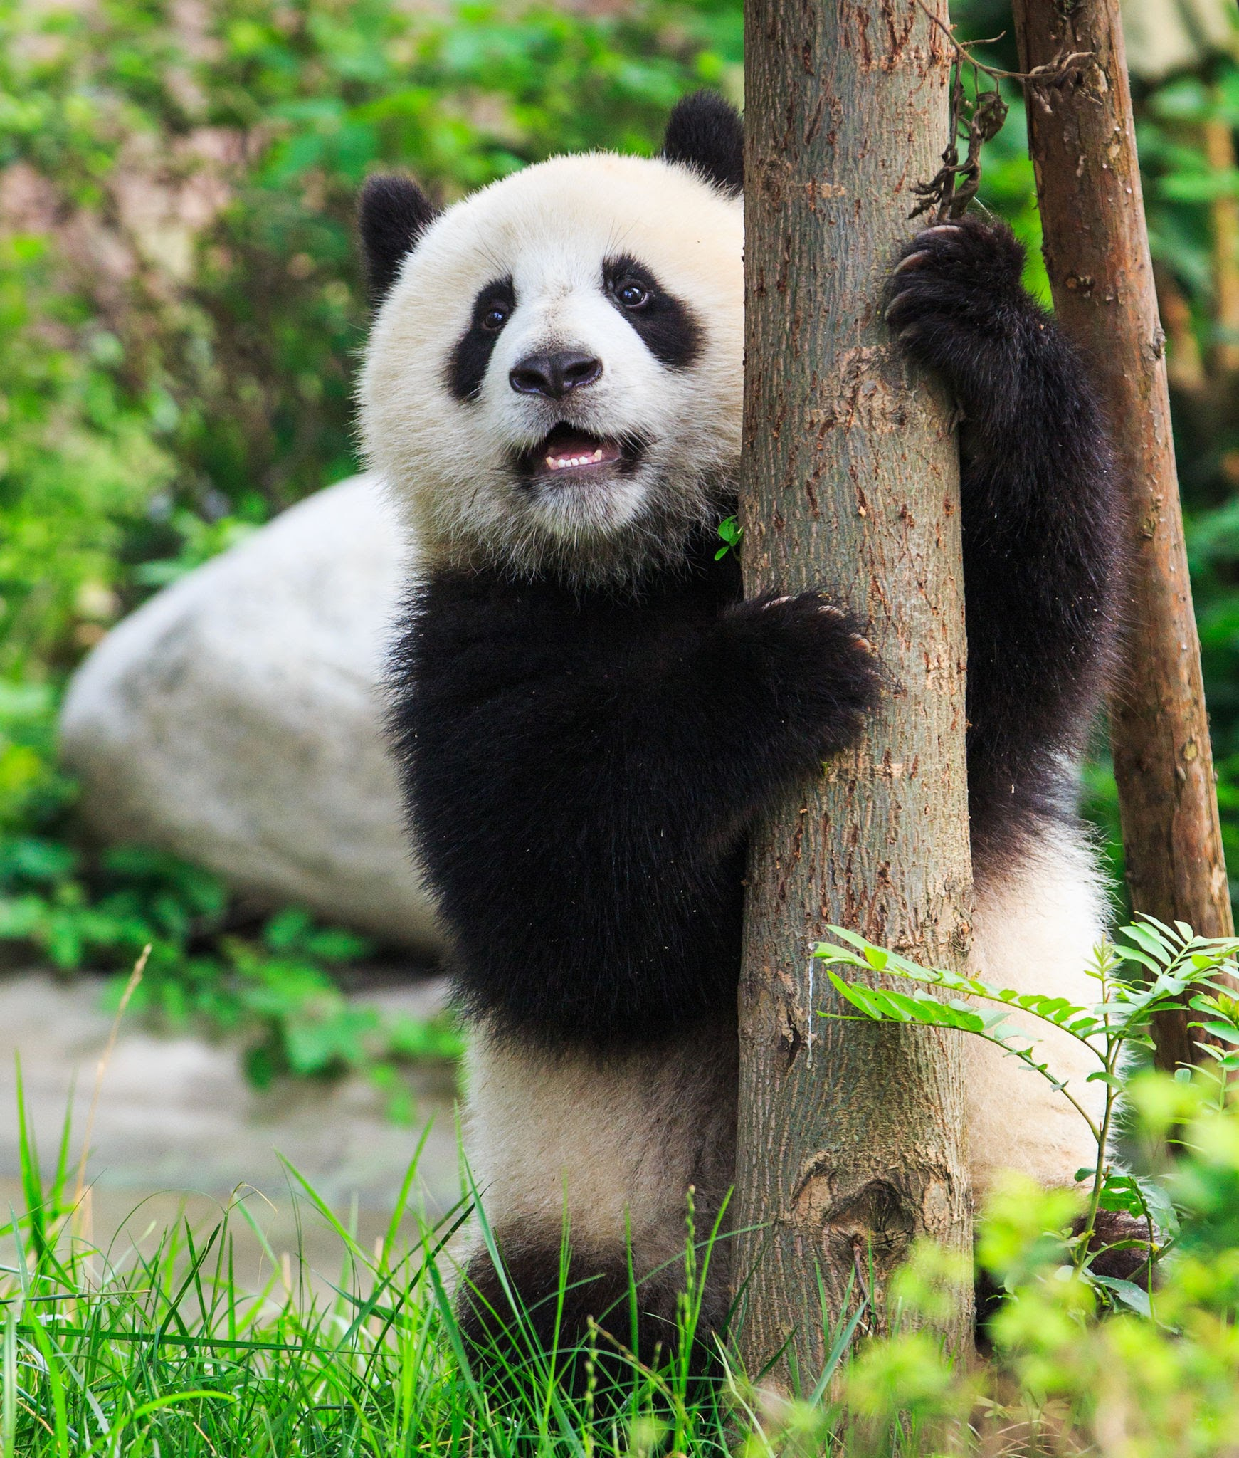
Giant Panda
Pandas live mainly in temperate forests high in the mountains of southwest China.
The giant panda, also known as the panda bear, is a bear species endemic to China. It is characterized by its bold black-and-white coat and rotund body. The name "giant panda" is sometimes used to distinguish it from the red panda, a neighboring musteloid.

Slide 3
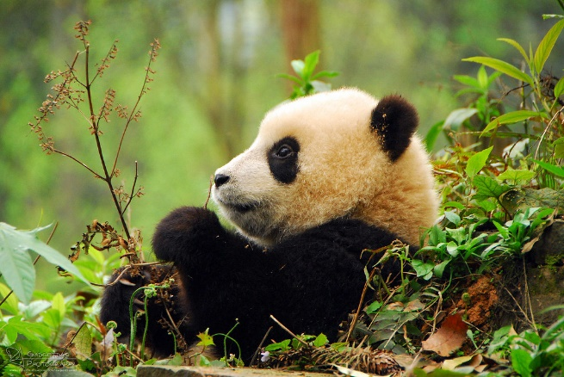
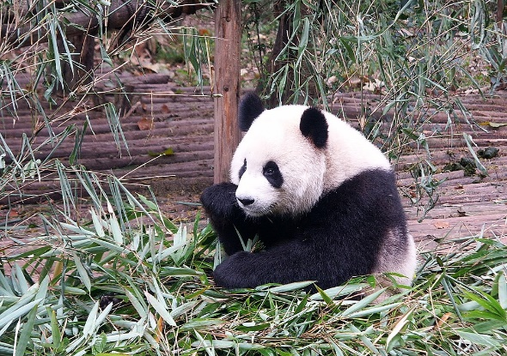
How pandas become endangered species ?
Pandas have become endangered species because of many reasons but some of them are : Loss of habitat, difficulty reproducing a bamboo diet and poachers.
But zoos and panda reserves are doing everything they can to keep this animals safe.

Slide 4
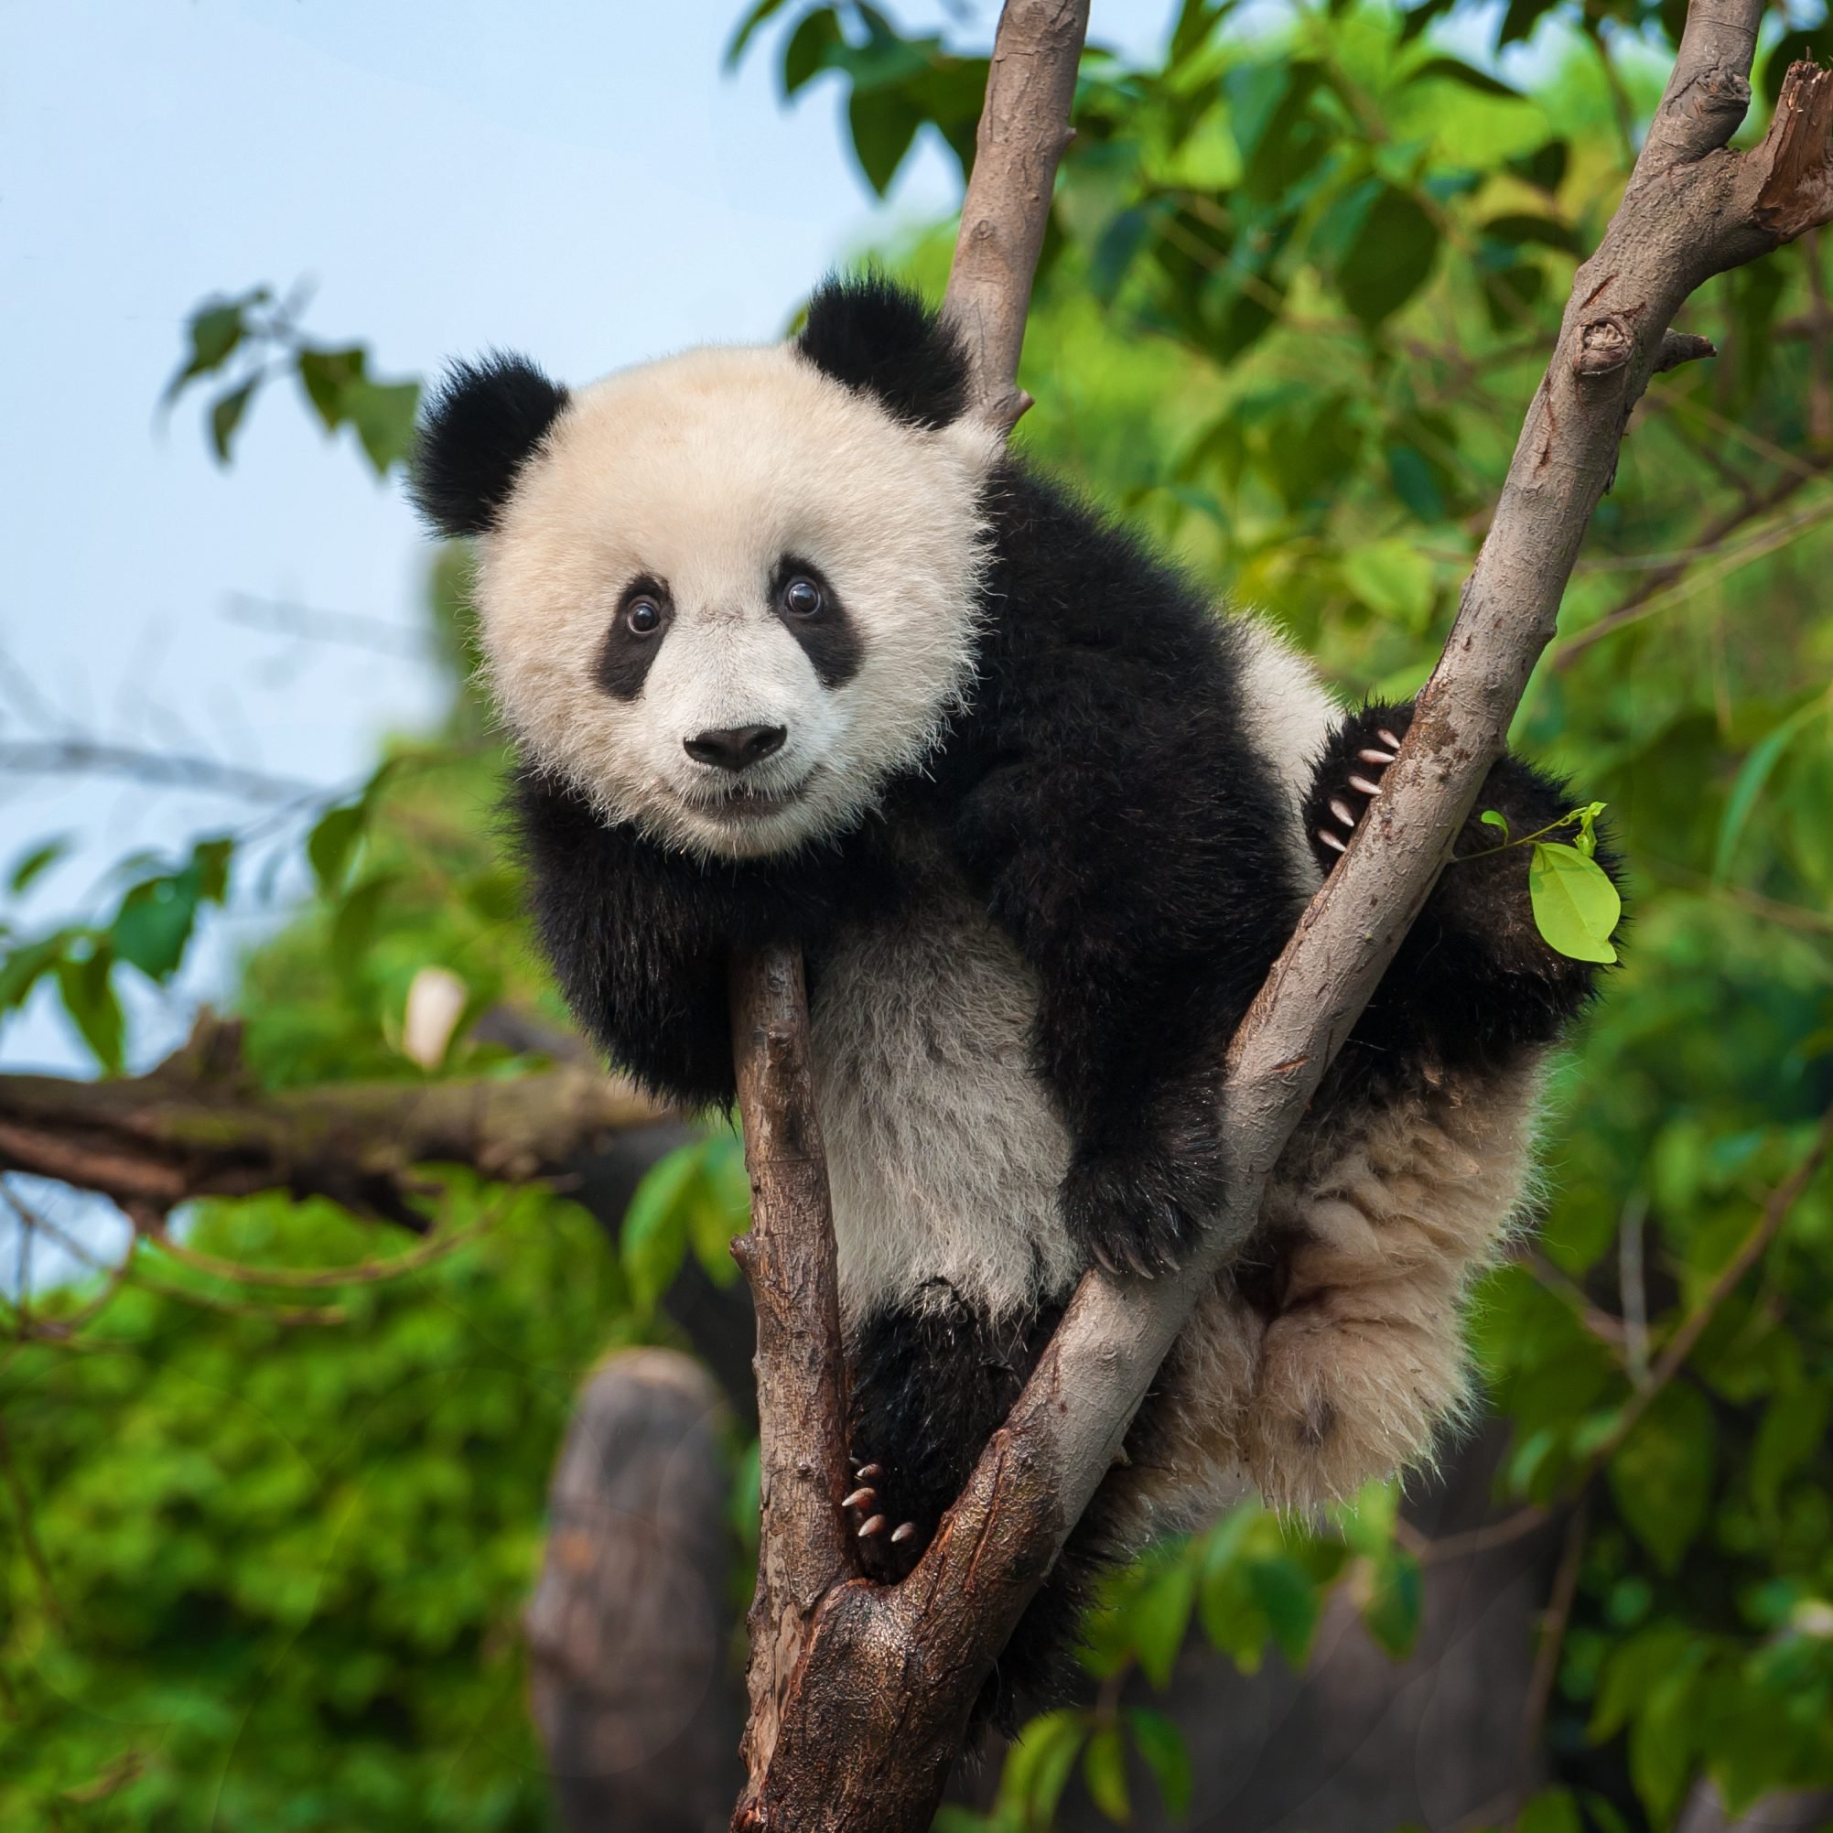
Panda Facts

Slide 5
Thank You for listening☺

