Slide 1
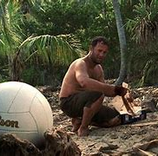
Cast Away movie
Created by Laith Haddadin – Class 6B

Slide 2
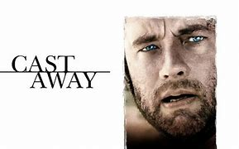
Cast away
The movie “Cast Away” released in the year 2000 directed by Robert Zemeckis “Cast Away” is a story of a FedEx worker named Chuck Noland (Tom Hanks). While he was on a business trip his cargo plane crashes and is left stranded on an island

Slide 3
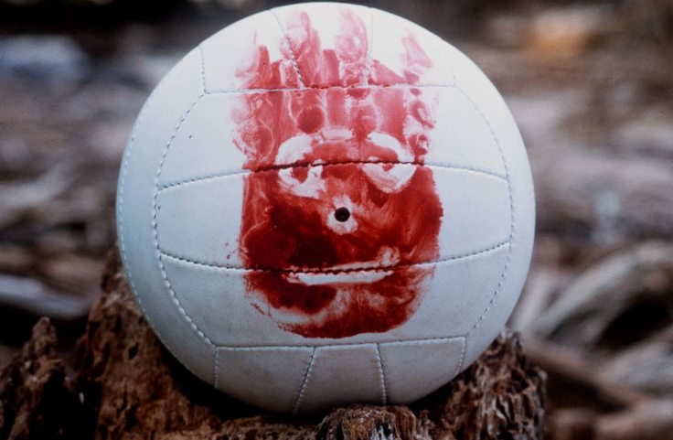
Chuck was left stranded on an island in the middle of the Pacific Ocean, a few days after the plane had crashed many packages were washed up onto the island’s shore so he started opening them to find anything necessary for his survival while he was searching through the packages from the cargo plane, he found a Volleyball which he decided to call “Wilson”.

Slide 4
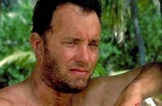
Four years later, in the year 1999, Chuck had moved to a cave for shelter. After a portable toilet enclosure washes up on the island, he builds a raft with the plastic as a sail, which then Chuck successfully launches the raft that he has filled with water, necessary supplies and unopened packages.

Slide 5
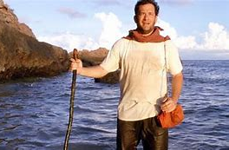
Chuck and the raft survive a storm, but afterward, Wilson falls off the raft and floats away into the Pacific Ocean. Chuck awakens and attempts to rescue Wilson but was not successful. Soon after, he was rescued by a passing ship. After returning to his city, Chuck finds out that he was declared dead by his family and friends. Later, Chuck returned to a hero’s welcome home party at the FedEx Headquarters in Memphis.

Slide 6
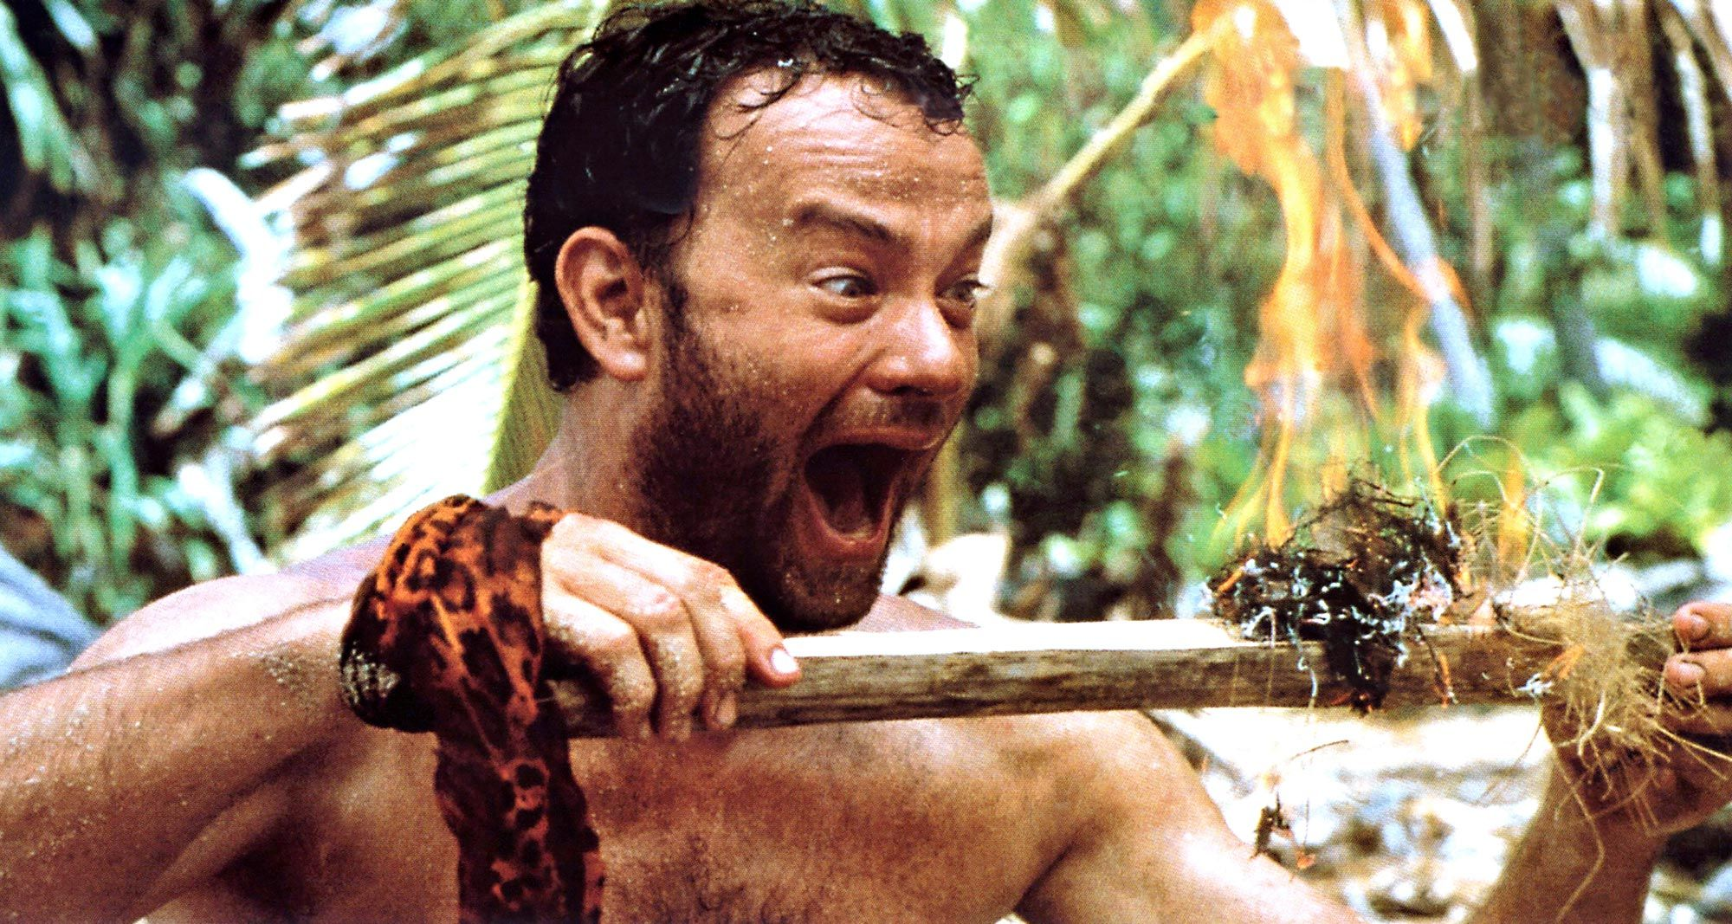
Moral of the story
To be strong and never give up. Chuck never gave up kept trying until he survived. Have was able to stay alive in a situation where basic survival tools were not available.

