Slide 1
Biology Living things in their Environment
Grade 6D
Tia Nazha
Teresa Alrabadi
Kinda Alsamarneh
Naya Tadros

Slide 2
Table of contents
01
02
03
Malayan Tapir
Habitat & Range
Adaptations
04
05
06
Statistics
Reasons behind extinction
Being done now to preserve

Slide 3
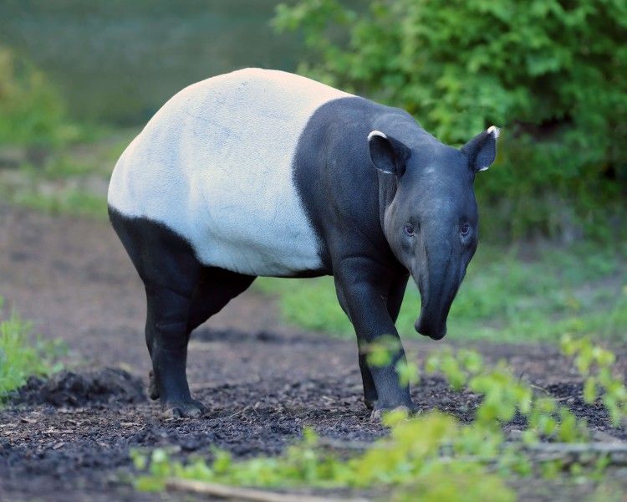
01
Malayan Tapir

Slide 4
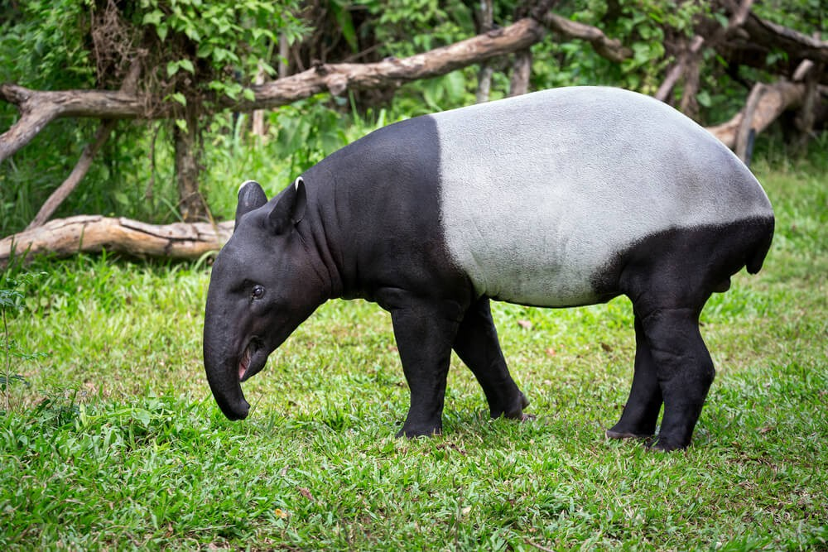
The Malayan tapir is the largest of the four species of tapir, and it's the only one located in Asia.
They are also the largest of the tapir species, weighing in at around 350 kg (720 pounds) and growing 1.8 meters long (6 feet).

Slide 5
02
Habitat & Range

Slide 6
Habitat & Range
Tropical lowland swamp, montane and hill forests, prefers dense, primary forests.
The tapir ranges through Myanmar (Burma) and Thailand south to Malaysia and Sumatra.

Slide 7
03
Adaptations

Slide 8
Adaptations
Black White Black
Malayan tapirs are sometimes called “Oreo” tapirs because their distinctive black and white color pattern resembles an Oreo cookie. The black on the front and back with white or gray in the middle is a form of camouflage that breaks up the tapir’s outline in the shadows of the forest. The stripes and spots on the vulnerable young help them blend into the dappled sunlight and leaf shadows of the forest and protects them from predators.

Slide 9
Adaptations
Prehensile Snout
The tapir’s upper lip and nose are elongated to form a distinctive prehensile snout that is similar to a stubby elephant’s trunk. This flexible extended nose is used for plucking leaves and shoots from trees as well as sniffing their way along forest trails. They have an excellent sense of smell and rely on scents for communication. Urine spraying is used to mark well-used pathways between feeding areas and water sources.

Slide 10
Adaptations
Barrel-Shaped Body
Tapirs have a thick heavy barrel-shaped body ideal for crashing through dense forest vegetation. When frightened or threatened, tapirs can run quickly. Despite their large size they can climb steep slopes on the banks of rivers. They are excellent swimmers and spend a lot of time in the water.

Slide 11
04
Statistics

Slide 12
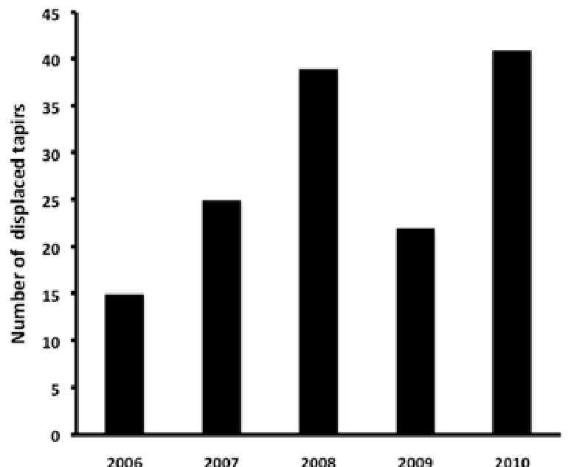
Statistics
Number of displaced tapirs

Slide 13
Statistics
According to Malaysia’s Department of Wildlife and National Parks (Perhilitan), in 2017, a total of 25 tapirs died after being hit by vehicles.
Statistics from Perhilitan show that 2,444 wild animals died as a result of roadkill from 2012 to 2017 despite signboards placed at areas known for wildlife crossings. The rampant hit-and-run cases involving Malayan tapirs have even garnered the attention of local politicians and non-governmental organisations (NGOs).

Slide 14
How many Malayan tapirs are left in the world 2022?
3,000 left in the wild (Endangered). This strange animal confuses many people. It looks like a combination of a pig and an elephant, but it is actually an animal called the Tapir.
Tapirs are most closely related to horses and rhinos, not pigs or elephants.

Slide 15
05
Reasons behind extinction

Slide 16
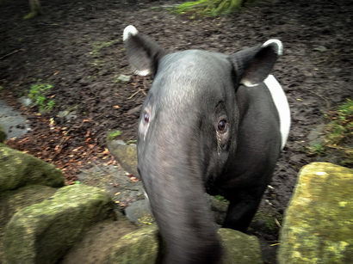
Reasons behind extinction
The Malayan tapir was first listed as endangered in 1986, due to an ongoing decline from loss of available habitat, fragmentation of remaining habitat and increasingly hunting pressure.
Tapirs are critically endangered because their habitat and environment is getting ruined, so the outcome means that tapirs won't have a place to live.

Slide 17
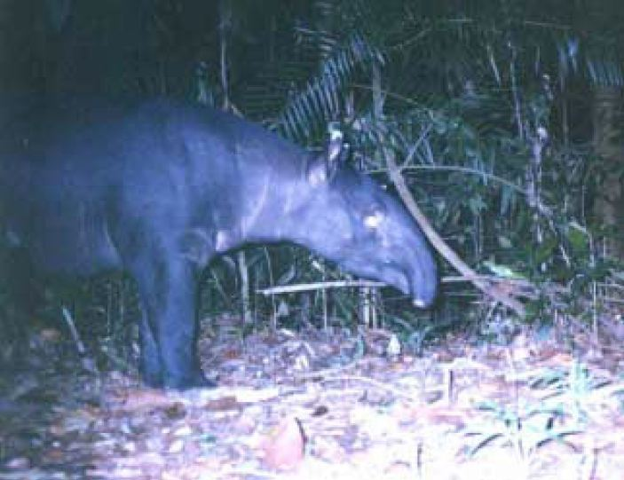
Reasons behind extinction
In fact, the Malayan Tapir is an easy target for speeding vehicles due to their poor eyesight.
Poaching and hunting tapirs for their meat and skin is also on the rise.

Slide 18
06
Being done now to preserve!

Slide 19
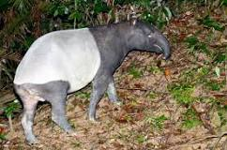
Being done now to preserve!
The best way to recover the species and their home would be to reclaim and protect the deforested areas and allow the Malayan tapirs to roam freely and reseed with their diet.

Slide 20
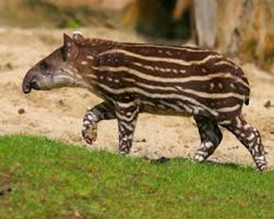
Being done now to preserve!
The World Tapir Day is celebrated on April 27 every year to raise community awareness on the importance of conserving tapirs and their habitats.

Slide 21
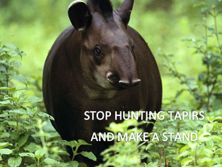
You can help too!
Many Ways to help out: 1. Help the environment by maybe planting some trees or helping the increase of pollution (e.g. putting rubbish in the bin, using ecofriendly lunch boxes, helping the community and help clean up the environment like Volunteer work).
2. Recycle (e.g. use recycled paper, recycle your cell phones, try to always throw out rubbish, using ecofriendly lunch boxes).

Slide 22
3. Reduce and Reuse.
4. Tell others about Tapirs being endangered and start helping the Tapir movement.
This will provide the tapirs with a better environment and a nicer habitat where they can live.

Slide 23
Stop hunting Tapirs and make a stand!

Slide 24
References
https://denverzoo.org/animals/malayan-tapir/
https://www.researchgate.net/figure/The-number-of-displaced-Malayan-tapirs-in-Peninsular-Malaysia-from-2006-to-2010_fig3_260292525
https://theaseanpost.com/article/protecting-malayan-tapirs

Slide 25
References
https://www.tapirday.org/malayan-tapir.html#:~:text=Conservation%20Status,habitat%20and%20increasingly%20hunting%20pressure
http://thetapirmovement.weebly.com/save-the-tapirs.html

Slide 26
Thank you!

