Slide 1
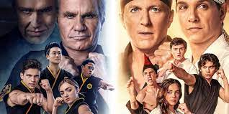
Cobra Kai
Zaid Al Dalo
6 B

Slide 2
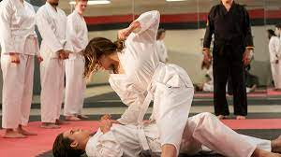
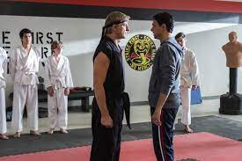
34 years after losing to Daniel Larusso in the All-Valley tournament, Jonny Lawrence has hit rock-bottom in life. After reluctantly saving his teenage neighbor Miguel Diaz from a group of bullies, Jonny decides to reopen the Cobra Kai dojo/club. Miguel quickly becomes his star student of the dojo.

Slide 3
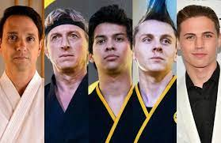
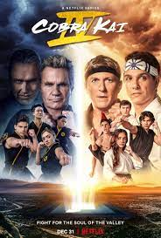
Main Characters
Miguel Diaz
Robby Keene
Tory Nichols
Hawk
Johnny Lawrence
Terry Silver
Daniel Larusso

Slide 4
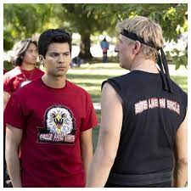
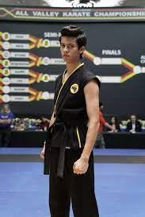
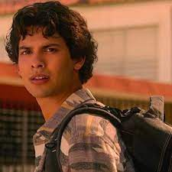
My favorite character is Miguel Diaz as he is brave, smart , strong and likes to be challenged

