Slide 1
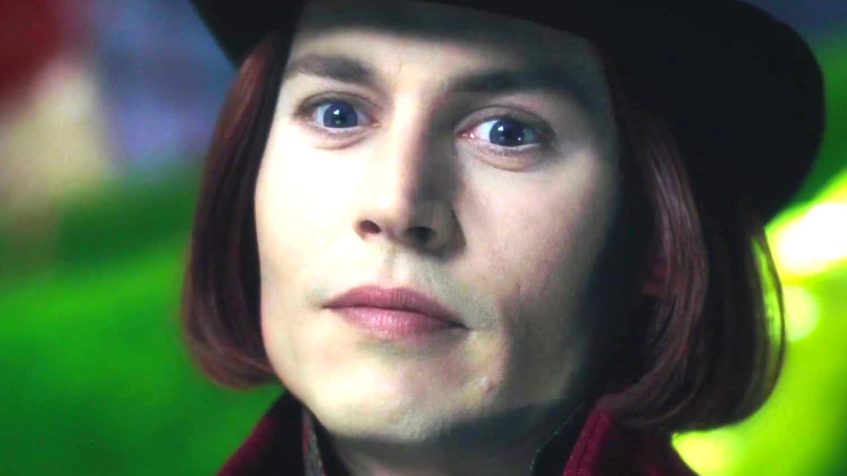
Charlie and the chocolate factory
By iskander saba

Slide 2
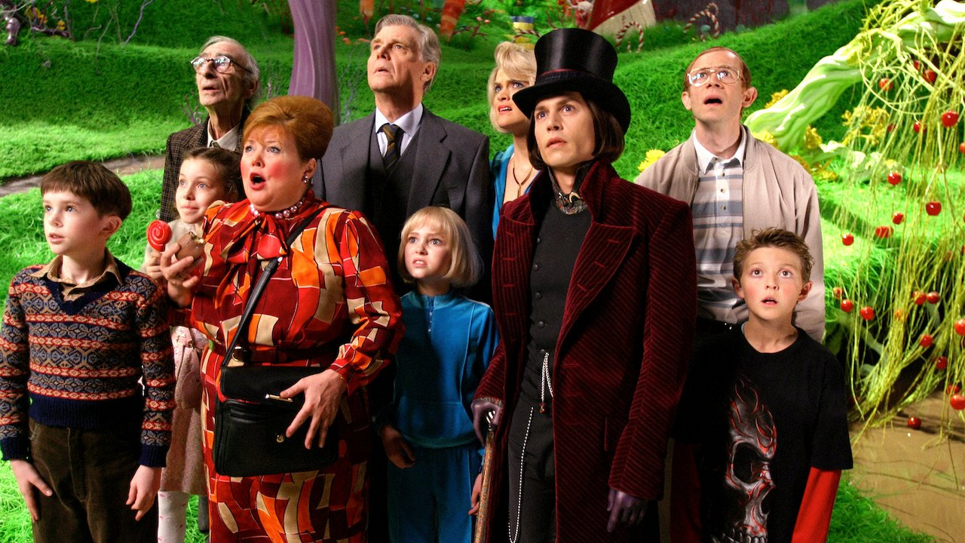
Introduction:
Charlie and the Chocolate Factory is a 2005 magical fantasy film written by John August and directed by Tim Burton, the film is based on the 1964 British children novel written by Roald Dahl.

Slide 3
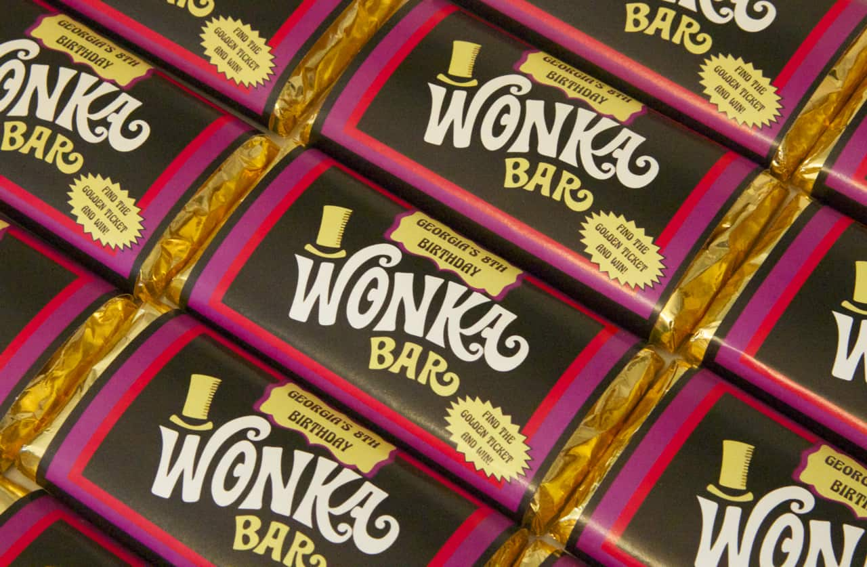
Summary:
Charlie Bucket is a ten year old boy who lived in a very small house with his poor family: his parents and all his four grandparents.
Each day he passed by the biggest and best chocolate factory in the world run by Willy Wonka.
Willy Wonka announced that he hid five golden tickets in his chocolate bars and the children who find them will have a tour in the factory.
Charlie was the last child to find the golden ticket.

Slide 4
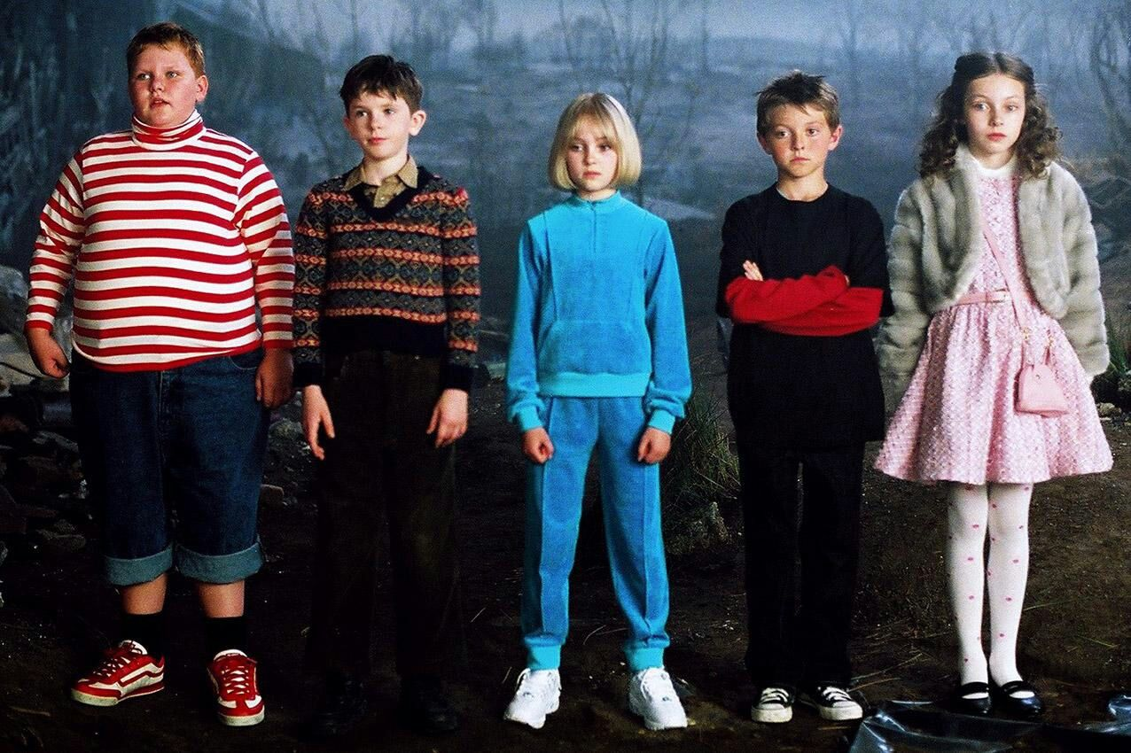
The inside of the factory was magical, the workers were the tiny cacao-loving Oompa-loompas, rescued from loompaland.
The four children that were with Charlie were too self-centered and very greedy, so they all had strange and painful accidents at the end of the tour.
Augustus Gloop- fell in to the chocolate river then got suck in to a glass pipe.
Violet Beauregarde- stole a piece of gum and then turned into a blueberry.
Veruca Salt- tried to take a squirrel for her self and then the other squirrels threw her into the garbage.
Mike Teavee- got shrunk to a pocket size.
At the end of the movie Wonka told Charlie that because of his respectful behavior, he was going to give him the chocolate factory, but Charlie refused and decided to live with his family.

Slide 5
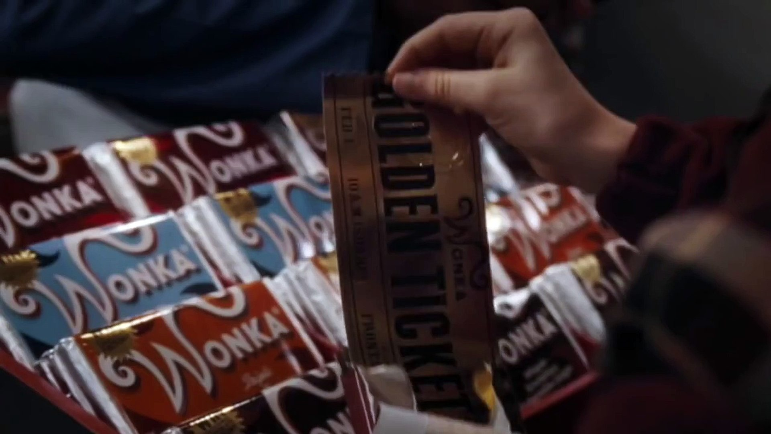
My favorite character:
My favorite character is Charlie, because he is a kind-hearted boy who takes care of his sick grandparents.
Charlie also is a responsible and respectful boy.

Slide 6
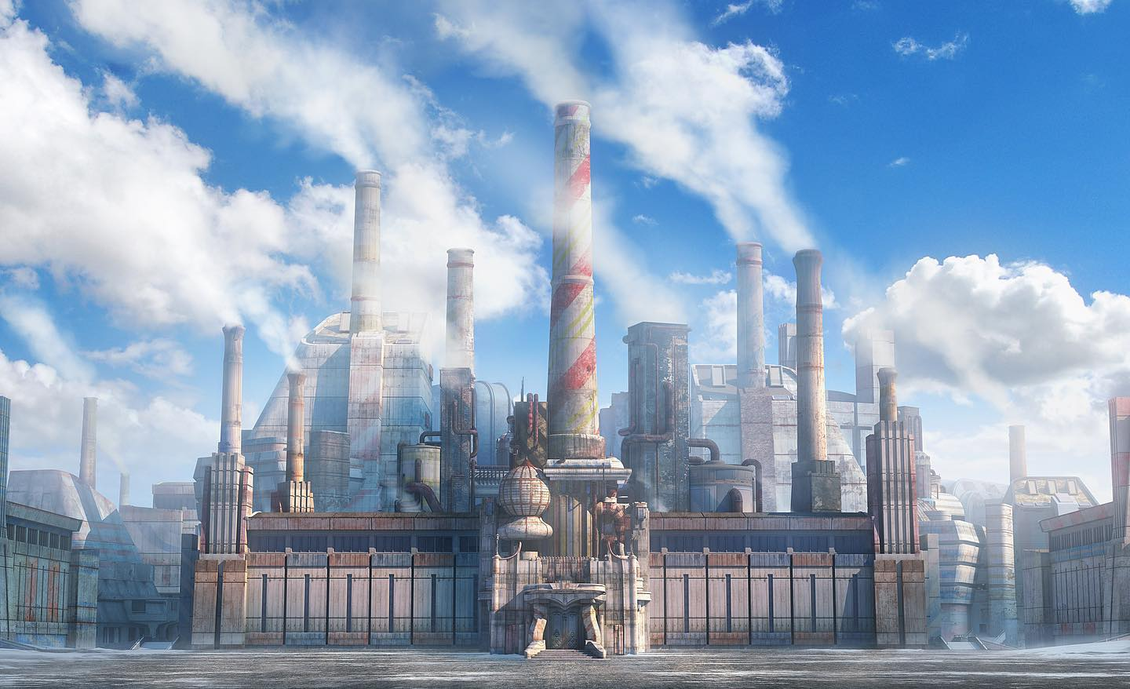
Moral of the movie
The moral of this book/movie is to always put your family and loved ones first because they are the only ones who will stand with you when you face any troubles.

Slide 7

For listening

