Slide 2
About
This movie is part two of spiderman far from
Home where everyone finds out that peter
parker is Spiderman. And spiderman goes to a doctor
Strange to make everyone forget who spiderman is
But everything goes wrong.

Slide 3
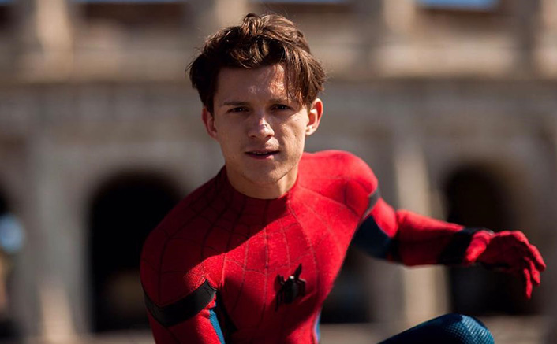
Peter Parker
Perter parker played by
Tom Holland, Also known as
spider Man is a young
teenager Who got bitten
by a radioactive Spider,
and gave him spider Like power.

Slide 4
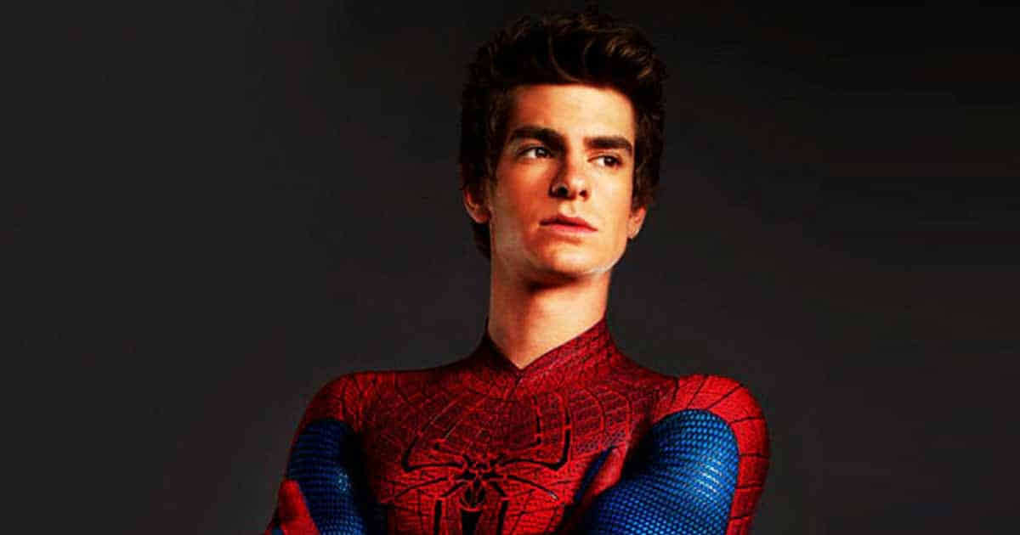
Peter Parker 2
Peter parker2 played by Andrew
Garfield is spiderman from another
Universe that got accidentally pulled
To the Marvel universe.

Slide 5
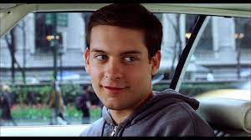
Peter Parker 3
Peter Parker played by
Tobey Maguire was
The second spiderman
from Another universe
who Got accidentally
Pulled To the Marvel universe.

Slide 6
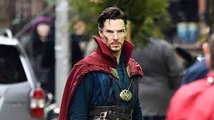
Doctor strange
Doctor Strange's powers and
abilities originally stemmed
from tapping into otherworldly
entities and planes, powerful
beings who granted magic-
users temporary access to
Magic.

