Slide 1
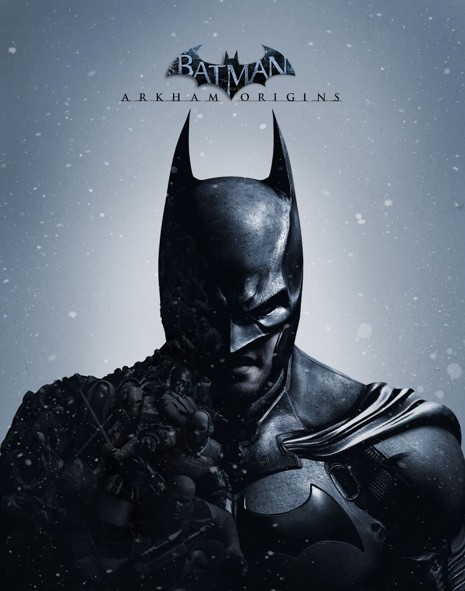
Batman
By Abdallah Sharab
6B

Slide 2
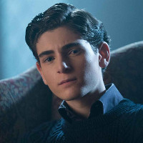
summarize
Bruce Wayne was a normal boy until he witnessed the murder of both of his parents by the mugger Joe chill, so he was raised by the family butler.

Slide 3
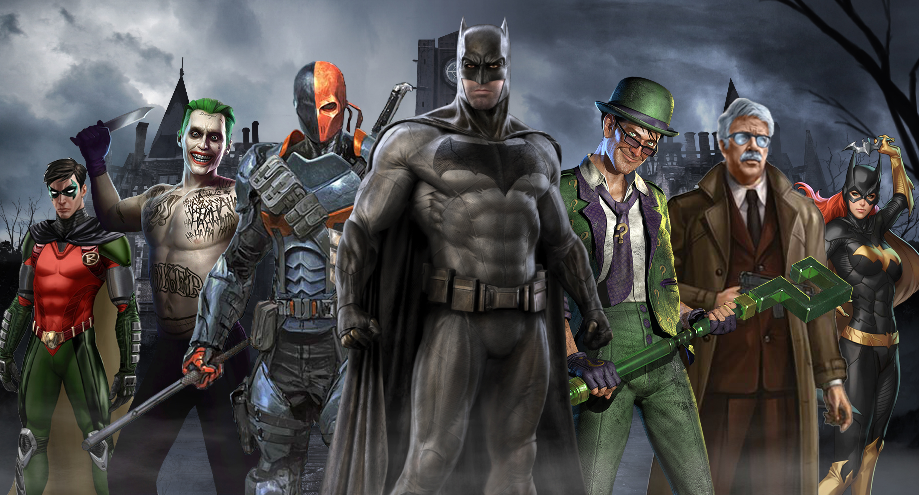
14 years later Bruce wanted revenge ,so he went to kill Joe, but some one did it before him , so Bruce spent years training to fight . He joined the league of shadows , but they wanted to destroy Gotham , so he burned their temple and killed the leader.

Slide 4
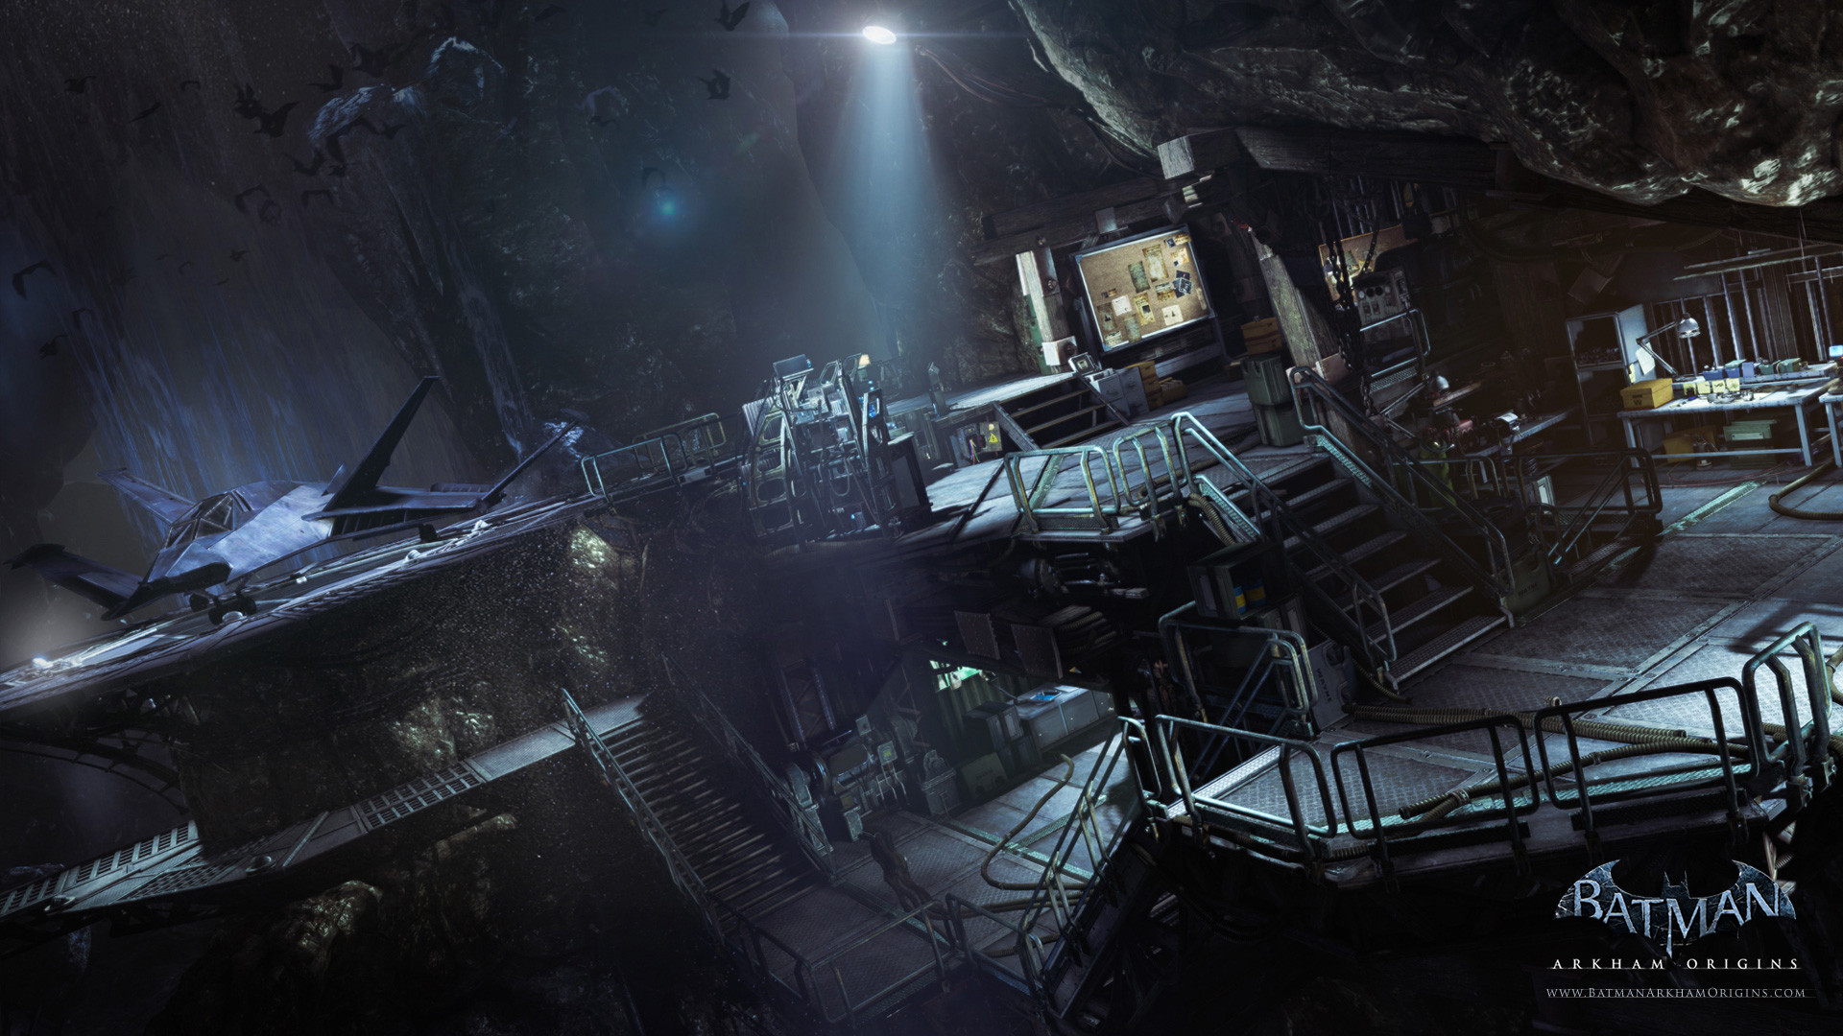
.
He wanted to observe his dads company so he got access to his dads company and built a secret base under it and started the batman journey . He helped the police solve cases like drug dealing and stealing . But one criminal reached out to him and his assistant and drugged them, but they found the antidote.

Slide 5
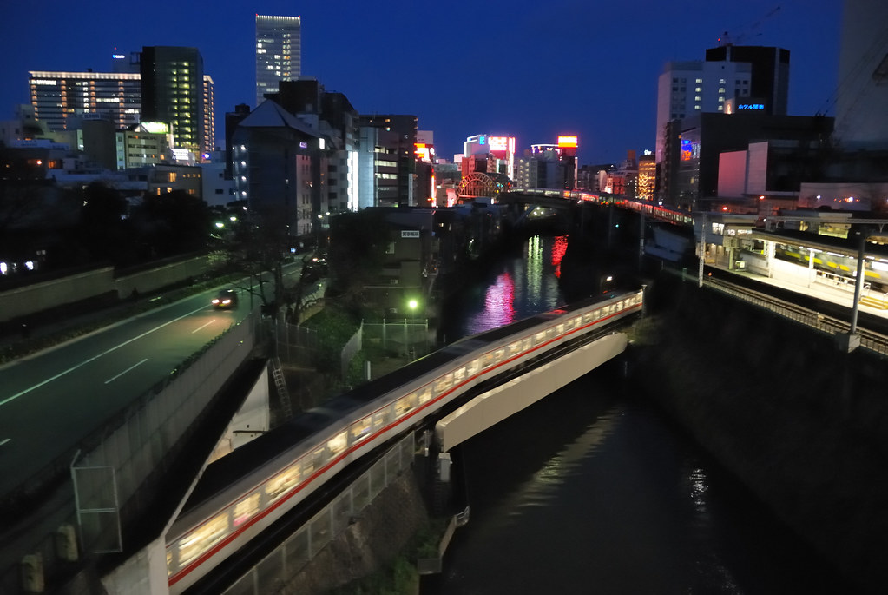
Turns out the leader is not dead and they fight again this time in a train. Batman’s assistant shoots the train and it brakes but, Batman doesn’t kill the leader ,he also doesn’t save him , so he flew away and the leader crashes and dies.
.

Slide 6
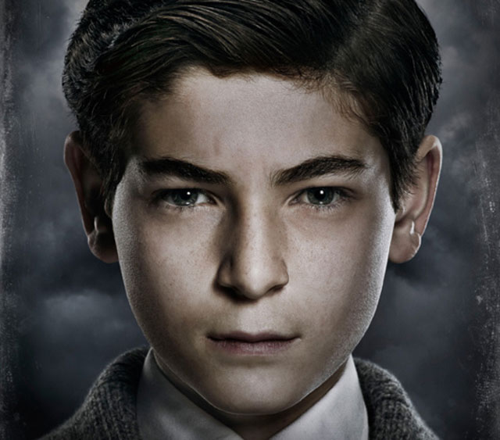
My favorite character Is Bruce
WHY?
BECAUSE HE IS INSPIRATIONAL ,BRAVE AND NEVER GIVES UP

Slide 7
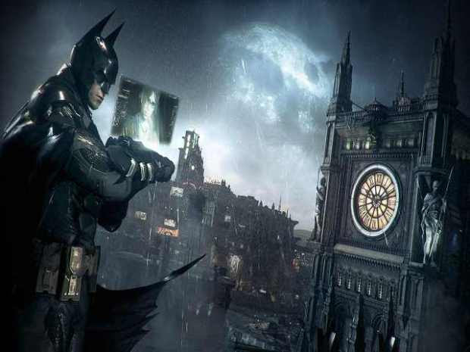
Moral
To try our best to stop crime.
Don’t try to defeat our enemy by becoming them.
Everyone has fears, what matters is that you defeat them.
Having enemies plays a big role in our life ,you keep fighting them and so you become stronger they help you grow and you end up learning a lot from the experience you got from them.

