Slide 1

Strategy Development
Jordan
Kick-off meeting
Finance Input
13 Sept 2022

Slide 2
From an IOR perspective during the last 2 years…
Achievements to build on
Very solid development in financial stabilisation during 2020-2021
  accurate funding frame
Liquidity steering of international funding has been put on solid ground
Need for close collaboration between the functions – locations has been fully recognized and became more visible
→ Important pre-requisite for strategy work

Slide 3


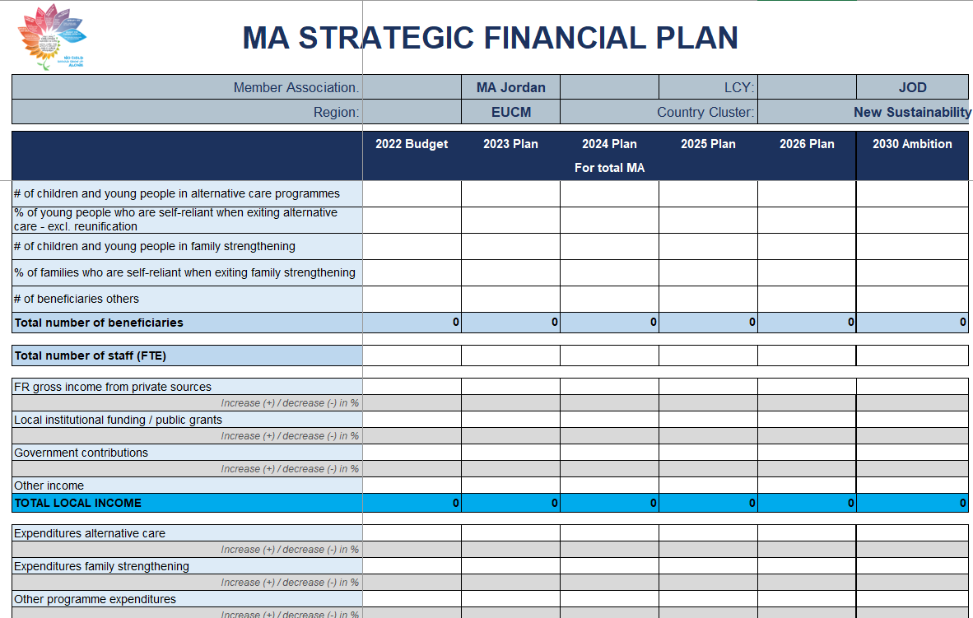
Strategy Jordan – financial parts
2 deliverables
Strategy
(narrative part)
Financial Plan Jordan 2023 - 2026
Guideline
+
Guideline for Strategy Development
2202-MA strategy template-V1-EN.docx (sharepoint.com)

Slide 4
Sustainability Strategy
Consider finance relevant parts – to be well aligned with Finance Plan
Chapter B: KPIs
Chapter D:
  Resources
  Fund development
  Risks
Chapter E - attachment

Slide 5
Financial Plan 23023 - 2026
Financial Plan Jordan 2023 - 2026

Slide 6
Financial target calculation – Federation expectation
Year | International Funds Incl. Sponsorships (Eur) | International Subsidies (Eur) | % subsidy related self-sufficiency
2022 | 2,300,00 | 1,700,000 | 28%
2023 | No inflation increase on international funds
2026 | 2,100,000 | 1,500,000 | 36%
2030 | 1,500,000 | 960,000 | 60%
2022: self sufficiency = 28% (Budget 2022)
Target 2026: self sufficiency = 36% (i.e. 2 % annually)
Outlook 2030: self sufficiency = 60% (i.e. 4% annually over the whole period 2023-2030)

Slide 7
Financial Plan
= is a multi-annual forcast of cost and income development
= is following assumptions taken in the
  local program strategy (care type, development of beneficiaries, staff need, investments)
  local income strategy (channels, investment need, expected return)
= is calculated excel-based using parameters (underlying assumptions) from other functional areas
= is mostly developed bottom up from a location (project or unit) view and is aggregated to a full NA view
= can offer valuable insights of financial impact and can support decision taking by ND/NMT
= can show more than one option, however for PSA presentation one preferred option is recommended
= it shows the international funding need (cost – local income = intern. Funding need)
= must be reviewed regularly to see if assumptions taken are still valid
attention: a Financial Plan is NOT a funding application!

Slide 8

Point of attention – what you need to look into
Work on financial strategy needs time – good organisation of day-to-day tasks, agree on delivering info along milestones
Sequence! Program strategy first! > critical input for Finance Manager (results-focus, project focus)
thorough analysis of cost/income – location leaders <> Finance Head (same page!), back up and support by ND
Critical view on processes (cross-cutting NO-locations) – position plan review, the usage of assets
Are realistic assumptions made in scenario tools (transparently displayed) – well informed by the strategy
also: presentation of investment need (per “project”) – to inform what resource input is needed for this strategy:
  Is the requested funding well anchored and described as crucial element in the strategy
  clearly drives sustainability of the program/project
  Beneficiary & staff development well in line with described actions
  Plausible assumptions, backed up with research, actual data
  All cost elements considered (incl infrastructure adaptation, HR cost)
  Co-funding options considered (mix of funding ?, options for partnering explored?)
  Makes it sense from an “investors perspective”
Mind - set

Slide 9
How were Strategies screened in the past? – Screening Criteria
Is there a STRATEGIC AND RELEVANT PROGRAMME VISION, which fits to government and CVI strategies and income opportunities?
Are sufficient actions planned to increase SUSTAINABILITY OF PROGRAMMES: e.g., hand over or close inefficient programmes, move out of isolated locations, re-design programmes; attract sustainable local income; share resources between programmes?
Are income projections SOUND and FEASIBLE?
Is there a logical progress in outlined SUBSIDY REDUCTIONS: e.g., not all reductions steeply planned for the end of the strategy period?
Have RISKS and ASSUMPTIONS been considered
Are FUNDS REQUESTS reasonable, with clear RETURN ON INVESTMENT: Do requested funds link clearly to actions in the strategy? Are the estimates of funds needed for key strategic actions reasonable? Is a return on investment (leading to subsidy reduction) demonstrated for all types of investments?

