Slide 1
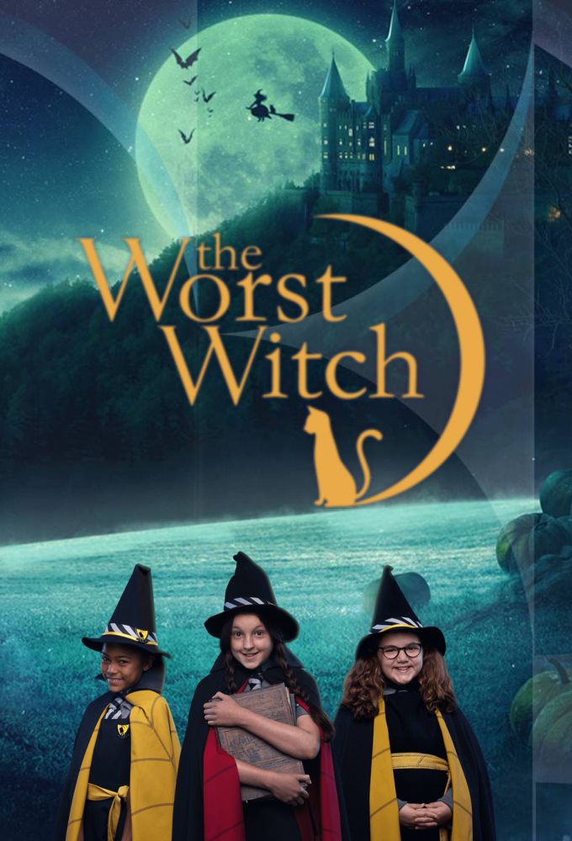
The worst witch

Slide 2
Today I am going to talk about my favorite book.
MY FAVORITE BOOK IS THE WORST WITCH, IT TALKES about a cackles academy for witches, and the worst witch was Mildred. She is a first year witch and all her spells and potions have to go wrong.
At the Halloween celebration she falls of her broomstick. One time she saw Mrs. Hard broom coughing in some smoke and she got a bucket of water and threw it all over Mrs. hard broom and even the bucket landed on her head, she was in a lot of trouble for that.

Slide 3
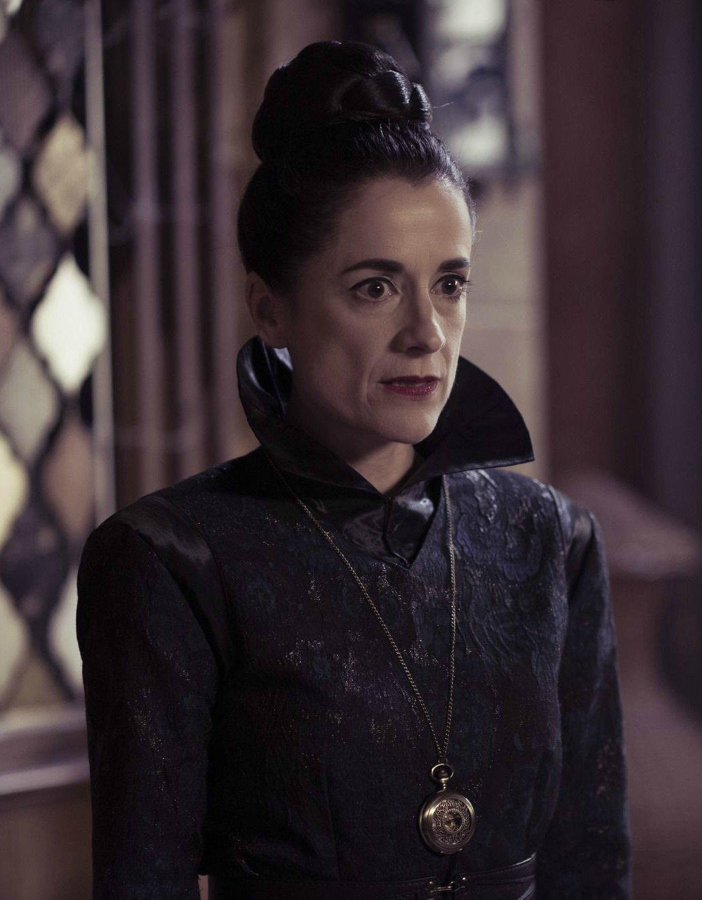
I chose this book because it was really funny and every time Mildred does something it has to go wrong spatially when she threw a bucket at Mrs. Hard broom and it fell on her head.

Slide 4
THE WRITER OF THE BOOK IS JILL MURPHY
JILL MURPHY WAS BORN ON 5TH JULY 1949 SHE IS A BRITISH WRITER AND illustrator OF CHILDRENS BOOK. AND SHE WAS best known for The Worst Witch stories and The Large Family picture books. She has been described as "one of the most engaging writers and illustrators for children in the land".

