Slide 1
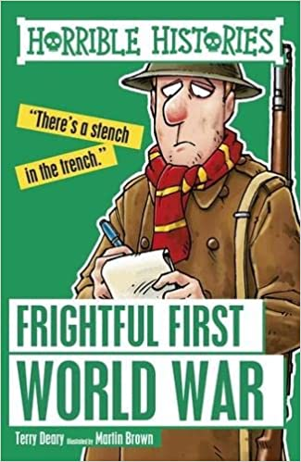
Frightful first world war
Written by Terry Deary
By Ramzi Abdelkhaleq
6E

Slide 2
What does the book talk about?
The book talks about all kinds of stories from how did the first world war start and how did people survive in the war.
This book may seem very boring but the writer makes a lot of jokes making it more fun to read.
Most importantly the book is very honest, for example it talks about embarrassing and awful things that happened during war.
Finally this book includes a lot of interesting and fun facts about the first world war.

Slide 3
My favorite part in the story
My favorite story is how world war one started. There were a lot of country groups in Europe, but the most powerful group was the `Allies` which were led by the French and British, and the second group called `Central powers` was led by Germany/Austria.
The war started when Bosnia was trying to leave central powers but Austria didn’t want it to leave, so Bosnia told another group called black hand led by Serbia that Austria wasn’t letting it leave so Serbia sent 7 assassins to assassinate the king of Austria.

Slide 4
My favorite part in the story
First assassin was driving a car full of bombs and guns but he failed because the route was blocked.
The second assassin nearly succeeded by throwing a grenade into the kings car but the driver threw it Back at him.
The 3rd 4th 5th and 6th assassins tried to shoot the king but got caught.
The king was driving near a cafe where the 7th assassin was, then the assassin pulled out his gun and shot the king.
Then Germany/Austria declared war on Serbia so Russia helped Serbia then France helped Russia then Britain helped France then total war began.

Slide 5
My favorite character
My favorite character was the 7th assassin who killed the king of Austria by doing so Bosnia was freed from Austria.
He is my favorite character because:
He`s brave
He`s loyal
He`s strong

Slide 6
Fun facts
Did you know that German plans got reveled from a pair of sock. It all happened when an American spying for Germany got arrested as soon as his socks were tested. When his socks were socked in water they produced invisible ink.
Did you know that a group of solders adopted a dog and said if the dog dies its bad luck so they gave the dog a helmet to protect it.

Slide 7
Conclusion
World war 1 was a terrible event in which 40 million people died in. and a disaster we will never forget.

Slide 8
The END
Thank you for listening

