Slide 1
My Favorite Movie
Home
About me
What I do
My experience
My work
Christina Khzouz 6C
Manifest

Slide 2
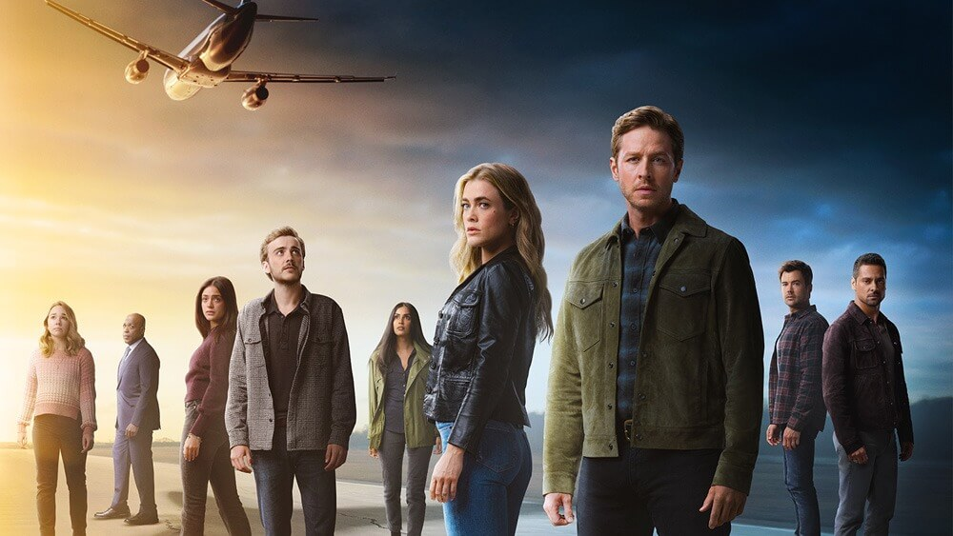
01
Home
About me
What I do
My experience
My work

Slide 3
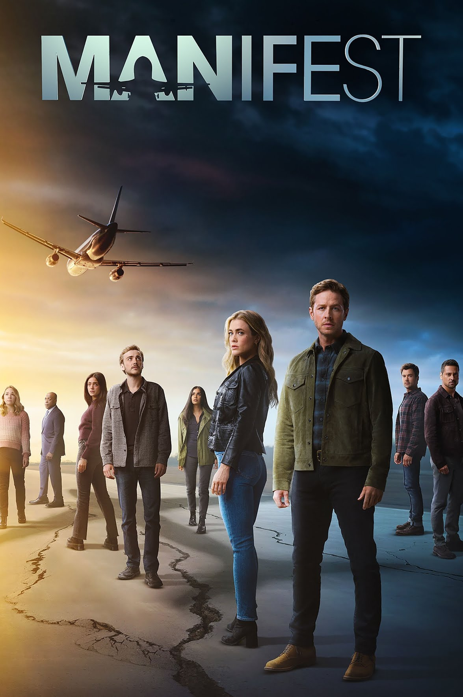
About Manifest:
Manifest is an American supernatural drama television series created by Jeff Rake that premiered on September 24, 2018, on NBC. It centers on the passengers and crew of a commercial airliner who suddenly reappear after being presumed dead for five and a half years.

Slide 4
Why I like the series Manifest:
Rating:
I love it because You don't need constant action to make a story, but each episode you get a different story about one of the passengers and another little piece of the mystery unravels, it really is what you make of it and how much you put your mind to it

Slide 5
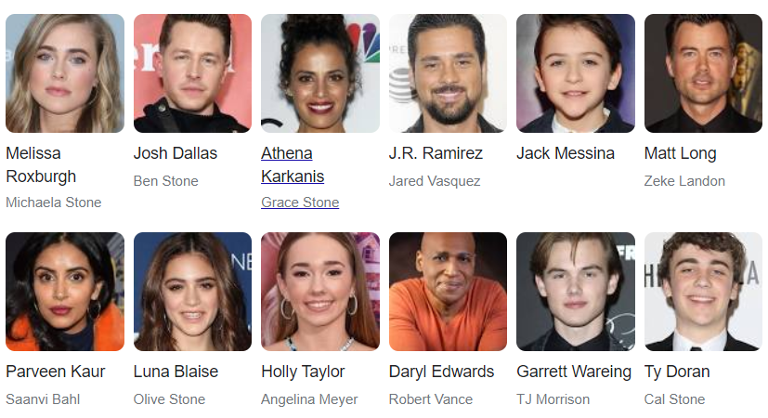
Manifest Cast

Slide 6
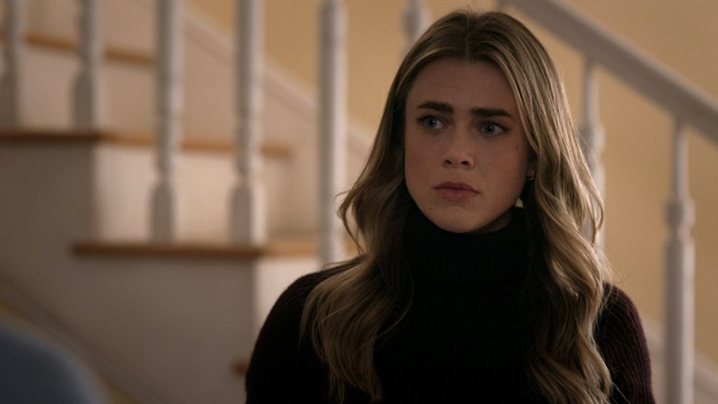
My favourite character
Michaela Stone
Home
About me
What I do
My experience
My work
Michaela Stone is a fictional character on Manifest. She is one of the main character and portrayed by Melissa Roxburgh. She is one of the passengers along with her brother and nephew, of the Montego Air Flight 828 that went missing on April 7th 2013 that came back five years later like no time had passed.

Slide 7
THE END

