Slide 1
karate kid
Made by rakan grade 6b

Slide 2
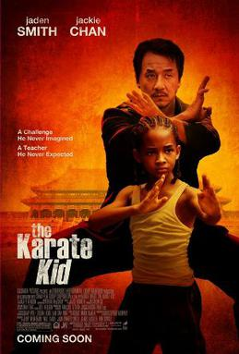
Introduction
Karate kid revolves around a kid named dre parker that had move to china because of his mothers job during the stay in china he gets bullied by a group of kids, one day he decides to throw a bucket of water on them, the group of kids chase him, catch him, and beat him up the maintance guy mister han defendes him

Slide 3
Problem and solution
problem
solution
Dre parker gets bullied and has to particapt in a tornumant
The mister han trains him

Slide 4
moral
To stand up for your self

