Slide 1
Charlie and the
Chocolate factory!
(the movie)
By: Angelina Shamieh 6c

Slide 2
What its about!
Based on the beloved Roald Dahl tale, this comedic and fantastical film follows young Charlie Bucket and his Grandpa Joe as they join a small group of contest winners who get to tour the magical and mysterious factory of eccentric candy maker Willy Wonka.

Slide 3

Why its my favourite!
Its my favorite because theres plenty of humor and fun
Moments, there is NEVER a dull moment in the movie!!
It’s a superior in my opinion, it never gets old.
I could watch the movie over and over again
Without getting bored!!

Slide 4
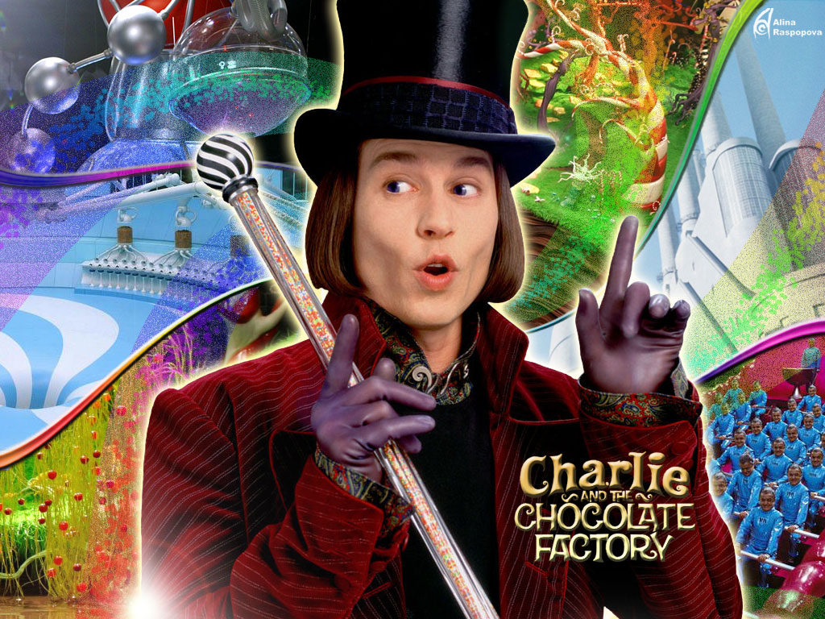

Brief Summary / description
A young boy wins a tour through the most magnificent chocolate factory in the world, led by the world's most unusual candy maker. When Willy Wonka decides to let five children into his chocolate factory, he decides to release five golden tickets in five separate chocolate bars, causing complete mayhem.
This Photo by Unknown Author is licensed under CC BY

Slide 5
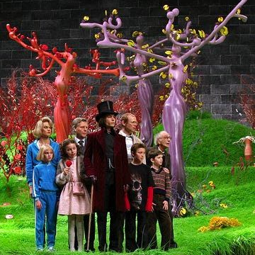
What do we learn from it?
Roald Dahl's Charlie and the Chocolate Factory is a very simple morality tale, in which children are either rewarded or punished for their cartoonish levels of goodness or badness

Slide 6
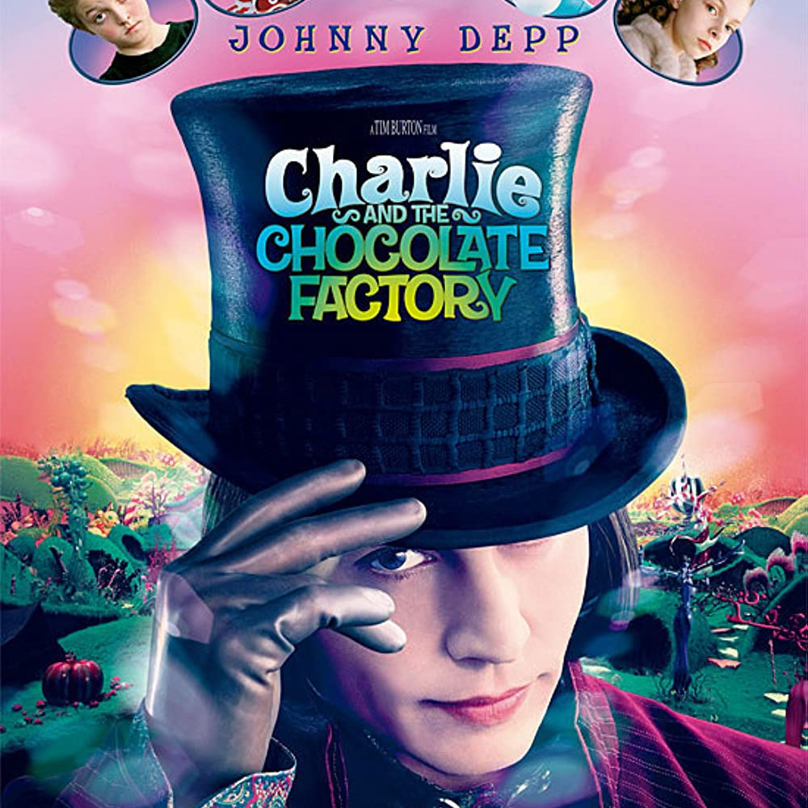
What happens at the end?
Charlie and the Chocolate Factory ends with Charlie, Grandpa Joe, and Willy Wonka crashing through the ceiling of the factory in a glass elevator. Charlie has just been told that he's won the factory and should bring his parents and grandparents back there to live with him.

