Slide 1
The Princess Switch
Done by Dina Haddad
Grade 6 D

Slide 2
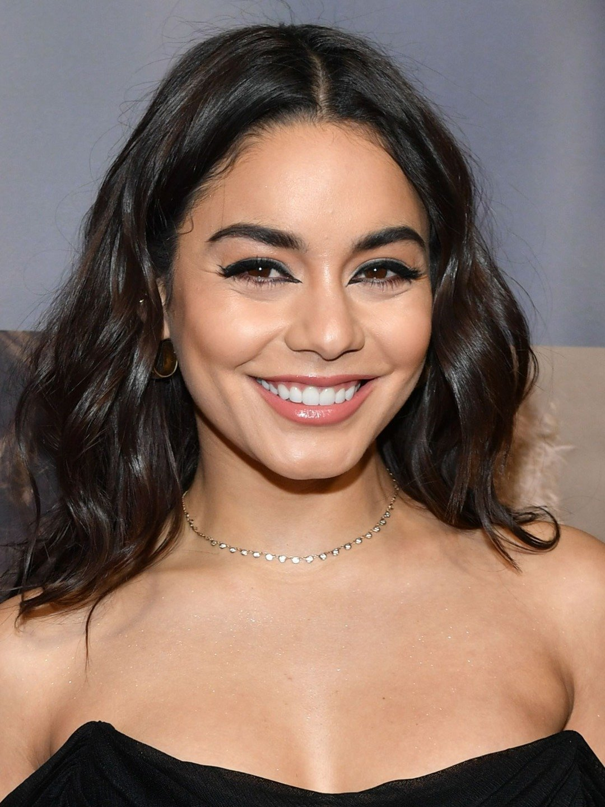
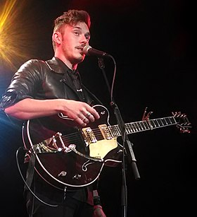
This movie is a romantic comedy and was written by Robin Bernheim and Megan Metzger.
This movie was followed by a sequel of movies; Switched again and The princess Switch 3 .
This movie was released by Netflex in 2018.
Cast:
Venessa Hudgens who played two roles;
the first one as a baker from Chicago (Stacy)
The second one as the Duchess of Montenaro (Lady Margaret)
Sam Palladio who played the Prince of Belgravia (Edward)

Slide 3
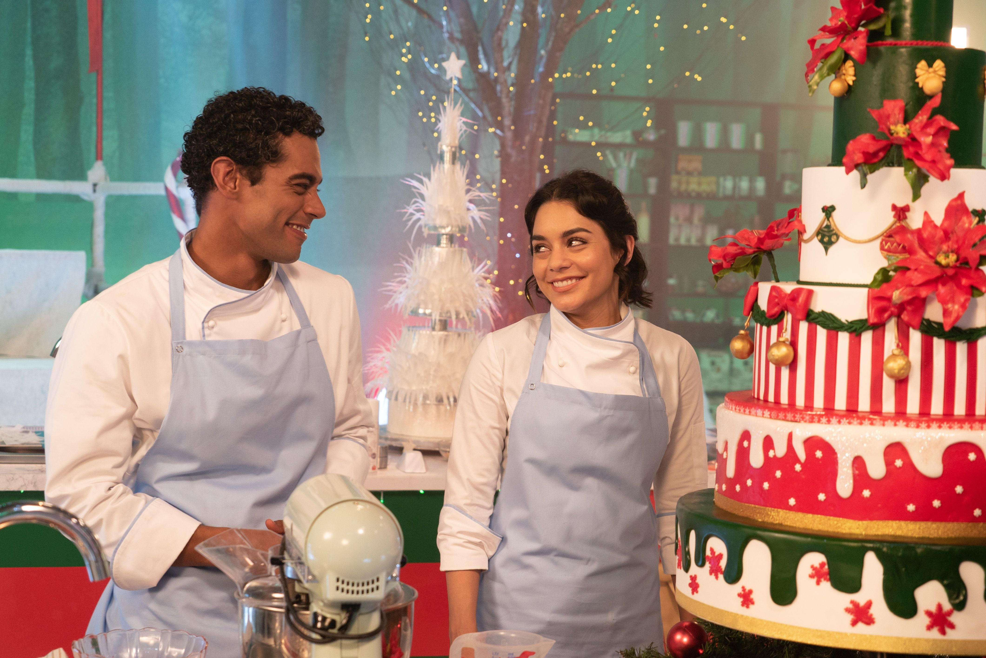
The movie talks about two identical people who change places, during Christmas season.
Stacy is a very good baker, she wins a ticket to compete in a contest in another country, she was so happy because she wanted to grow in her career, and she was engaged to a man but she wasn’t sure that he’s the right person.

Slide 4
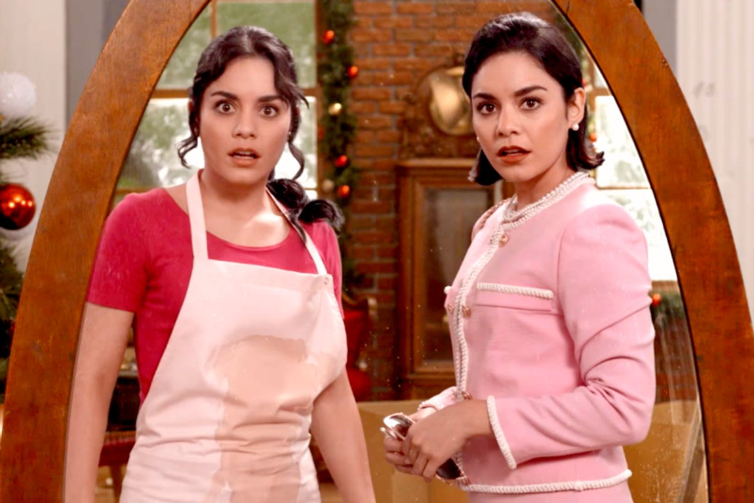
Upon arriving at this new place, she happens to meet the Duchess of Montenaro, who looked exactly like her.
The Duchess was engaged to a prince, and she wasn’t sure she should marry him either, and was tired of the royalty life.
So, she had a bright idea of exchanging places with Stacy….. And that’s where the entertainment comes in.

Slide 5
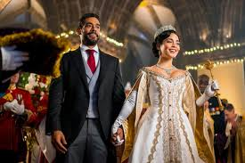
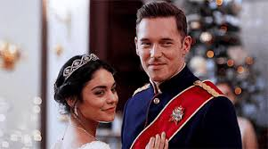
Stacy and Margaret end up finding each other’s respective bridegrooms.

Slide 6
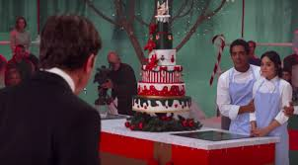
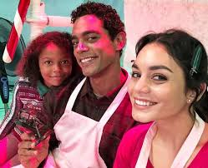
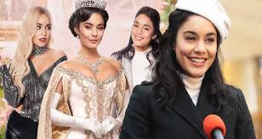
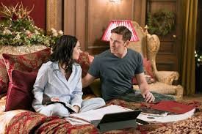
I like this movie a lot because it’s funny, relaxing, enjoyable and heartwarming holiday movie. The songs after the movie fills me with Christmas joy. Everything in the movie made it glow, it’s a great Christmas movie to watch with your loved ones.

Slide 7
Thank you

