Slide 1
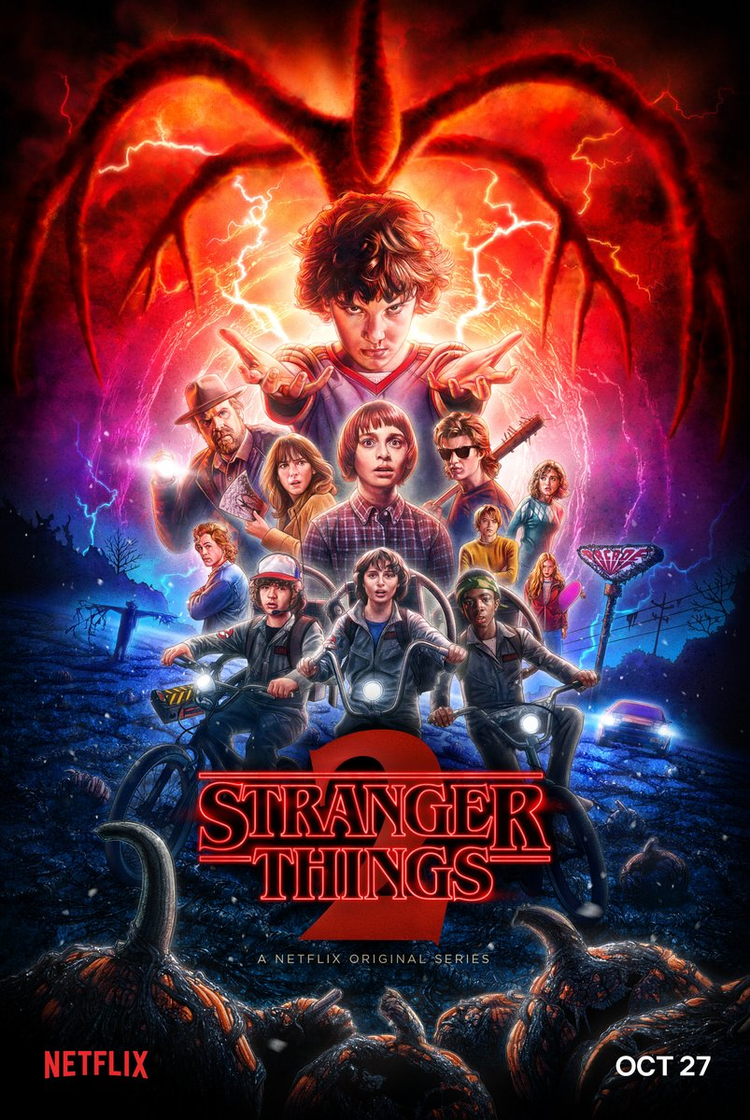
Stranger Things
Done by: Kareem Dabit

Slide 2
story
Stranger Things talks about a girl named Eleven she lived in the Hawkins lab with her father(Dr. Brenner) her father is a research scientist that loved testing his children’s mind powers During one of his tests eleven opened a portal to another dimension, and then she managed to escape. As she was running away Eleven was introduced to Mike Wheeler, Dustin Henderson and Lucas Sinclair who are out looking for their friend Will Byers who has gone missing . after year later in October 1984. Will has been rescued When it is discovered that Will is still being possessed by an entity from the Upside Down, his friends and family learn that there is a larger threat to their universe. set several months later, in the days leading up to the Fourth of July celebration in 1985. The new Starcourt Mall has become the center of attention for Hawkins residents,Unbeknownst to the town, a secret Soviet laboratory under Starcourt seeks to open the gateway to the Upside Down. several months later, in March 1986. Joyce, Will, Eleven, and Jonathan have moved to Lenora, California for a fresh start. In California, Eleven struggles with the loss of her powers and being bullied in school. Meanwhile in Hawkins, a being from the Upside Down—an entity later dubbed Vecna—begins killing the residents of Hawkins, opening new gates between the two worlds in the process. Planning to stop Vecna, Dr. Sam Owens and Dr. Martin Brenner take Eleven to a facility to help her regain her powers. Meanwhile, Joyce and Murray fly to Russia to rescue Hopper from the Gulag.

Slide 3
Characters
Eleven
Max Mayfield
Robin Buckley
Will Byers
Nancy Wheeler
Steve Harrington
Jim Hopper
Eddie Munson
Lucas Sinclair
Billy Hargrove
Erica Sinclair
Mike Wheeler
Argyle
Dustin Henderson
Suzie
Vecna

Slide 4
Time and place
It was filmed in Georgia, the first season was released on Netflix on July 15, 2016. Its second, third, and fourth seasons followed in October 2017, July 2019, and May and July 2022.

Slide 5
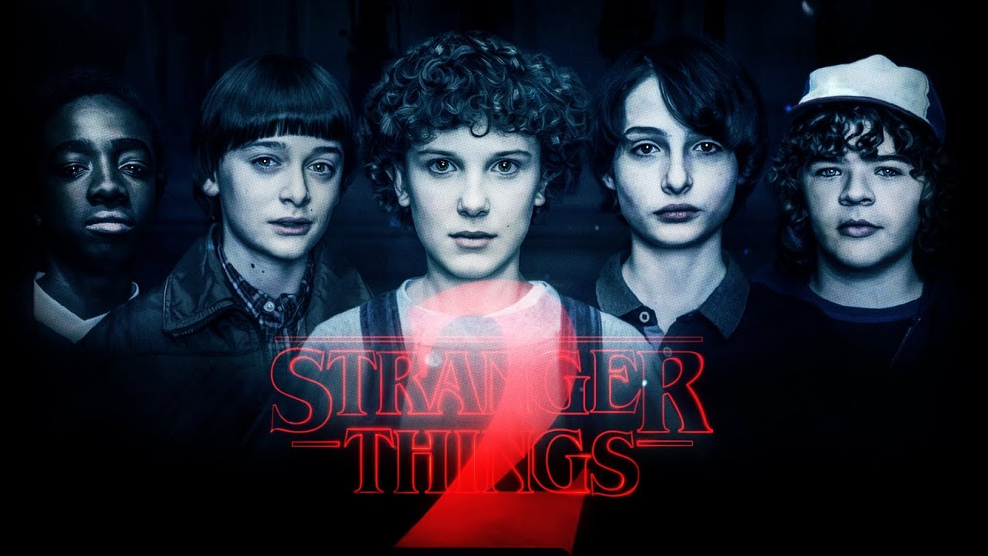
Thank you for listening

