Slide 1
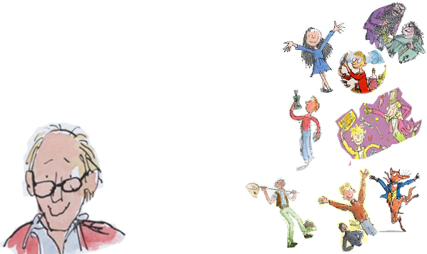
My favorite author Roald Dahl
Abdullah khattab
6C

Slide 2
DESCRIOTION OF ROALD DAHL:
Roald dahl is the best-selling children’s author. He was born on the 13th September 1916 in Llandaff, Wales. His parents Norwegian-born .
Dahl was a spy, ace fighter pilot, chocolate historian and medical inventor. His first moment of inspiration came when he was at boarding school, when a local chocolate factory invited pupils to trial new chocolate bars - 35 years later, Charlie and the Chocolate Factory was published.
Roald Dahl didn’t start writing children’s books until he had children himself. The first book to be published was James and the Giant Peach in 1961, followed closely by Charlie and the Chocolate Factory. Fantastic Mr Fox was then released in 1970, and throughout the 1980s stories such as The Twits, Matilda and The BFG were published. His books went on to sell over 250 million copies worldwide, establishing Dahl as one of the greatest and best-loved children’s authors of all time.
He died on November 23rd 1990 in Oxford England because of a rare blood disease. Although Roald Dahl died he will always be the world’s number one story teller .

Slide 3
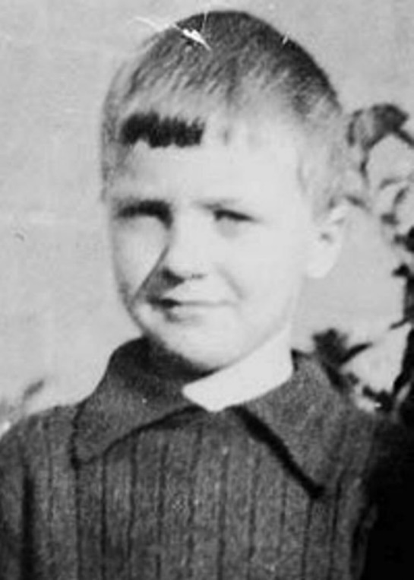
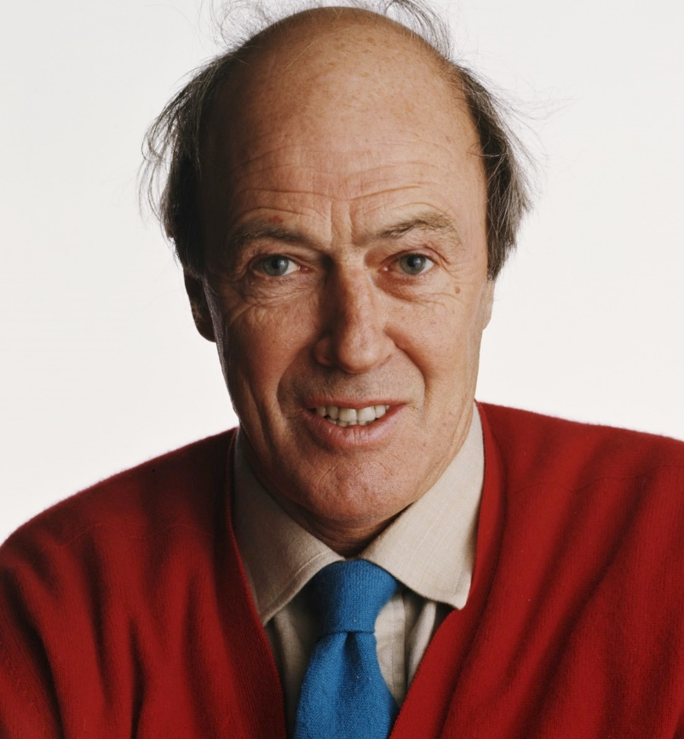
Reasons I chose him:
Roald Dahl is one of my favorite authors. Personally, his books inspire me to try write in an extraordinary way just like he did. His way of making his own words is wonderful. The first time I heard about him was in 2nd grade, ever since that I was interested in reading his books, luckly my father bought me most of his famous books. From reading his books, I found out that they are full of rich vocabulary.
His work is so original! His children’s stories and characters could definitely be said to be fantastical. And one of the biggest parts of Roald Dahl’s appeal for children is his ability to make them laugh! His books are filled with hilarious incidents. Finally, Suspense is another Roald Dahl genre, because his books are full of high stakes and they keep us guessing what will happen next.

Slide 4
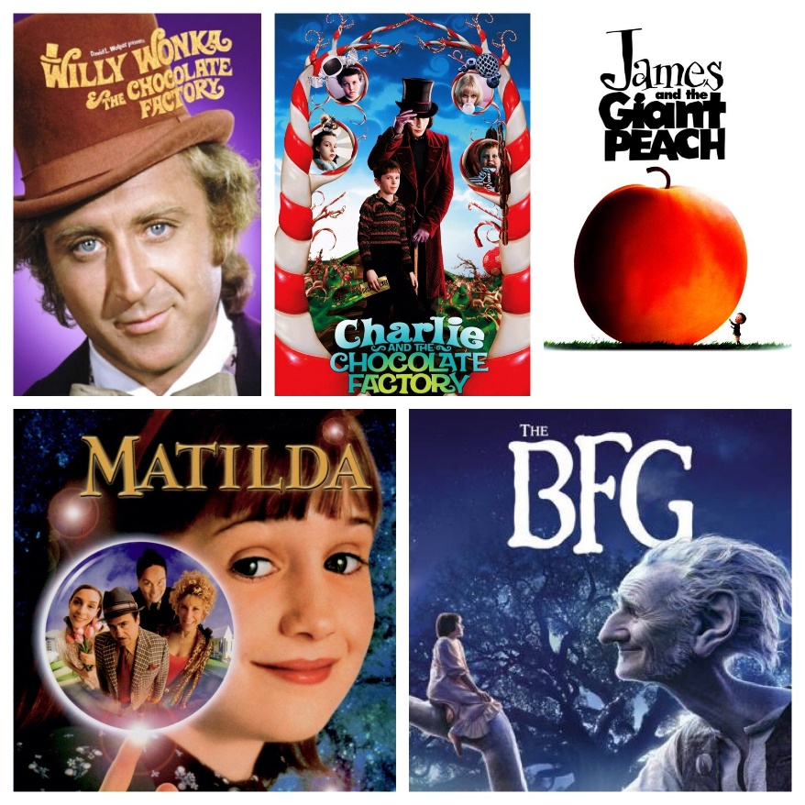
I read many books by Roald Dahl, I have also watched movies of some of his books. My favorites are:
Fantastic Mr. fox
The BFG
Matilda
Danny the champion of the world
George’s magic medicine
The twits
The magic finger
Charlie and the chocolate factory

