Slide 1
chromatography
Done by: Mariam Nimri

Slide 2
what is chromatography?
Chromatography is a process for separating components of a mixture. To get the process started, the mixture is dissolved in a substance called the mobile phase, which carries it through a second substance called the stationary phase
What is chromatography is used for?
Chromatography can be used as an analytical tool, feeding its output into a detector that reads the contents of the mixture. It can also be used as a purification tool, separating the components of a mixture for use in other experiments or procedures.

Slide 3
How does changing the solvent affect chromatography?
f the solvent used in chromatography is highly polar in nature then we cannot separate the mixture of components into individual components. - If the solvent used in chromatography is non-polar then also we cannot separate the mixture of components into individual components.
What is your hypothesis?
My hypothesis is that the vinegar with make the pigment go further

Slide 4
Manipulating the variables
Controlled Variable | How will you keep this controlled? | How could it affect your results if not controlled?
Solvent volume | By using a measuring cylinder | It will effect the RF value

Slide 5
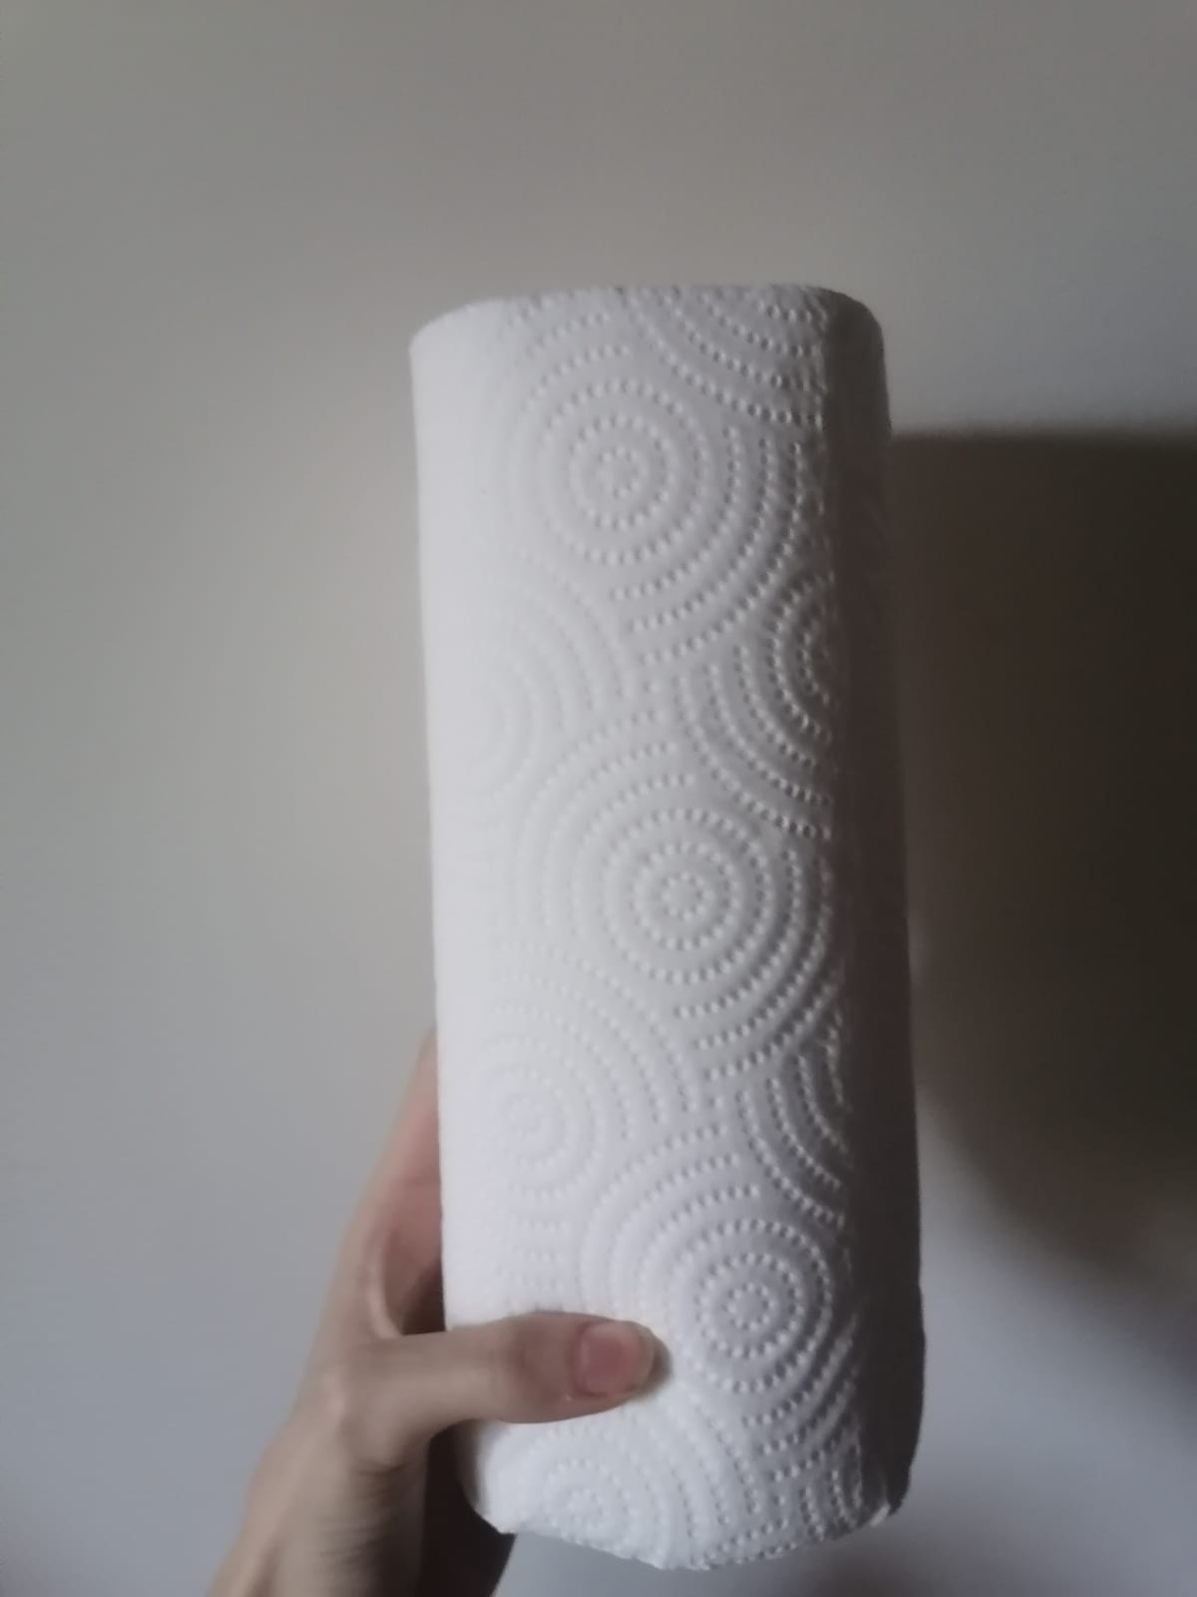
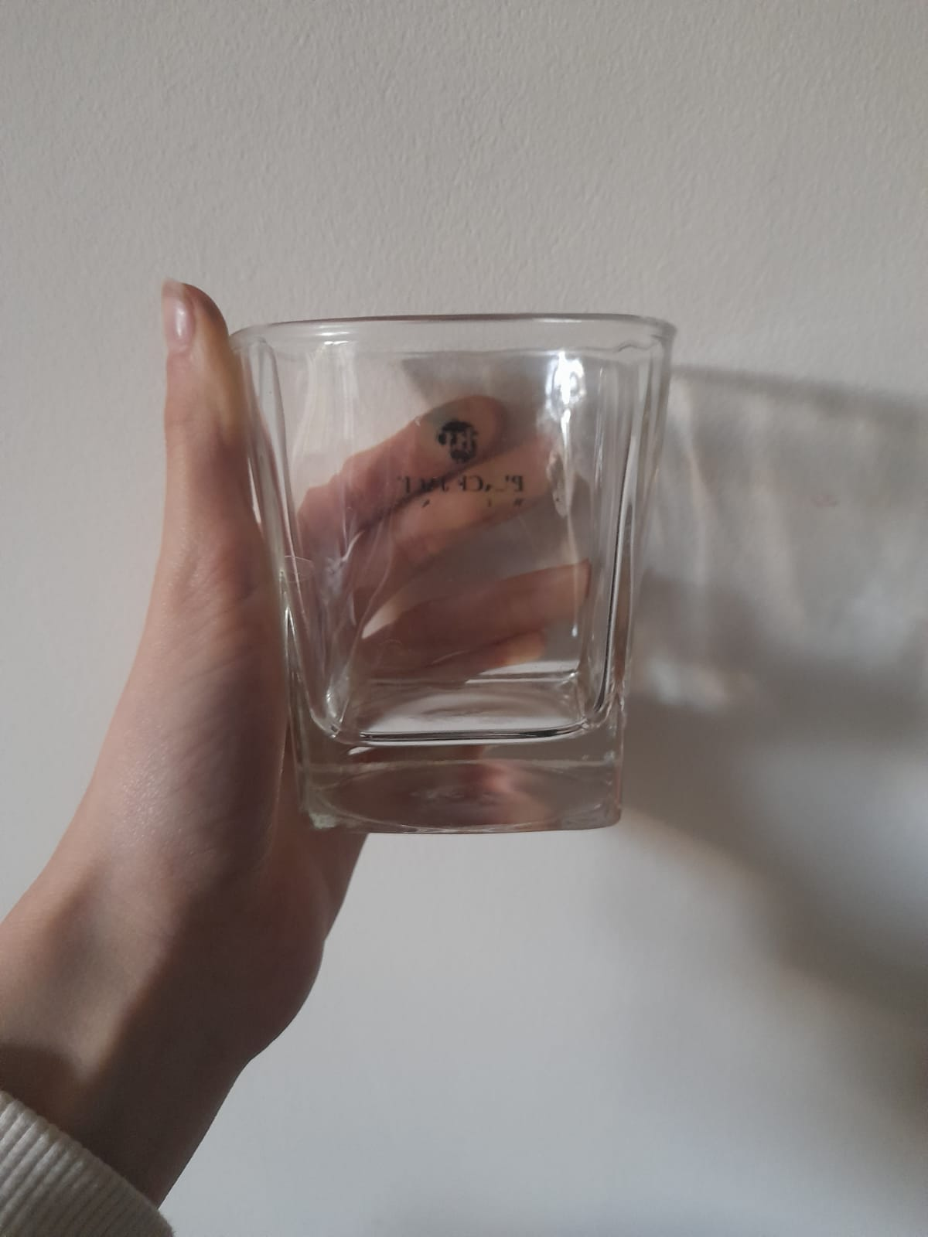
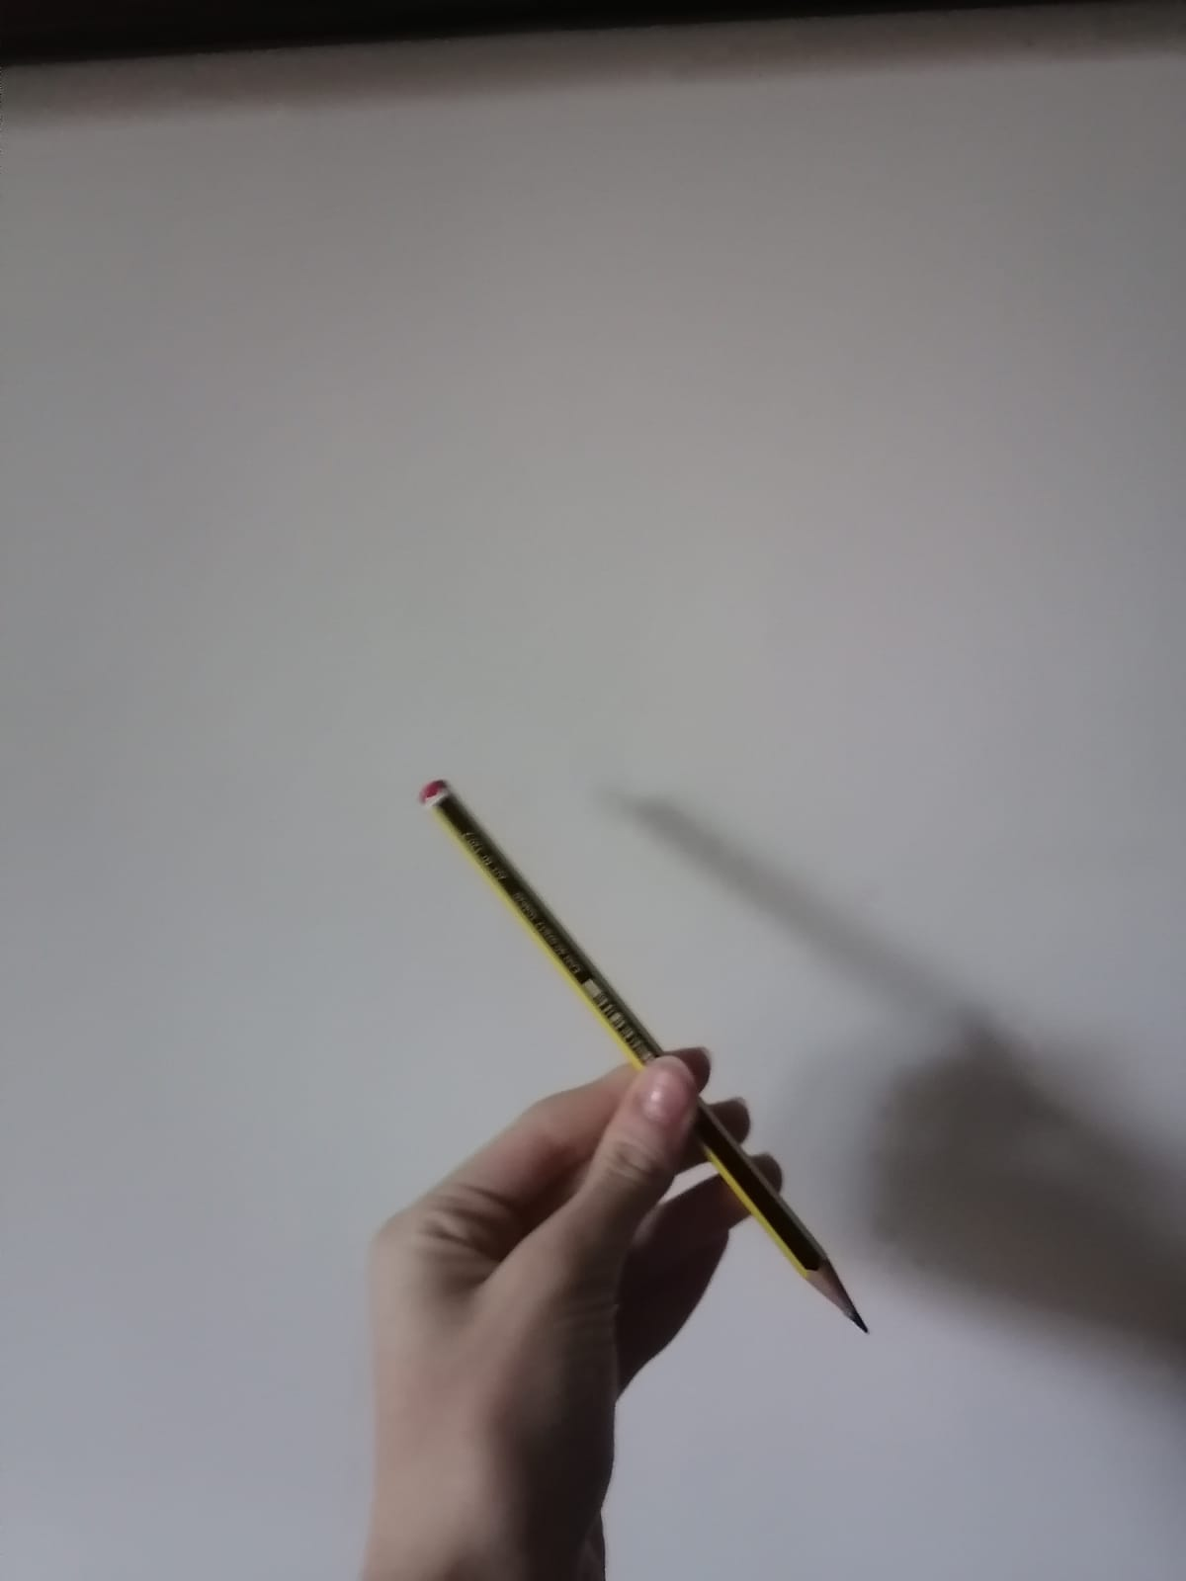
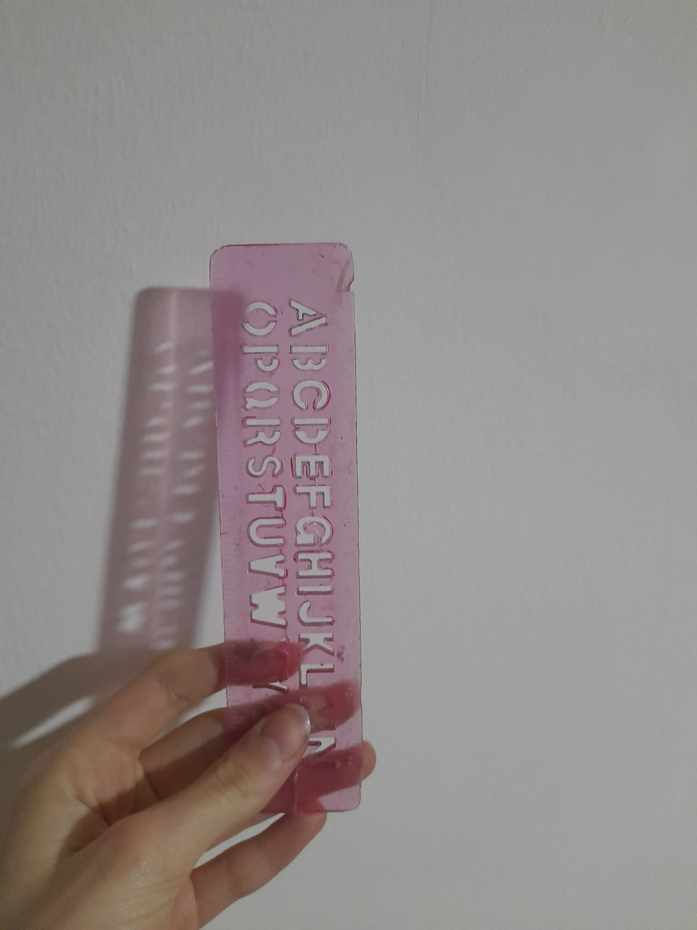
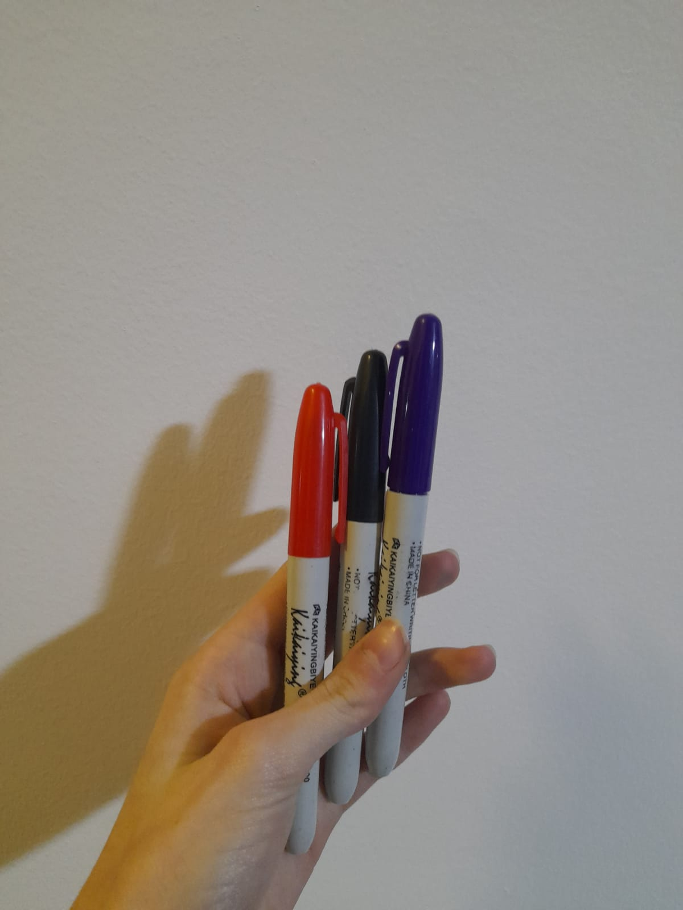
Materials and Method:
paper towel strips glass cups
Pencil Ruler (it has cm and inch)
Sharpie Water +Rubbing alcohol +vinegar

Slide 6
Method:
Cut paper towel/ coffee filters in strips.
Draw a pencil line across the width of each paper strip, about one centimeter from the bottom end.
Take the marker and a paper strip and draw a short line (about one centimeter) on the middle section of the pencil line. Your marker line should not touch the sides of your strip.
Repeat step 3 for all the markers.
Use a pencil to write the color of the marker you just used on the top end of the strip
Fill cups with a bit of the solvent you are testing out: START WITH WATER. add water to the glass until the level just reaches the bottom end of the paper strip.
Hang the paper strip over the edge of the glass so that the paper towel/ coffee filter touches the liquid, but the line is above the liquid.
Watch as the water rises up the strips.
Record your observation. (What happens to the colored lines on the strips? Does the color run up as well? Do you see any color separation?
Repeat steps 1-9 using another solvent (rubbing alcohol + vinegar)

Slide 7
Safety precautions
Don’t use rubbing alcohol/ nail polish remover near flames.
Wash hands after using any chemical.

Slide 8
Results
solvent | color 1 | Colors appeared& distance travelled by each color/ cm | color 2 | Colors appeared & distance travelled by each color/cm | color 3 | Colors appeared& distance travelled by each color/cm
water | purple | 2.1 | red | 3 | black | 0
Rubbing alcohol | purple | 6 | red | 5.7 | black | 6
vinegar | purple | 5 | red | 3 | black | 2

Slide 9
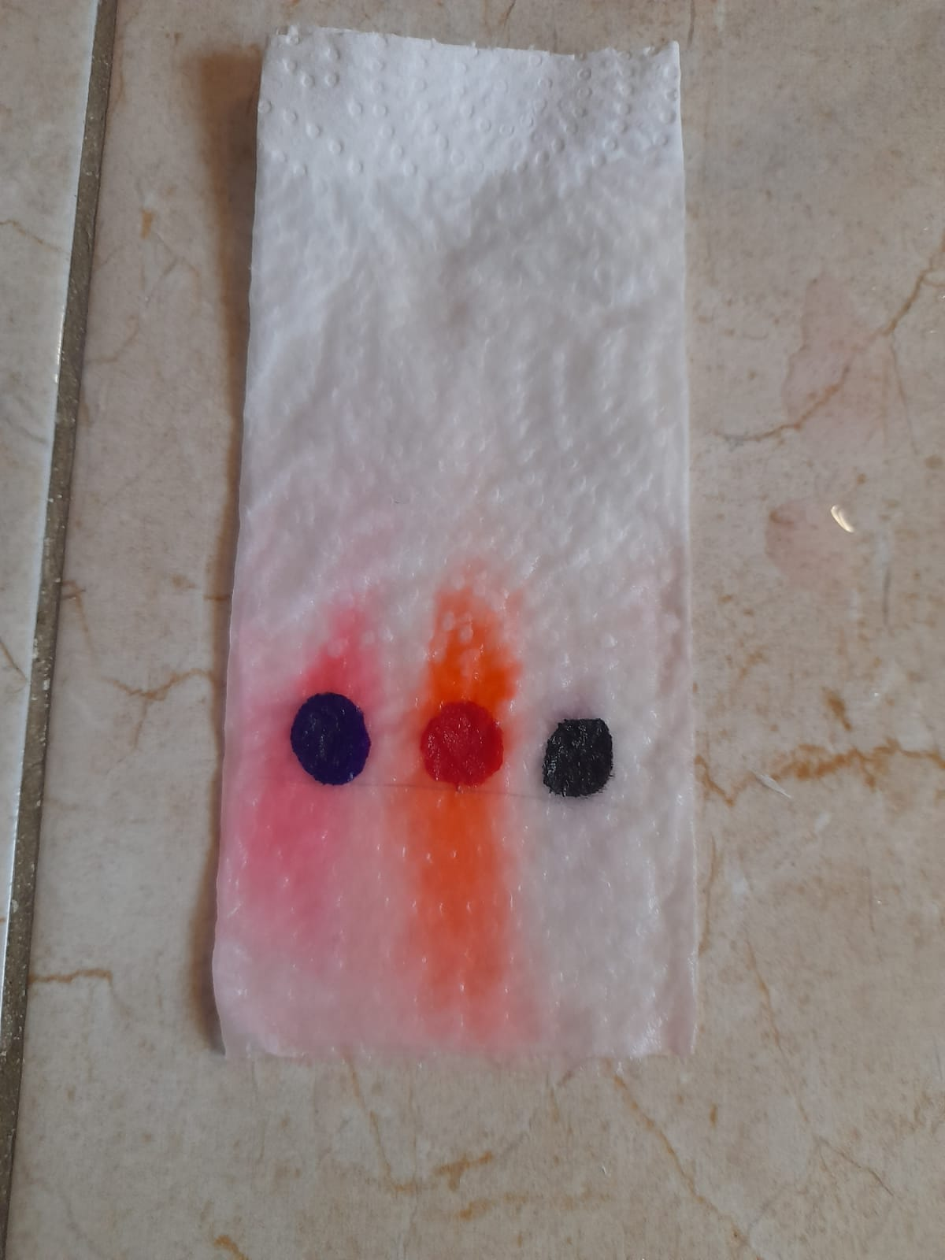
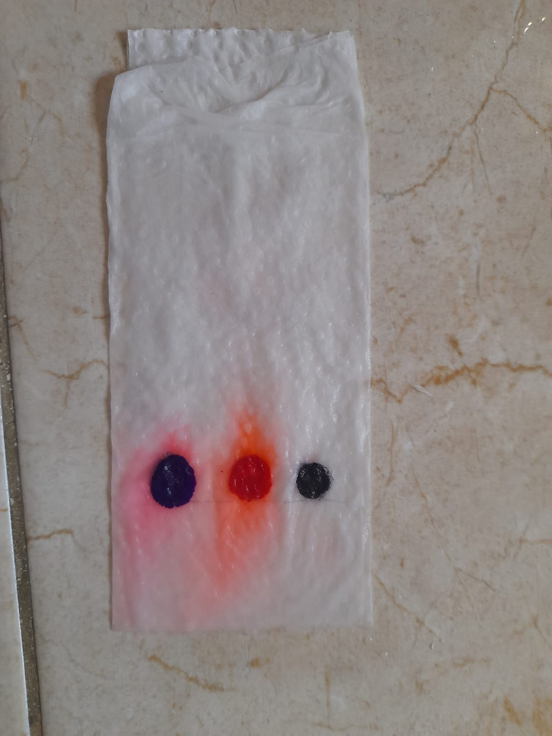
My result
Rubbing alcohol
vinegar
water

Slide 10
The end

