Slide 1
A Journey to the Arctic
Yazan Halaseh
Rayan Makhamreh
Amir Haddadin
Karam Al Saleh

Slide 2
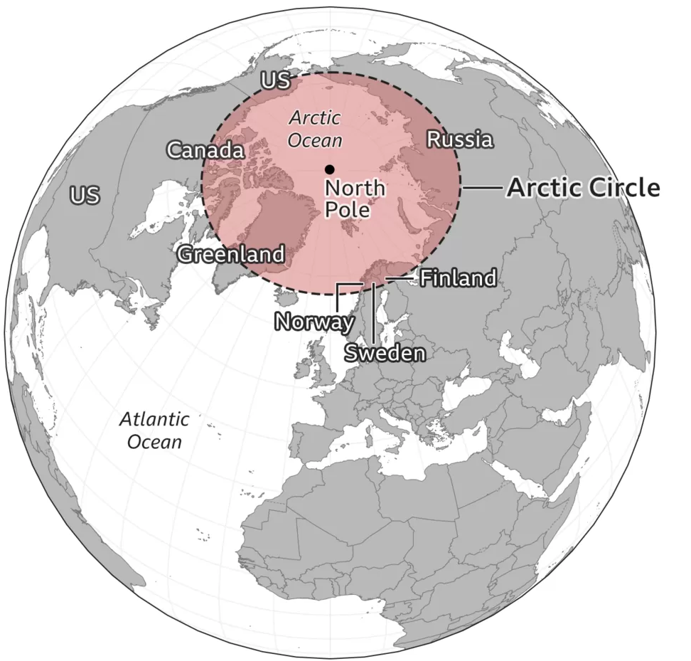
Table of Content
Characteristics of the Environment / Animal’s habitat.
Reasons Behind Extinction.
Numbers in the Past and Now.
What is Being Done Now to Preserve the Remaining Numbers of that Animal?

Slide 3
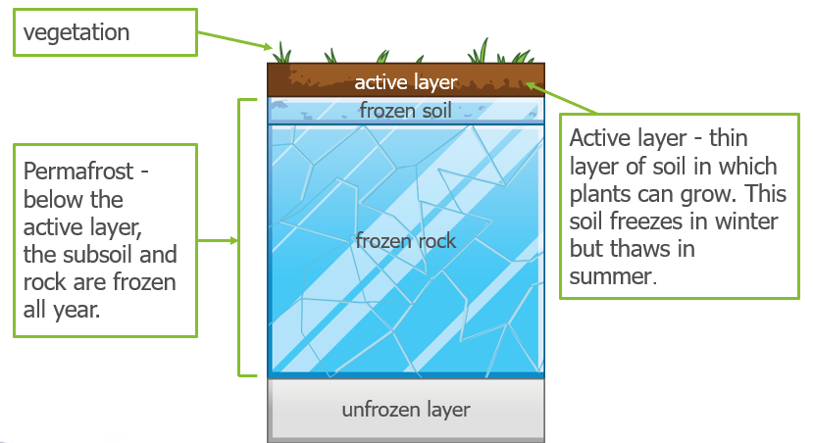
Characteristics of the Environment
The Arctic habitat is a freezing cold area at the top of the Earth, above the Arctic Circle. It's made up of the Arctic Oceans, as well as areas of the U.S., Canada, Russia, Iceland, Sweden, Finland, Norway and Greenland. It's a diverse habitat, meaning that lots of different plants and animals live there.
The Arctic is made up of icy glaciers, sea ice on the Arctic Ocean, and flat plains covered in ice and snow.
Animals like polar bears adapt in their environment like having a thick layer of fat under their skin to stay warm and small extremities to prevent heat loss, large webbed feet to prevent sinking in the soft snow and finally the polar bear can close its nose trill to prevent water to get in their while swimming.
The Arctic habitat is partly made up of
frozen sea-ice, and partly made up of land
covered in a layer of permafrost, which is
soil that stays frozen throughout the year.
On top of that, there's a thin layer of
topsoil, which thaws for a short amount of
time each year. Arctic plants take root
here and grow.
There isn't much soil for plants to grow in, however, so they tend to grow low to the ground and together in bunches.

Slide 4
Reasons Behind Extinction
Climate change: Climate change, and the loss of sea ice habitat, is the greatest threat to polar bears. Soaring temperatures, rapidly melting ice and snow, rising sea levels and acidifying oceans are threatening all Arctic wildlife, from great whales to tiny plankton — not just the iconic polar bear.
Toxic pollution: As top predators, such as Polar Bears are exposed to high levels of pollutants through their food.
Oil exploration: Expansion of oil and gas drilling in their habitat could be extremely damaging. Direct contact with spilled oil would kill polar bears

Slide 5
Numbers in the Past and Now
The polar bear populations had been stable to growing over the past few decades, so the numbers have increased from 23,000 in 1980 to 26,000 in 1995 to increasing by 29,000 in the year 2015, but in the year 2021 there was estimation for the number of polar bears to be around 22,000 to 31,000.
Scandinavian countries were able to increase the number of arctic fox from 40–60 adult individuals in year 2000 to an estimated 450 adult Arctic foxes live in Norway, Sweden, and Finland.
Year | Snowy Owl | Polar Bear | Arctic Hare | Seal
2000 | 1,500 | 25,000 | 8,000 | 100,000
2022 | 900 | 21,000 | 3,400 | 2,659

Slide 6
What is Being Done Now to Preserve the Remaining Numbers of that Animal?
By Living Lifestyle: By walking or driving a bicycle to places as much as possible, so you can limit the amount of use going into the atmosphere because if you don’t it will cause Global warming, and it’s a huge problem for Arctic animals.
By Recycling: it will help because Arctic animals habitat are being destroyed by the lack of recycling, so if we recycling more and care for our environment so the chance of the arctic animals going extinct will reduce.

