Slide 1
Black Adam
By: Rayan Samawi

Slide 2
Storyboard
Nearly 5,000 years after he was bestowed with the almighty powers of the Egyptian gods--and imprisoned just as quickly--Black Adam is freed from his earthly tomb, ready to unleash his unique form of justice on the modern world.

Slide 3
Reawakening after 5000 years, Black Adam becomes the world's ruthless protector: an anti-villain to take on the likes of Superman and Wonder Woman. Now in the 21st-Century, Black Adam must face off against the Justice Society of America and its heroes: Doctor Fate, Hawkman, Atom Smasher and Cyclone. The fate of the world hangs in the balance.

Slide 4
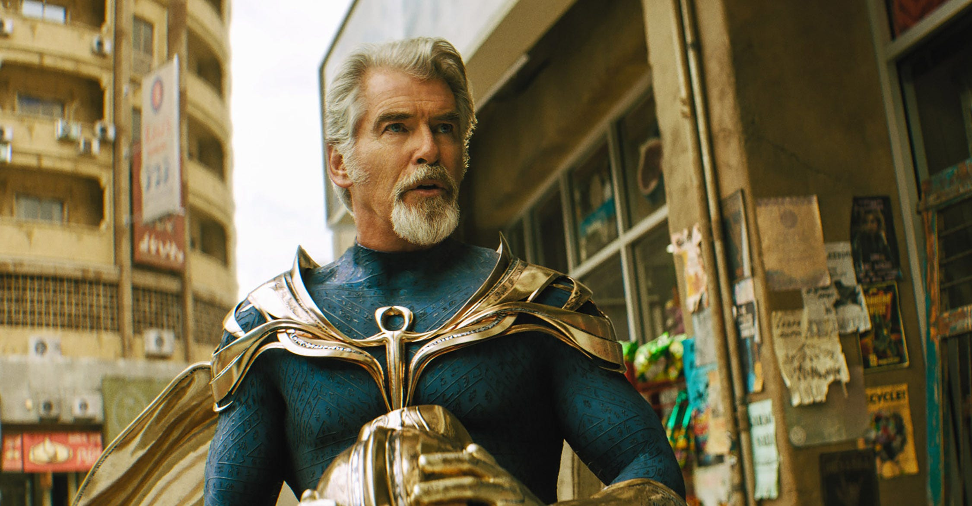
Doctor Fate
a powerful sorcerer and agent for the Lords of Order who fights evil alongside his wife Inza. He is a founding member of the Justice Society of America.

Slide 5
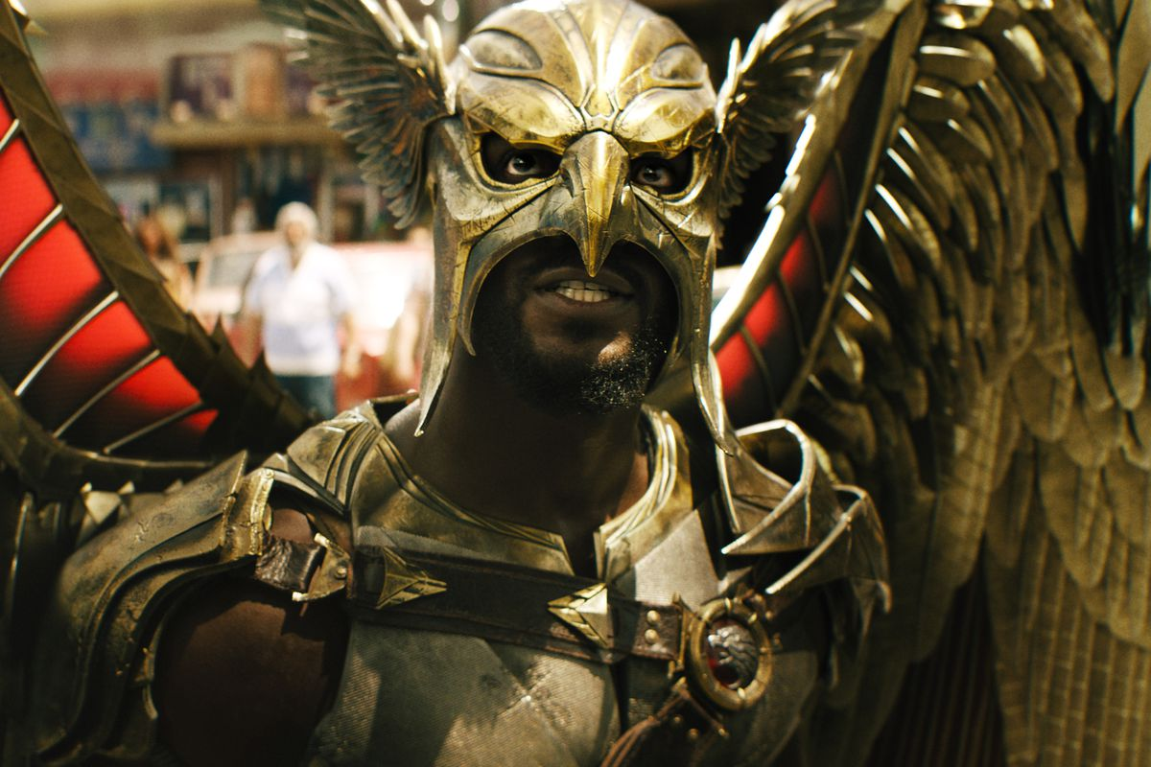
Hawkman
Hawkman is a winged vigilante who fights crime using a flight harness made from Nth metal and a mace.

Slide 6
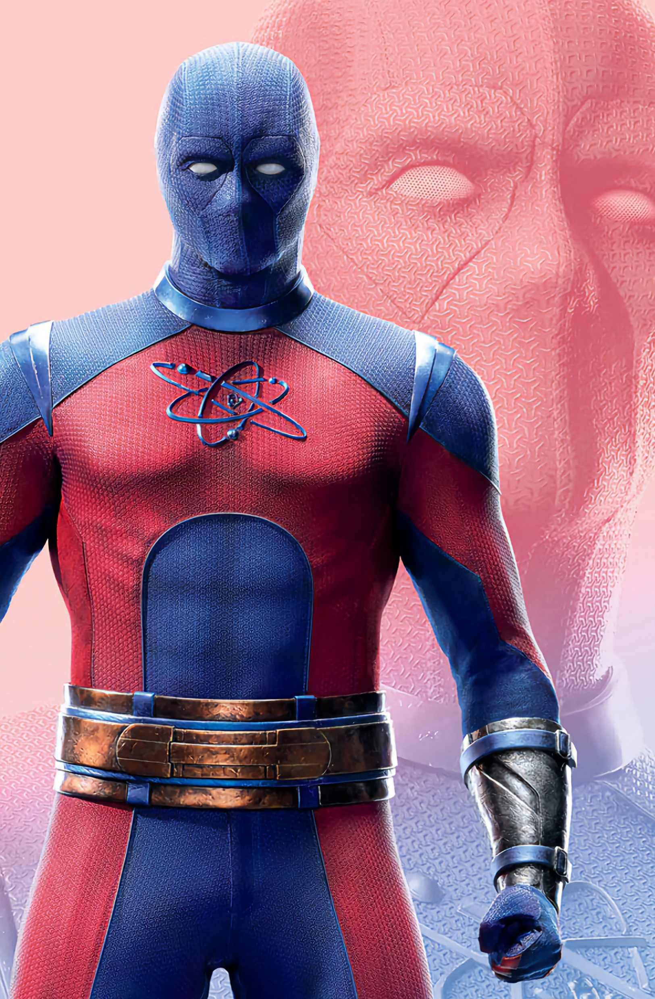
Atom Smasher
is a metahuman with the power to increase his size, a member to the Justice Society, being the nephew of the original Atom Smasher. Trying to prove himself ready to become a vigilante,

Slide 7
Cyclone
As her name suggests, Cyclone has airokinesis, or the ability to manipulate air. Utilizing this power in multiple ways, Cyclone is capable of flight, both for herself and others, and using the power offensively by pushing gale-force winds to slow down projectiles and pin enemies back.

Slide 8
Why I wrote about Black Adam?

