Slide 1
Stranger things
Season 1

Slide 2
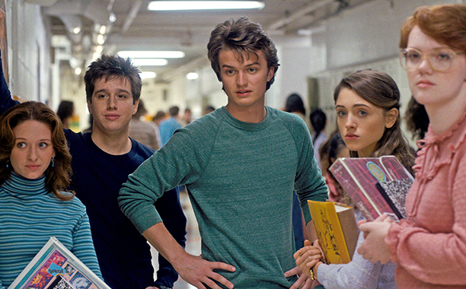
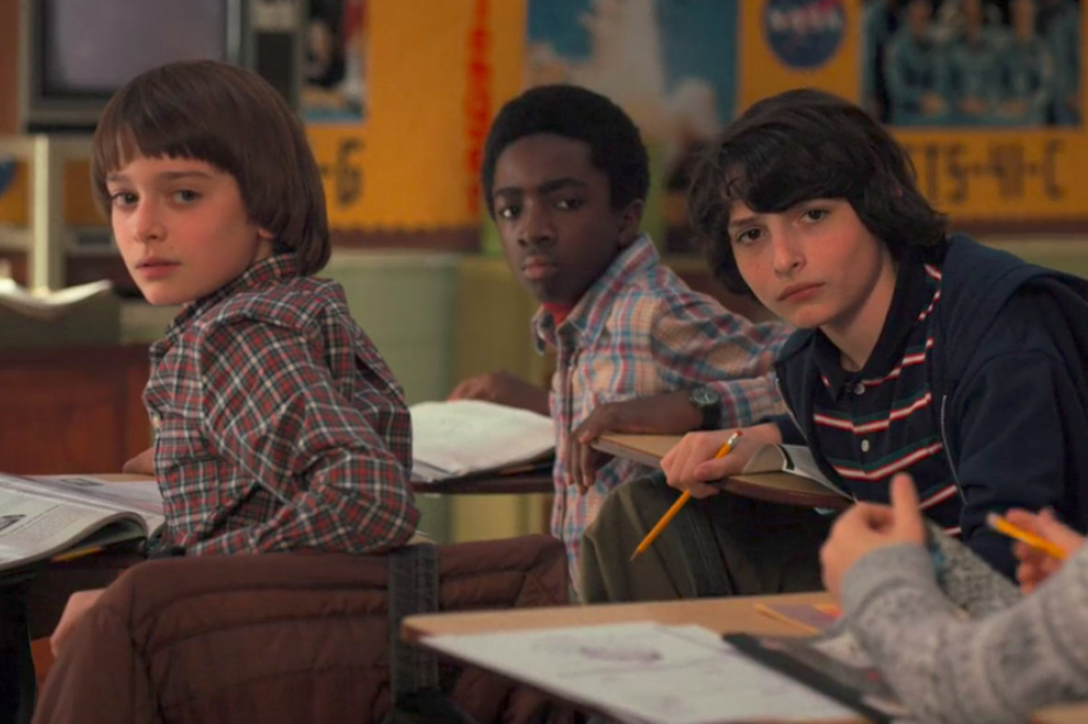
Stranger things is a series which takes place in the 80s.It talks about a girl named eleven/jane who has powers

Slide 3
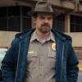
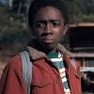
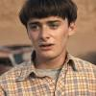
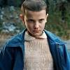
Stranger things characters
Characters | Actors
Eleven/jane | Millie bobby brown
mike | Finn wolfhard
Lucas | Caleb
Dustin | Gaten matarazzo
will | Noah schnapp
Joyce | Winona ryder
hopper | David harbour

Slide 4
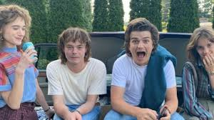
season 1
There are still many more characters in the show but not are all introduced in season 1.
And there are many more seasons
Each season talks about specific journeys
Season ones journeys main point is trying to find will.
They have gone through many research from going to the police to ending up in the upside down world and facing the Demogorgon in the school and the byer’s house, this has lead to a couple of deaths for example Barb.

Slide 5
How did eleven meet the group?
In the beginning of season 1 after the disappearance of will , mike, Dustin and Lucas were searching for will in the woods only to end up finding eleven. Mike and the others decided to grab eleven to mikes house and give her clothes that are more appropriate for the weather then the clothes she was originally wearing . mike had full trust in eleven but not all of the group had full trust.

Slide 6
Fun facts about the actors
Joe Keery Wrote An Album
Millie Bobby brown is British
Maya Hawke Has Famous Parents

Slide 7
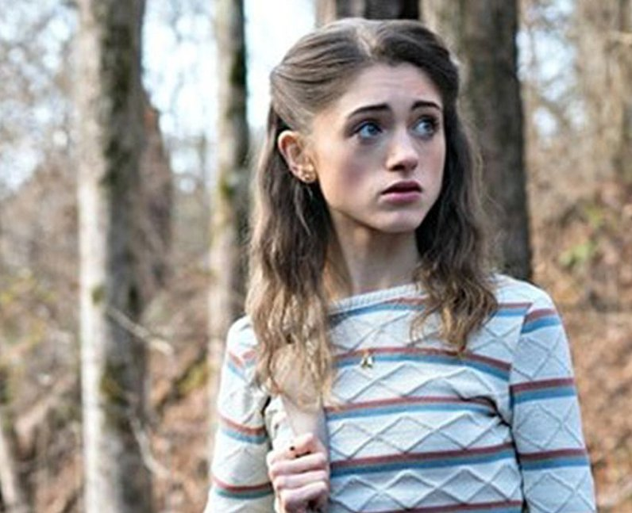
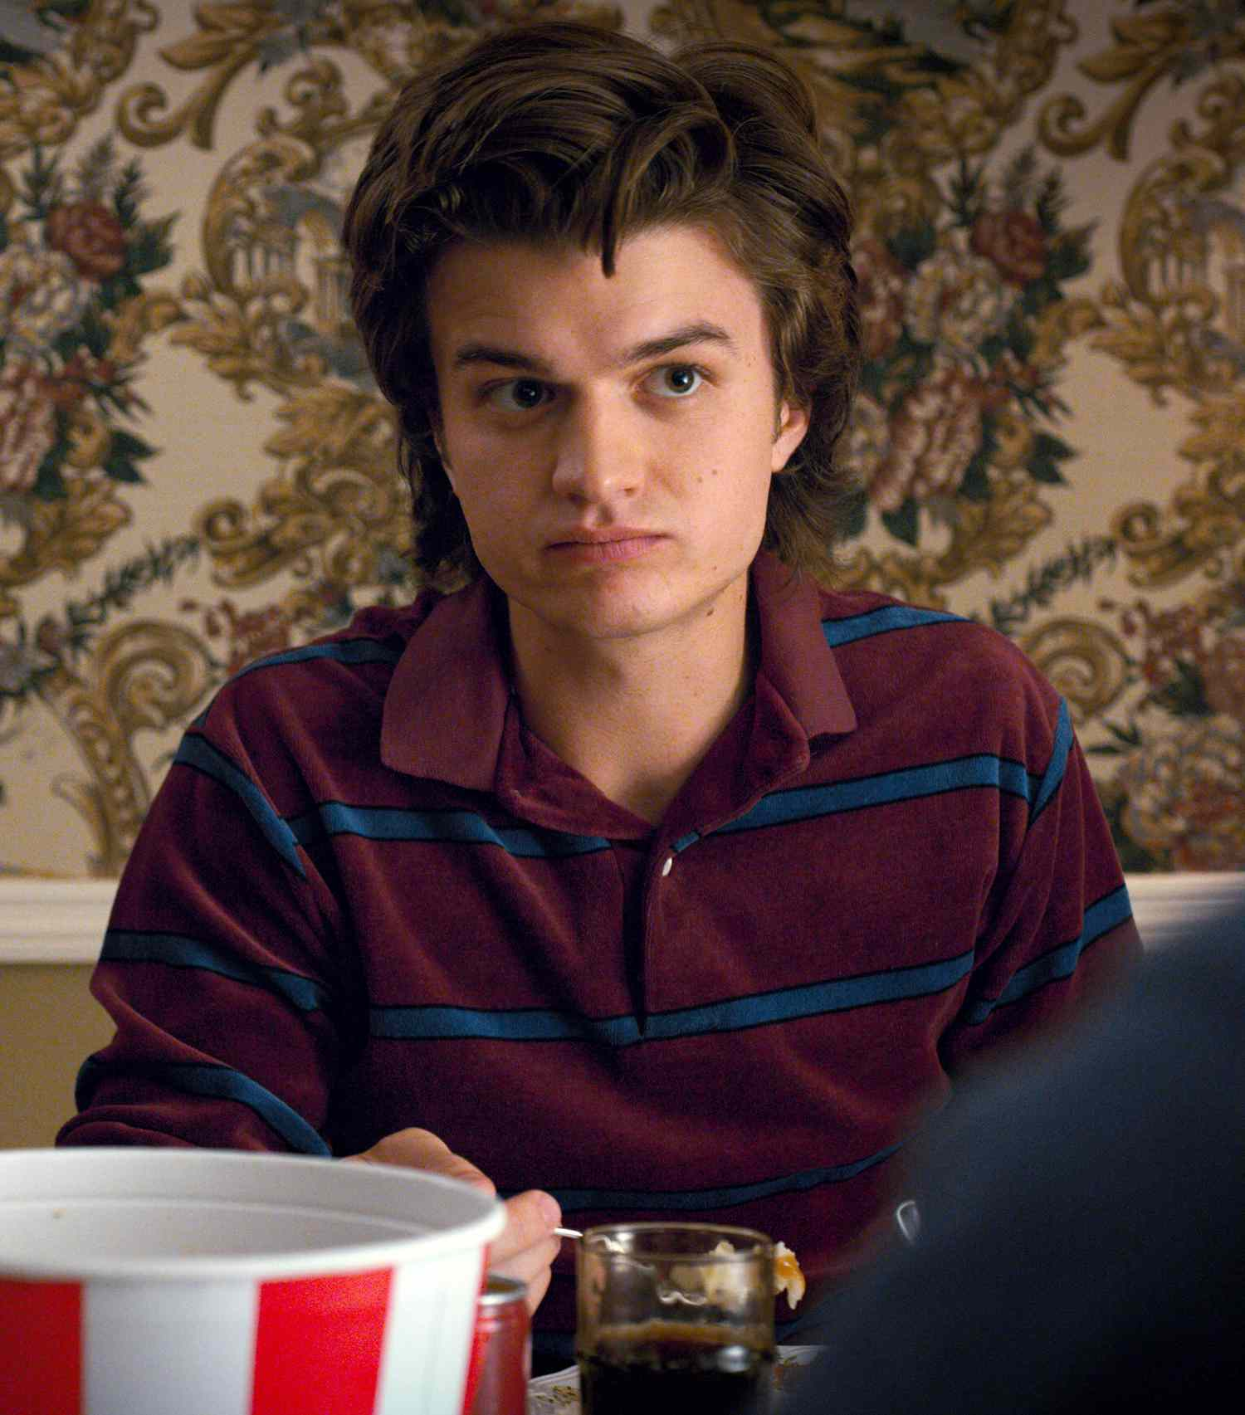
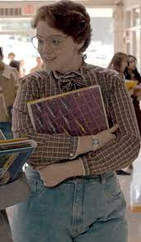
More about the teenagers
In the beginning of season1 we were introduced with a couple of teenagers in a group. This group includes Nancy wheeler(Mike’s older sister), Steve Harrington , Barb , Carol and Tommy. We don’t know much about Tommy ,Carol and Barb . At first Nancy and Steve weren’t likeable characters but later on they became better and more lovable characters but for the others they remain the same other than barb because we don’t know much about them

Slide 8
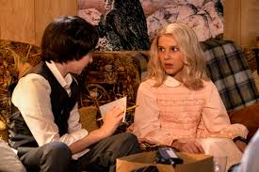
Thank you for listening

