Slide 1
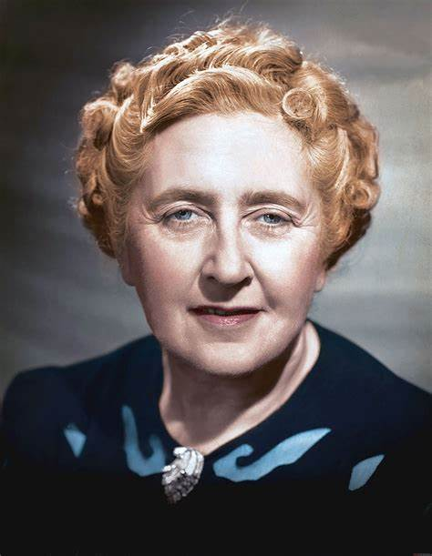
Agatha Christie1
By Celine

Slide 2
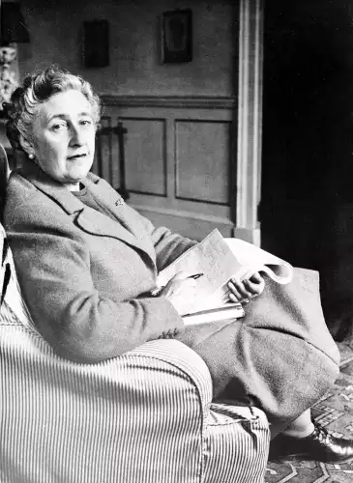
Birth and Death
1-Born at the 15th September 1890 in England
2-Died at the 12th January 1976

Slide 3
Work
1- 66 detective novel
2- 14 short collection's
3- 6 Novels
4- World longest – running play, The Mousetrap Since 1952.

Slide 4
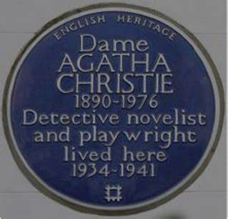
PRIZES
In 1971, she was made a Dame by Queen Elizabeth II.
Best selling fiction writer of all time by Guinness World Records.
First recipient of the Mystery Writers of America's Grand Master Award.
Received an Edgar Award for best play
And much more.

Slide 5
Failure and Success
Her stories were refused to be published 6 times before 1920.
In 1920, after she created Hercule Poirot her work continued to publish on radio, TV and as books.Her novels sold more than 2 billions copies.

Slide 6
Life Experience and Imagination
In WW1 and WW2 she worked in hospital and learned so much about medicine and poison.
She used that knowledge in her writing and to create detective stories.
She lived in different places such as Egypt with her mom, Iraq with her husband, an archeologist, who went to the middle east for archeological expeditions

Slide 7
Plot and Comments of Others
"Duchess of Death", the "Mistress of Mystery", and the "Queen of Crime“
According to Hannah, "At the start of each novel, she shows us an apparently impossible situation and we go mad wondering 'How can this be happening?' Then, slowly, she reveals how the impossible is not only possible but the only thing that could have happened”.

Slide 8
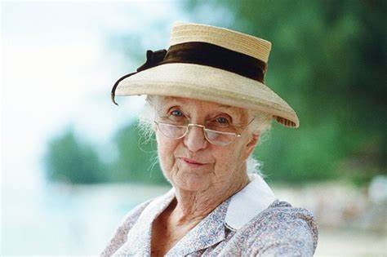
Characters
Mrs. Marple (The sleeping murder)
Mr. Hercules Poirot (Murder on the Orient Express)
Imaginary detectives created by Agatha to solve the crimes in her novels.

Slide 9
Morals
1- To try hard to achieve dreams.
2- What goes around comes around.
3- Equity can not be achieved on earth
4- Human nature stays the same everywhere and every time.

Slide 10
Favorite Novel /Movie
A Murder on The Orient Express

Slide 11
Reference
1 https://en.wikipedia.org/wiki/Agatha_Christie
2 "An interview with Sophie Hannah". The Home of Agatha Christie. Archived from the original on 31 August 2019. Retrieved 29 April 2020.

