Slide 1
ENOLA HOLMES 2
My Favorite Movie
By Karmel 6B

Slide 2
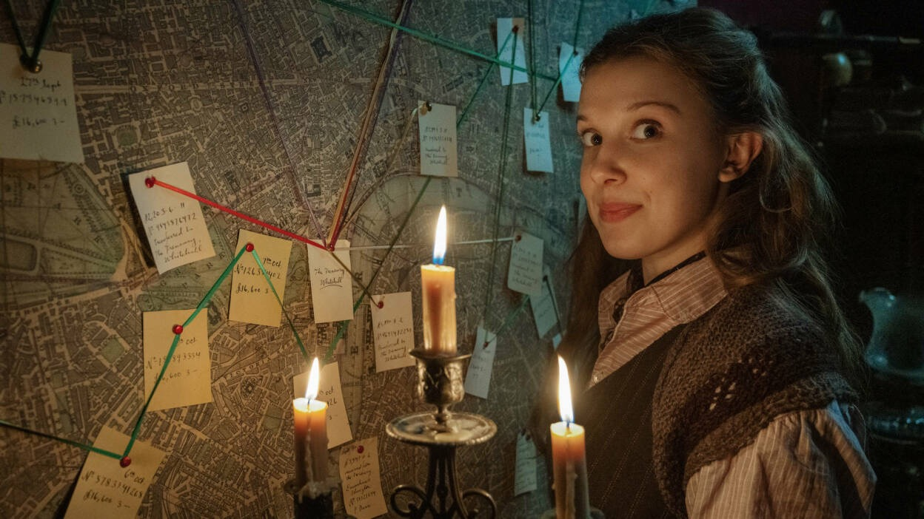
This movie talks about how 16 year old Enola started her journey of becoming a detective

Slide 3
She started her journey by opening a detective agency.
Unfortunately it didn't work out because she is a girl and many people only came only to ask about her brother(Sherlock Holmes).

Slide 4
Because it didn’t work out she had to close.
As she was closing a little girl came for help cause she saw a month old poster of the agency.
She wanted Enola to help her find her missing sister so Enola accepted her case.

Slide 5
The case was difficult so Enola needed help figuring it out by the help of her brother (Sherlock Holmes)and Lord Tewkesbury.

Slide 6
At the end Enola solved the case with help.
But she is always ready for a new one.

Slide 7
THE END…..

