Slide 1
Home Alone
By: Qais Al Abweh
Grade: 6
Section: B

Slide 2
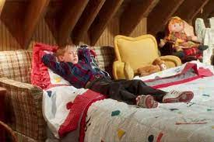
The movie talks about an 8 year old kid named Kevin who feels ignored by his large extended family.
While everyone is preparing for a Christmas vacation in Paris, Kevin gets in trouble, and is banished to the attic overnight, and wishes his family would just disappear.

Slide 3
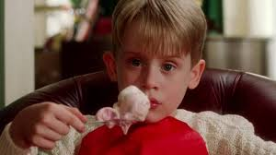
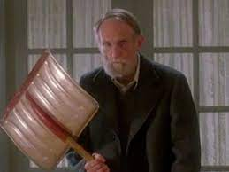
Kevin wakes the next morning to find the house empty. He thought that his wish came true, he was so happy to be alone in his huge house.
Later, Kevin was frightened by the next door old man neighbor. As the kids around the area used to say that he was a killer who killed his own family.

Slide 4
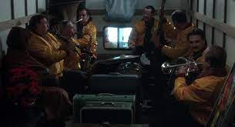
Kevin’s mother realizes on the plane that she forgot her child alone at the house, but it was too late. All flights were fully booked and the phone lines were down due to the bad weather.
She finally managed to find a ride back home with a band in their van. Which will take more time.

Slide 5
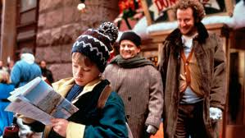
During that time, two thieves who are breaking into empty houses in the neighborhood, decide to rob Kevin’s house. Kevin tricks them into thinking that his family is still home, but they later found out that the kid was home alone.
Kevin starts missing his family and he wishes that his family would return on Christmas.

Slide 6
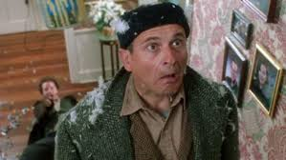
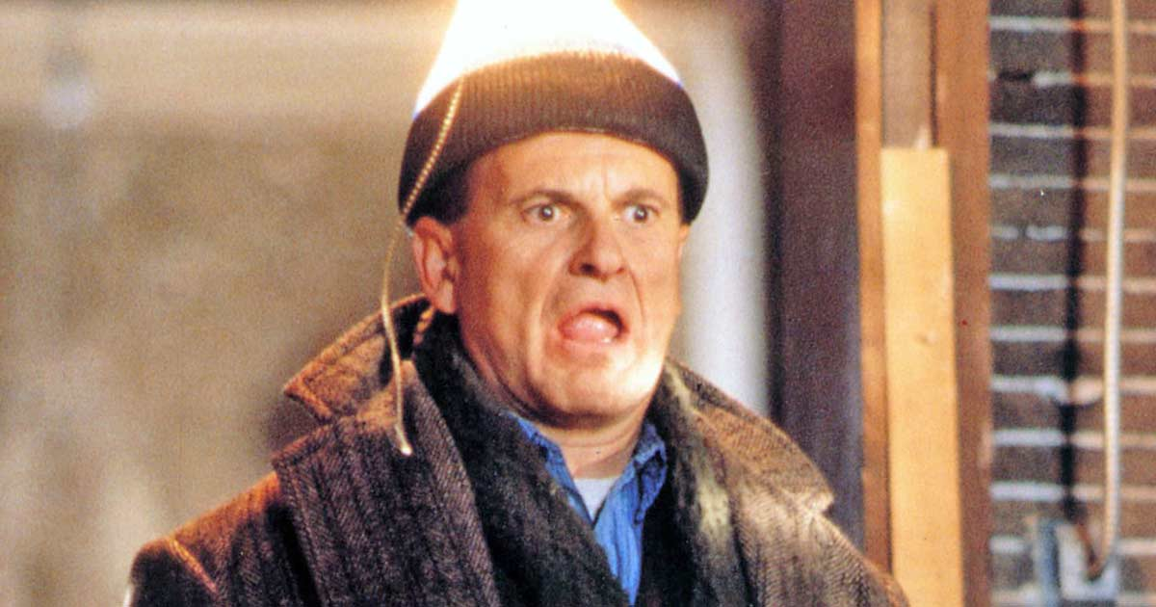
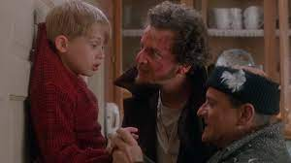
Kevin overhears the two thieves plan of breaking into his house, and starts preparing the house with all kinds of traps.
They got injured badly trying to get into the house. And then they got in, and started following Kevin through the house. Then Kevin managed to call the police, and the old man neighbor helped him until the police arrived and captured the thieves.

Slide 7
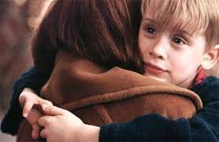
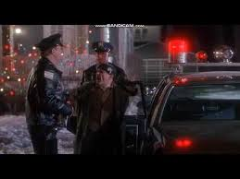
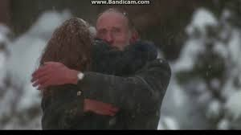
On the day of Christmas, Kevin’s wish came true. His mother arrived and then the rest of the family returned home too.
The old neighbor gets united with his daughter as well.
It was a merry Christmas for everyone, except for the two thieves.

