Slide 1
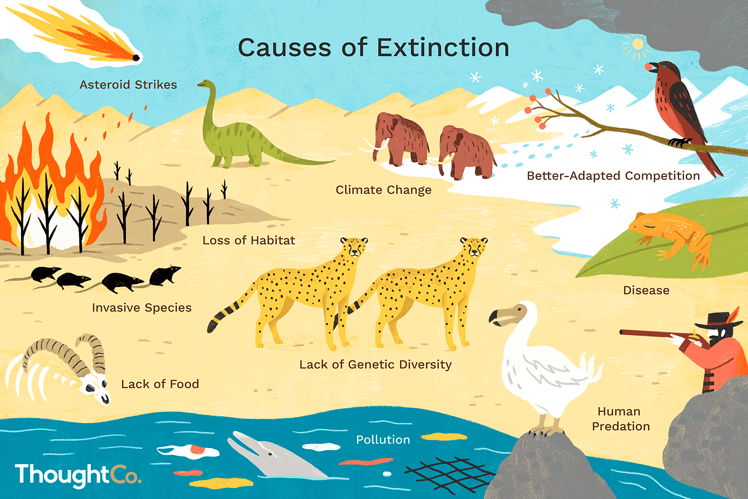
Reasons Behind Extinction
By: Layan Kurdi 6E

Slide 2
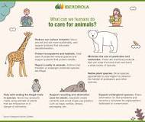
What are the reasons that let the animals extinction?
animal extinction causes:
genetic and demographic phenomena.
habitat destruction in the wild.
species introduction that are invasive.
global warming.
hunting and illicit trade.

Slide 3
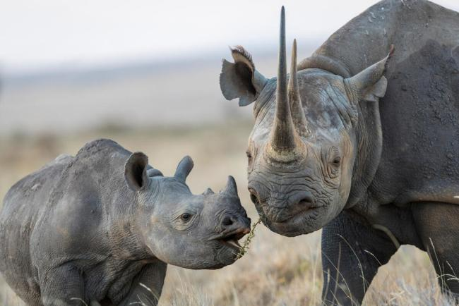
Black Rhinos
Critically Endangered
why are black rhino extinction?
Due to growing demand for rhino horn from some Asian users, notably in China and Vietnam, who utilize it in traditional cures, black rhinos are now still considered to be severely endangered.
Anther reasoners why black rhinos are extinction
Habitat Loss and Fragmentation
Next to poaching, loss of habitat contributes to declines in rhino population. Human activities such as agriculture, settlements, and infrastructure development result in the loss and fragmentation of rhino habitat, which increases the risk of poaching and inbreeding.

Slide 4
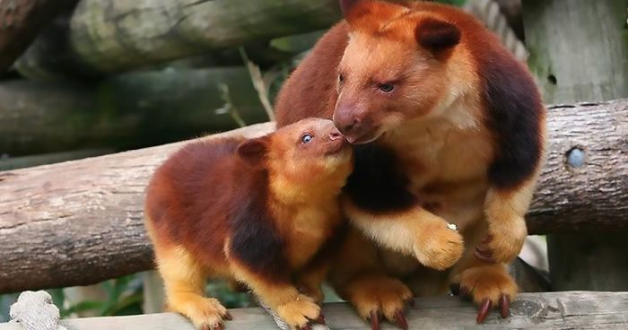
Tree kangaroo
Threats to Conservation Status and With an estimated natural population of fewer than 2,500 individuals, Matschie's tree kangaroos are a threatened species (IUCN 2014). Populations of tree kangaroos are under risk due to habitat degradation brought on by mining and forestry activities.
why are Tree kangaroo extinction?
This species is on the verge of going extinct due to habitat loss brought on by poaching and deforestation. WWF strives to stop illegal logging and promotes the Forest Stewardship Council certification of wood and wood products in order to lessen habitat loss due to deforestation.
anther reasons why are Tree kangaroo are extinction
This species is on the verge of going extinct due to habitat loss brought on by poaching and deforestation. WWF strives to stop illegal logging and promotes the Forest Stewardship Council certification of wood and wood products in order to lessen habitat loss due to deforestation.

Slide 5
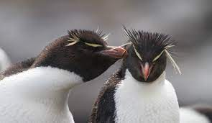
Rockhopper Penguins
stance on conservation Due to comparable food shortages and new predators like rats on their nesting islands, their relatives, northern rockhopper penguins, are listed as Endangered, which carries a higher risk of extinction.
why are Rockhopper Penguins extinction?
stance on conservation
Vulnerable. Southern rockhopper penguins are losing access to food due to pollution, climate change, overfishing, and changes in fish populations.
anther reasons why are Rockhopper Penguins are extinction
Numerous seabird species have seen population losses globally as a result of anthropogenic modifications to the maritime environment and changes in the global climate. The significant population reduction of rockhopper penguins (Eudyptes chrysocome and Eudyptes moseleyi) may be caused by rising sea surface temperatures (SST). Since rockhopper penguins normally occupy a low trophic level among diving seabirds in the Southern Ocean, one may anticipate that they will sensitively and quickly reflect changes to the food web brought on by climate change.Adult survival rates in a colony of southern rockhopper penguins (E. chrysocome) on the Falkland Islands were tracked for five years using passive integrated transponders. The range of the mean yearly survival rates was 84 to 96%.Compared to other crested penguin species, these values are high, and they represent

Slide 6
Resources
Recently Extinct Animals and Causes – Iberdrola
Tree Kangaroo: Facts About These Declining Species – WWF
About Tree Kangaroos - Woodland Park Zoo Seattle WA
Southern Rockhopper Penguin - New England Aquarium
https://www.worldwildlife.org › species › black-rhino
Survival of rockhopper penguins in times of global climate ...

