Slide 1
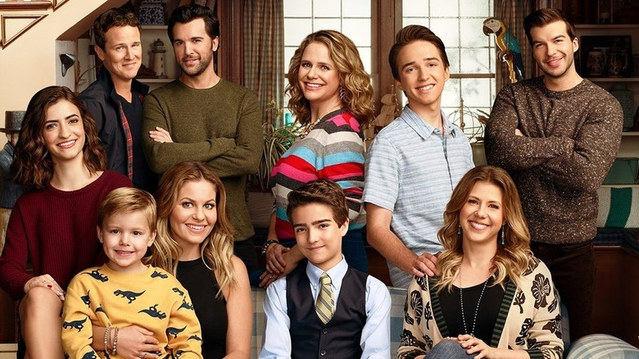
Fuller House
By: Yasmina Qannas

Slide 2
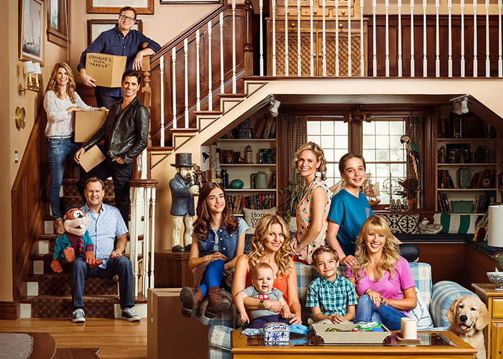
Main characters
D.J Tanner : Candace Cameron
Stephanie Tanner : Jodie Sweetin
Kimmy Gibler : Andrea Barber

Slide 3
Favorite characters
Ramona Gibbler
She is a very strong and independent girl.
Max Fuller
He is a very smart and witty boy

Slide 4
What it is about
D.J. is a single mum of three sons. She finds herself back at her childhood home alongside her sister Stephanie and her lifelong friend Kimmy.
They all raise their families together in a loving and fun atmosphere.

Slide 5
More about Fuller House
It was created by Jeff Franklin
It was first released on February 26, 2016
It was based on a previous show ‘Full House’
It runs for 5 seasons!

