Slide 1
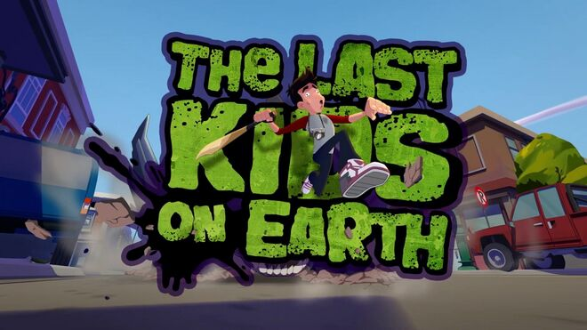
Made by Ayoub

Slide 2
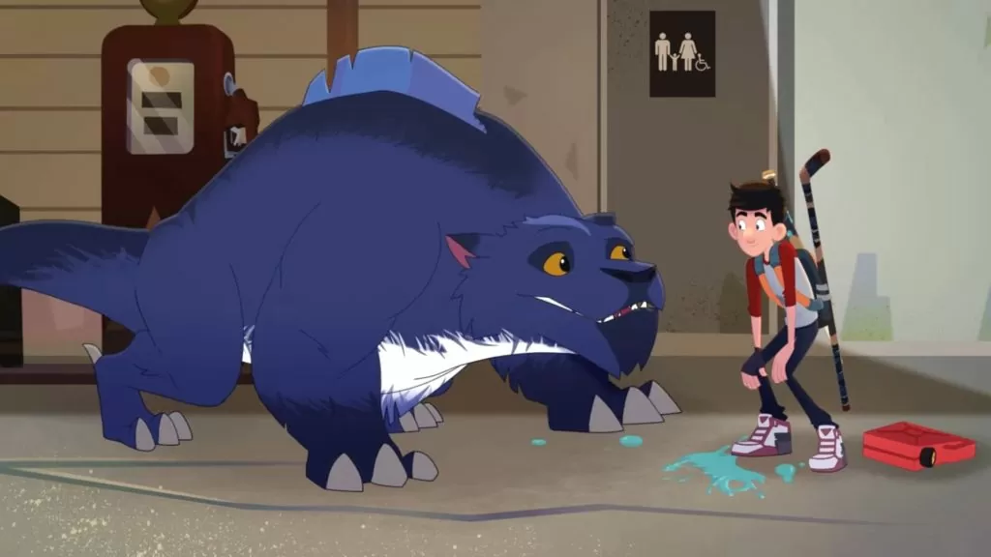
The Last Kids on Earth is a children's illustrated novel and subsequent book series by American author Max Brallier, illustrated by Douglas Holgate, with audiobook format narrated by Robbie Daymond. Novels in the series have been recognized on Best Seller lists of both The New York Times and USA Today
Author: Max Brallier
Genre: Children's novel; Middle-Grade Literature; Action & Adventure Literature; Comedy; Apocalyptic fiction
Published: October 13, 2015 – present
Illustrator: Douglas Holgate

Slide 3
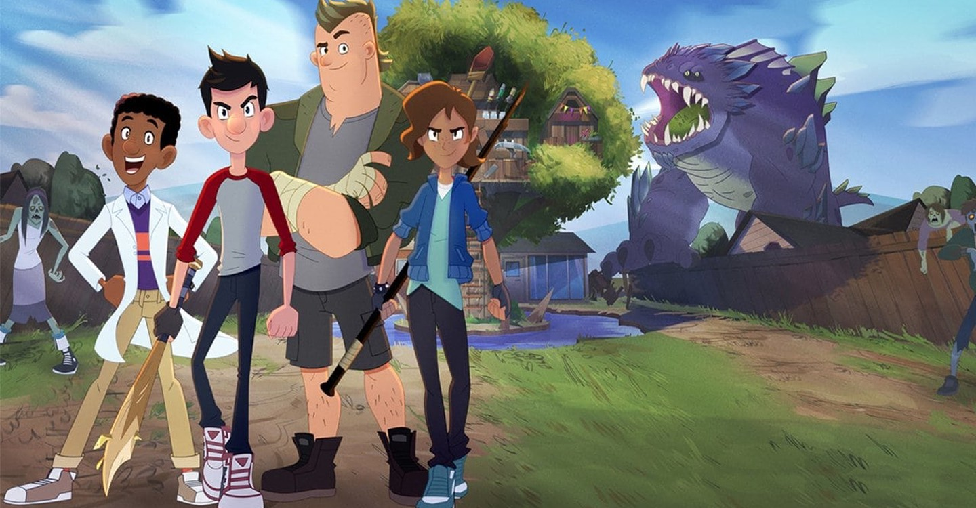
The moral of this series
The moral is Genuine Friendship as a Form of Survival. Besides comedic fun and action, this story serves as an ode to friendship, and the importance of having a support system of companions in your life.

