Slide 1
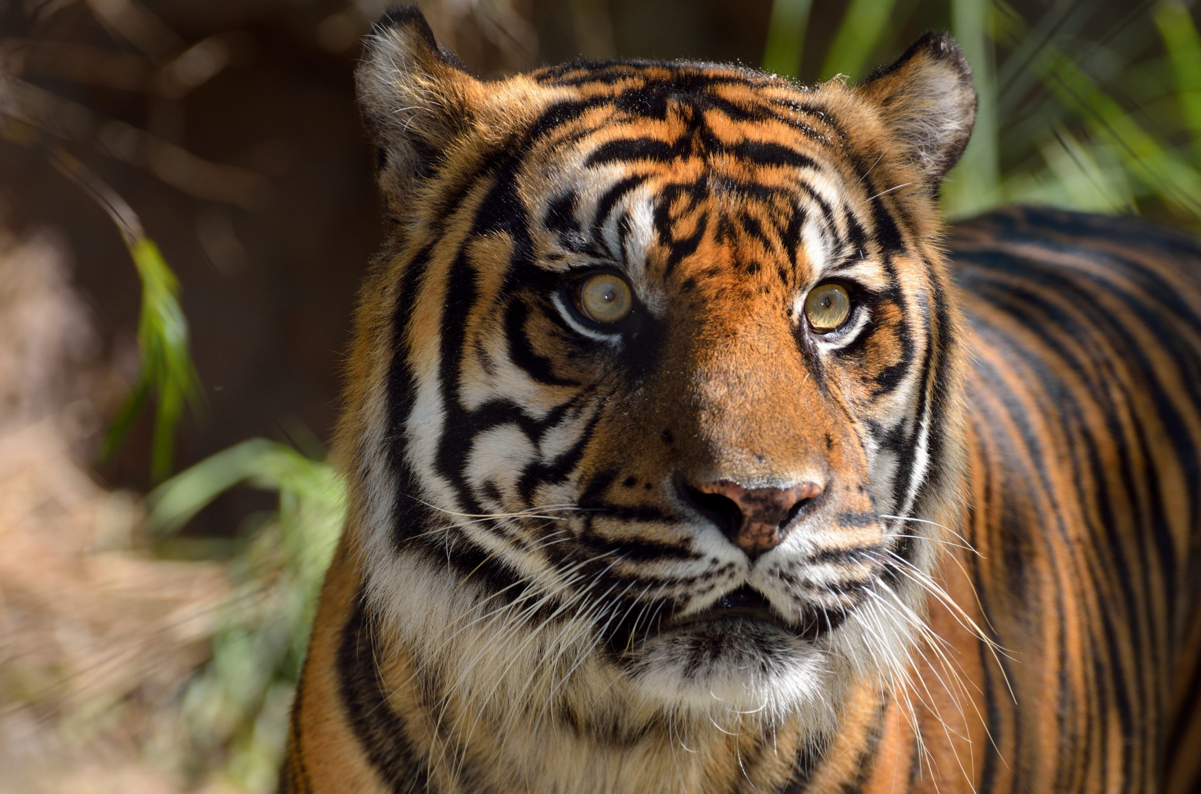
Biology project
Endangered Animals
Tigers
By: Lareine Hammad,
Abdullah Khattab,
Fares AL Zumut,
Jad Al Far
Omar Balbol
Grade Six C

Slide 2

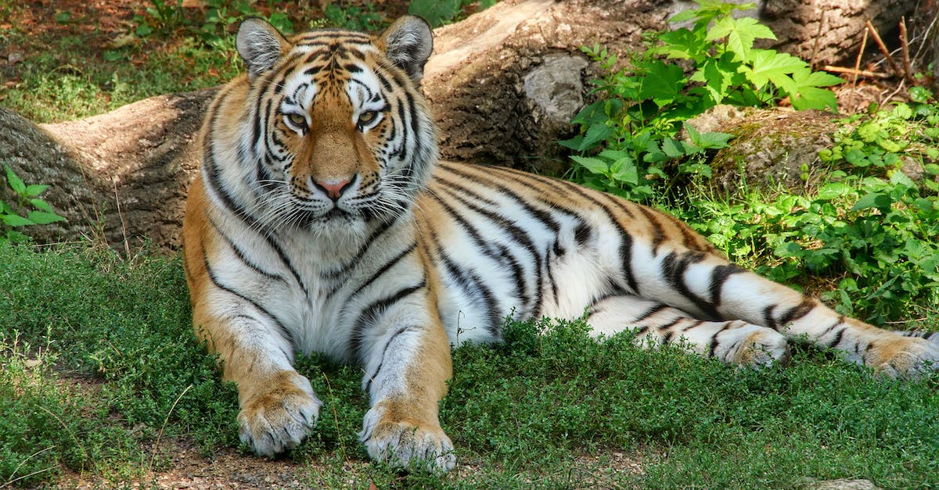
Tigers
Tigers are one of the most recognizable animals in the world. intimately connected with strength and untamed nature. A symbol of nature’s wild places. Tigers are the largest members of the cat species, and their particular species name is Panthera Tigris. There are nine subspecies of tigers, however, three of them are extinct now.
Tigers have lost an estimated 95% of their historical range. Their habitat has been destroyed, degraded, and fragmented by human activities. People clearing the forests for live stock and timber, along with building roads, networks and other development activities pose serious threat to tigers.
https://www.worldwildlife.org/species/tiger
https://www.twinkl.com/teaching-wiki/tigers-habitat

Slide 3

Tigers Statistics
Sadly, tigers are on the brink of extinction. Just over a century ago, 100,000 wild tigers roamed across Asia. Today, fewer than 3,900 live in a mere four per cent of their historic range. The largest tiger population can now be found in India, home to half of all remaining wild tigers. Much of this decline has occurred in the past decade.
New data suggests a potential 40% increase in tiger numbers, from 3,200 in 2015 to 4,500 in 2022,
Due to monitoring the numbers of the tiger population is increasing. Habitat protection projects showed that recovery is possible
At present its distribution only includes southeast Asia, India, some Russian regions and western China.
https://panthera.org/newsroom/global-tiger-population-stable-and-potentially-increasing-despite-extreme-threats
https://wwf.ca/species/tigers/
https://travel2next.com/how-many-tigers-are-left-in-the-world/
https://sg.news.yahoo.com/wild-tiger-population-40-showing-123252118.html?guccounter

Slide 4
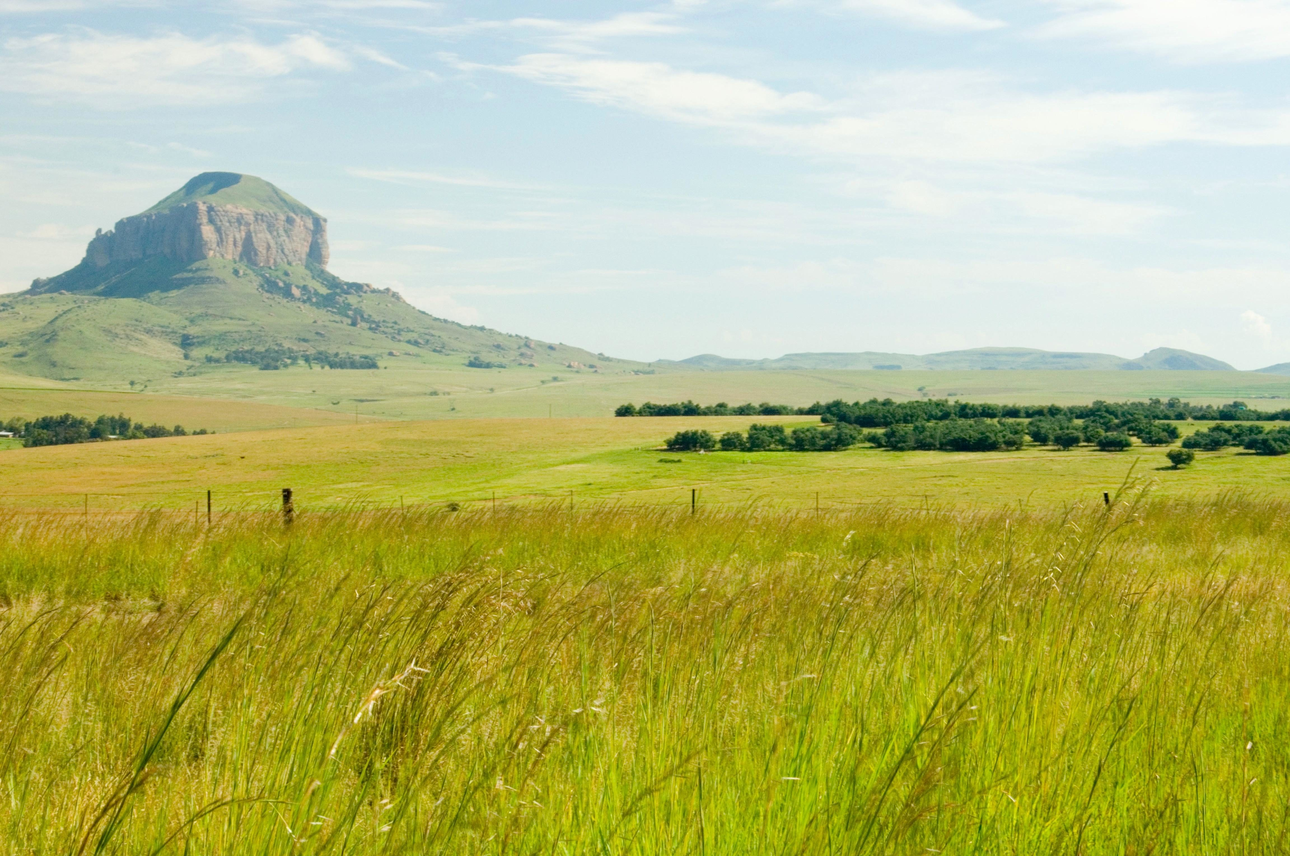
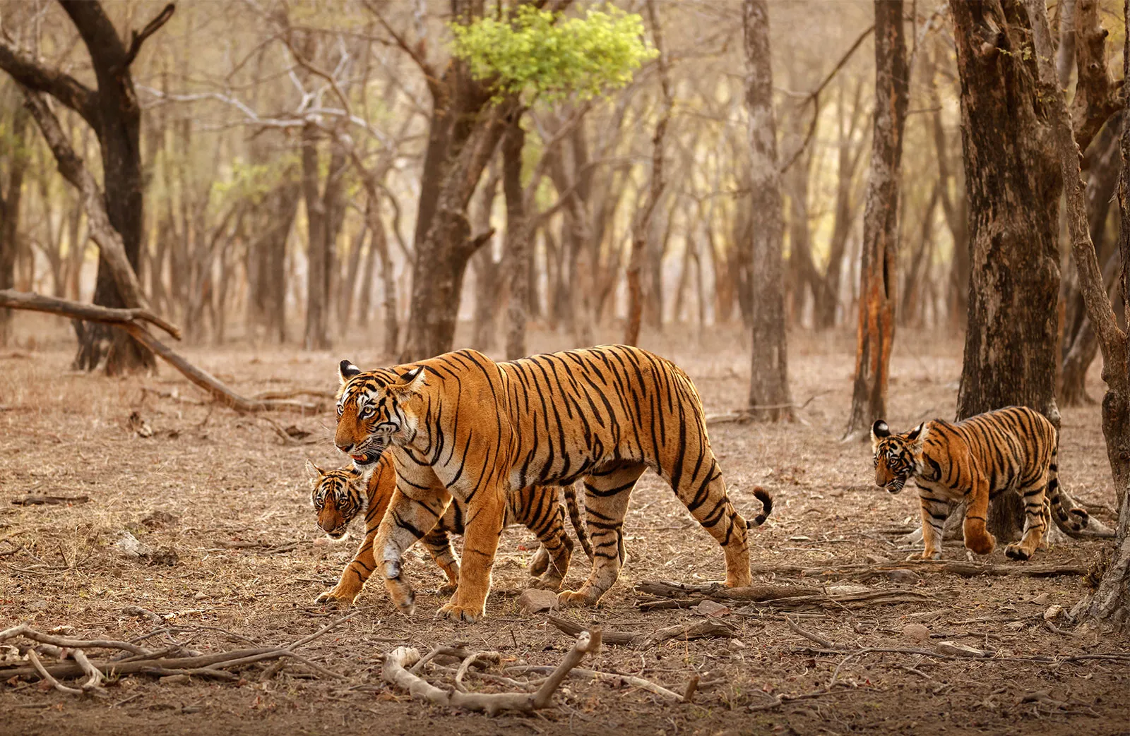
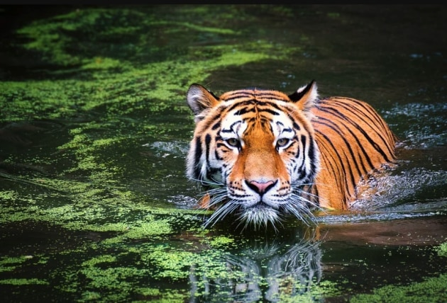
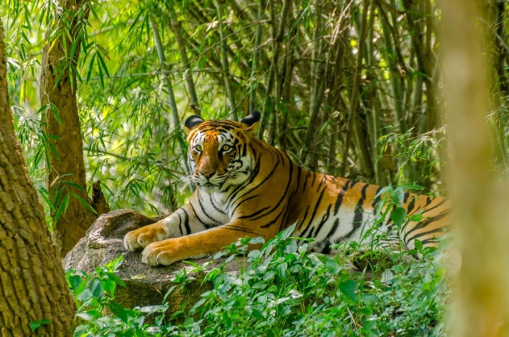
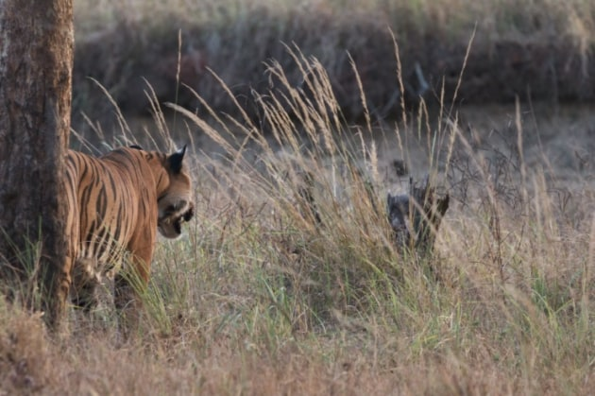
Tigers habitats all over the world
Tigers can live in many habitats, depending on where in the world they live, and what type of tiger they are . they will live in all sorts of different conditions too, from sun to snow . Tigers can be found in remarkably diverse habitats such as:
Rain Forests: Found near the Earth’s equator, the most biodiverse places on the planet. Rich in wildlife, tropical rainforests are an excellent habitat for the carnivorous tiger.
Evergreen Forests: Made up of evergreen trees, they exist in a range of climates. the trees provide excellent shade and cover for tigers to evade hunters and stalk their prey.
Mangrove Swamps: Formed by mangrove trees in slightly salty tidal waters, Mangrove area between India and Bangladesh is the home of the Bengal tiger.
https://www.twinkl.com/teaching-wiki/tigers-habitat

Slide 5
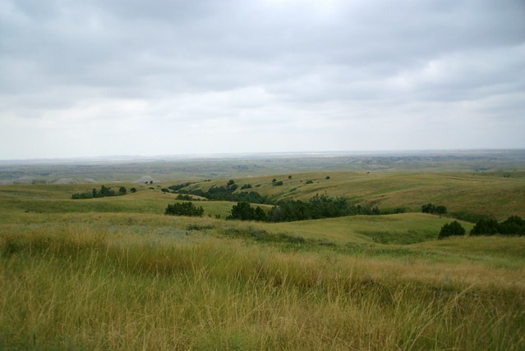
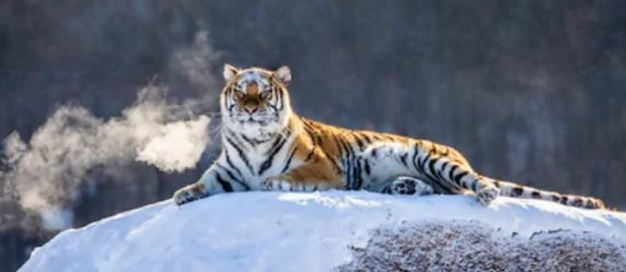
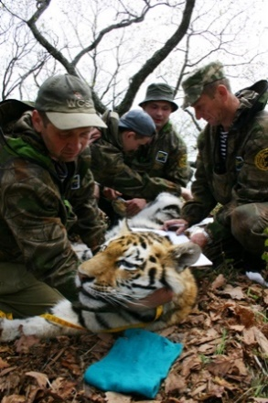
Savannahs: Characterized by grasses and trees spread out, It provides a large area for the tiger to roam.
Grasslands: Offering a continuous covering of grasses and fewer taller plants, They’re home to larger mammals which are the tigers’ prey.
Mountains: With steep sides and exposed bedrock, some tigers inhabit mountain regions.
https://www.twinkl.com/teaching-wiki/tigers-habitat
Reasons Makes Tigers Endangered
Several factors have negatively impacted these magnificent creatures. These include poaching, Illegal trade of tiger parts, loss of habitat, human conflict, and climate change. Perhaps the most significant factors are poaching and illegal trading of tiger parts. People hunt tigers for their pelts, teeth, claws, and bones.
https://thehomeschoolscientist.com/tigers-endangered/

Slide 6

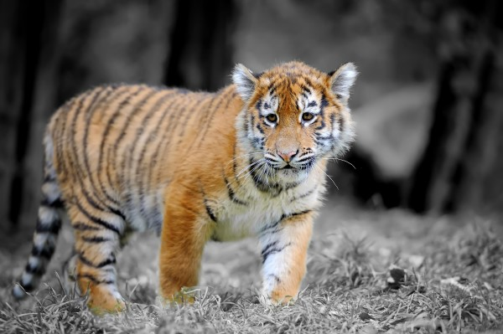
The Preservation Of Tigers
There are many ways in which we can all help contribute to the preservation of tigers:
Protect tigers and their habitat.
Reduce human- tiger conflict.
Tiger Campaigns work for the recovery of wild tiger populations by fighting the illegal trade, pressing for better legislation and the protection of their habitat and exposing the role of tiger farming in stimulating demand and thus poaching of wild tigers.
The government of India has a successful project for the protection of the tigers so that a healthy population of the tigers exists.
Hunting and habitat loss made tigers endangered. Only 7% of its former size is left. That’s why we need to protect these wild beasts.
https://thehomeschoolscientist.com/tigers-endangered/
https://www.wcs.org/our-work/species/tigers

