Slide 1
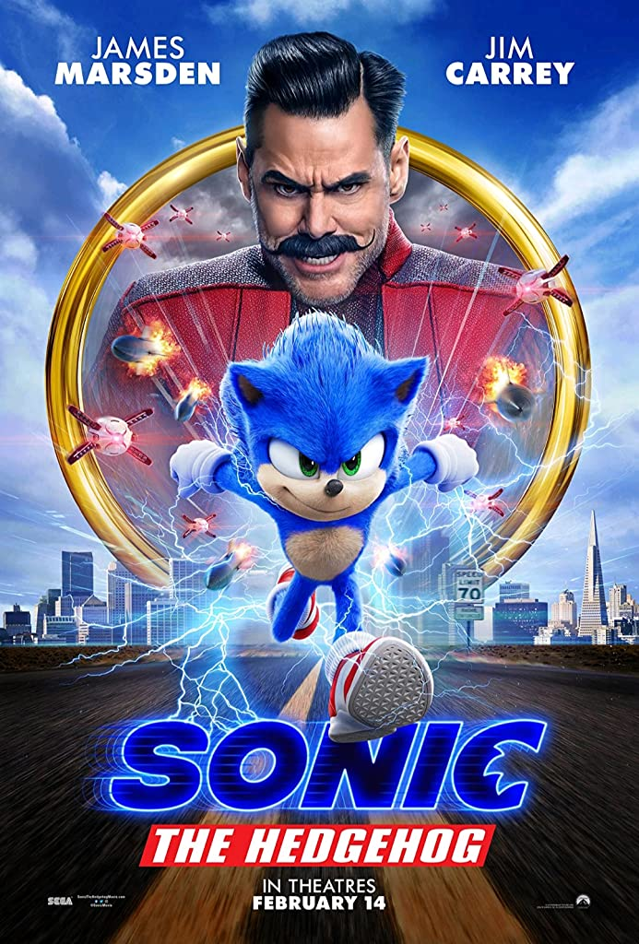
SONIC THE HEDGHOG

Slide 2
AUTHOR AND DIRECTOR
Director: Jeff Fowler
THE AUTHORS ARE: Pat Casey and Josh Miller

Slide 3
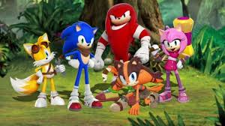
The Main characters are
sonic
tails
knuckles
Doctor Eggman
Tom Machowski
Maddie Wachowski

Slide 4
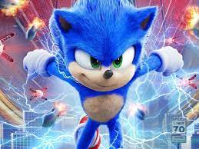
About this movie
Action – adventure comedy film based on the video game series of the same name published by Sega

Slide 5
Sonic the hedgehog 1
After discovering a small, blue, fast hedgehog, a small-town police officer must help him defeat an evil genius who wants to do experiments on him.
Based on the global blockbuster videogame franchise from Sega, SONIC THE HEDGEHOG tells the story of the world's speediest hedgehog as he embraces his new home on Earth

Slide 6
Sonic the hedgehog 1
The film follows Sonic who, after settling in Green Hills, wants to prove he has the makings of a hero, his big test comes when the evil Doctor Robotnik returns, alongside his new sidekick, Knuckles the Echidna, in search from the Master Emerald. Sonic team-ups with Tails to find the Emerald before it falls into the wrong hands.
Sonic the Hedgehog was first created in (2020).

Slide 7
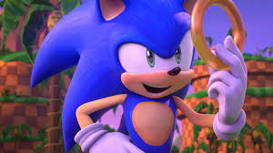
What is sonic Real Power
Sonic's greatest ability is his running speed, and he is known as the world's fastest hedgehog. Using the power of the seven Chaos Emeralds, he becomes Super Sonic and can achieve even greater speeds

Slide 8
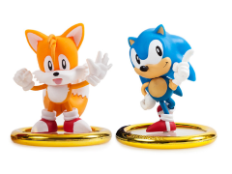
I recommend you to watch this move
Thank you
Zaid hieshan
Grade 6 E

