Slide 1
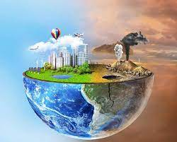
Living Things In Their Environment
Made by zaid Alhieshan,fasial alayoub,joseph kfoof
Grade 6 :”E”

Slide 2
What is Environment
The environment is everything around us
All our surroundings including the air, soil , water, plants , and animals make up the environment .

Slide 3
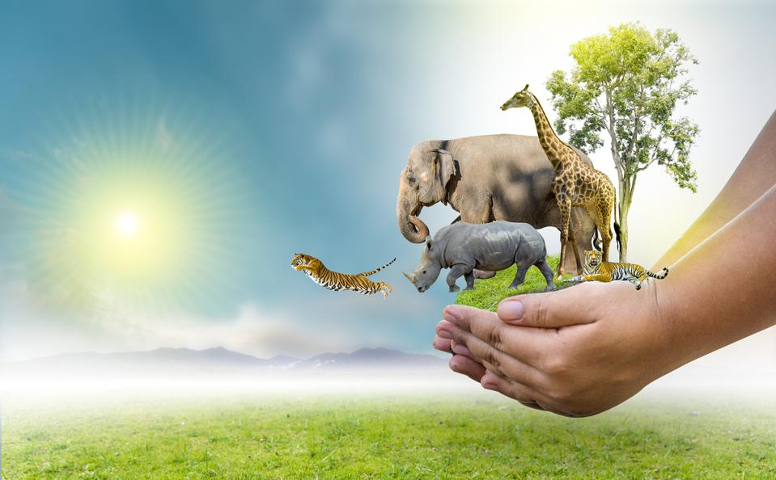
What is the best way to save endangered animals?
Scientists tell us the best way to protect endangered species is to protect the special places where they live. Wildlife must have places to find food, shelter and raise their young. Logging, oil and gas drilling, over-grazing and development all result habitat destruction

Slide 4
How to Help Endangered Species
Limit Your Consumption of Factory.
Make Your Home Wildlife-friendly.
Reduce Your Impact on the Environment.
Help Endangered Species When You Travel.
Don't Buy Plastic Products.
Harassing Wildlife Is Cruel and Illegal.
Support Endangered Species Conservation Organizations

Slide 5
Examples of Endangered Animals

Slide 6
What are the main reasons animals become endangered?
Habitat loss is the primary cause of higher extinction rates. Other causes include habitat changes, over-exploitation of wildlife for commercial purposes, the introduction of harmful nonnative species, pollution, and the spread of diseases

Slide 7
Thank you

