Slide 1
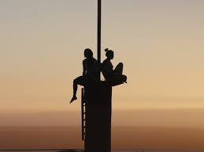
My favorite MOVIE
BY:Mourad Madain

Slide 2
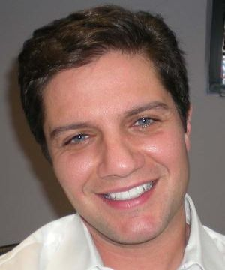
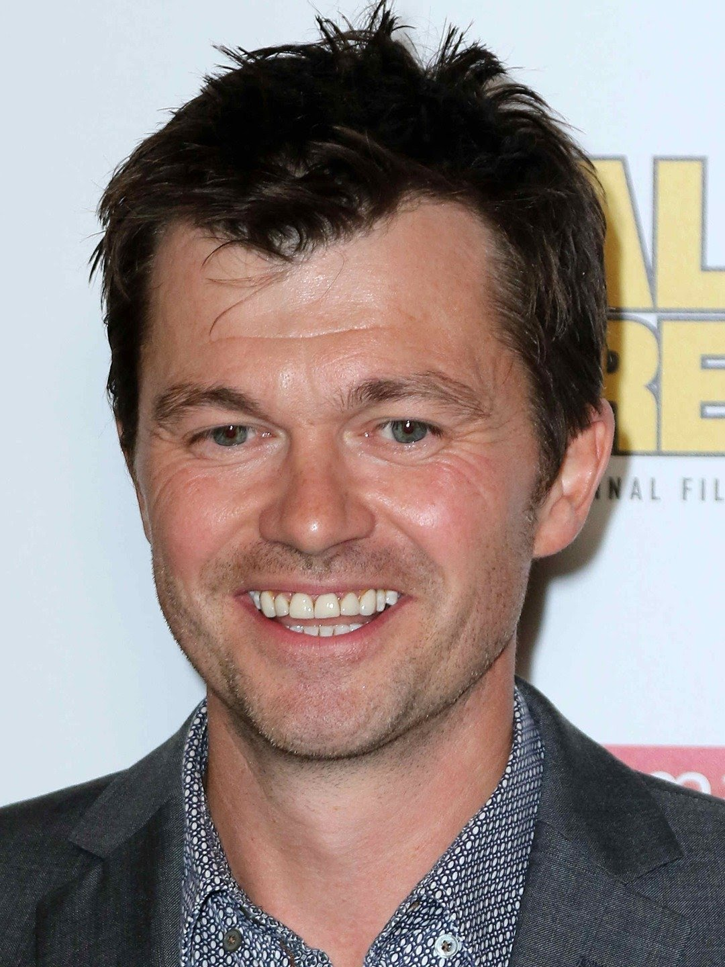
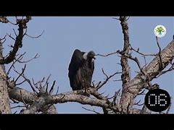
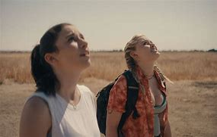
FALL
My favorite film of this year is named by FALL
It was produced by Christian Mercuri
It was directed by Scott Mann
Grace Caroline Currey as Becky Connor Virginia Gardner as Shiloh Hunter were the major character in the movie
vultures

Slide 3
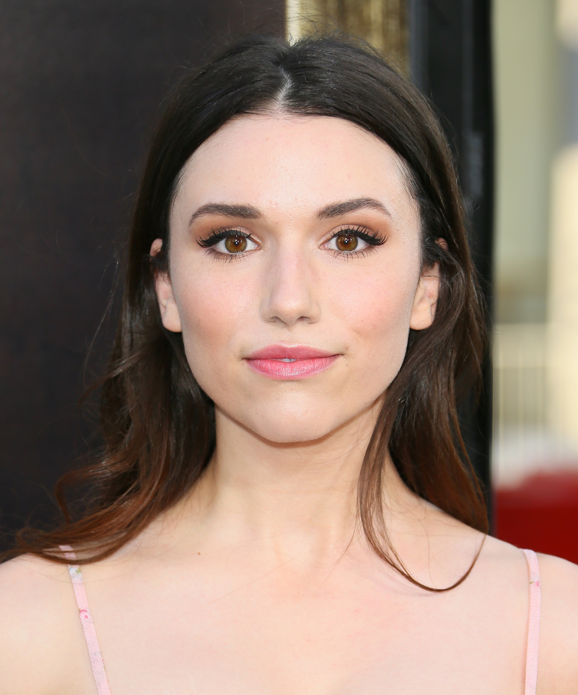
Introducing:
Main characters:Becky , Hunter.
My favorite character:Becky.

Slide 4
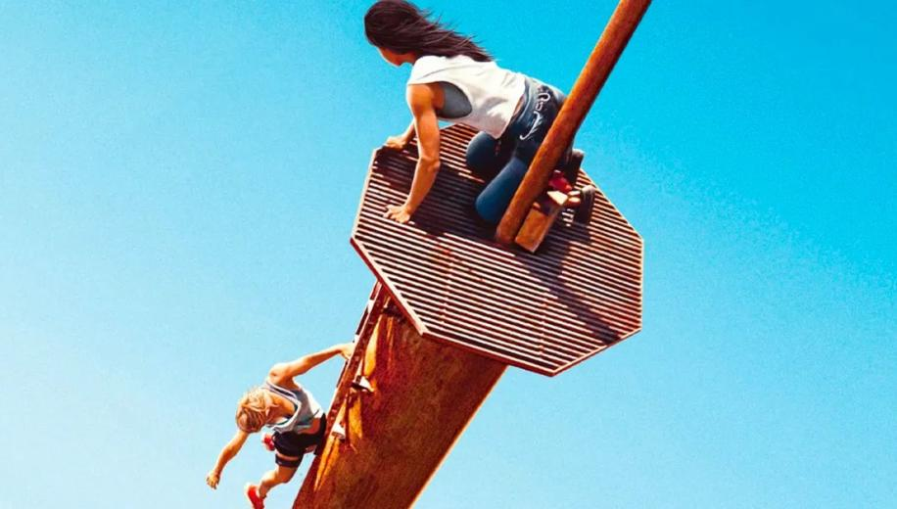
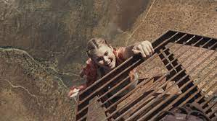
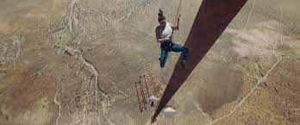
WHY IT IS MY FAVORITE FILM?
It has a lot of adventures and action and the whole point in this movie is to get rid of your fears and to believe in yourself.
The movie is directed very well.
the director knows how to make the audience feel empathy for the girl.
The photography is very good and the music is superb.
All the actors did their part very well.

Slide 5
summery
Becky , husband Dan and Becky’s BFF Hunter are climbing a sheer mountain face in the opening scene when tragedy strikes and Dan plummets to the ground below. A year later, Becky gave up and became an alcoholic.
Hunter comes to Becky with a proposal: They’re going to climb an abandoned 2,000-foot TV tower that’s basically in the middle of nowhere, from which they will find closure and spread Dan’s ashes. Of course, it goes very wrong, leaving Becky and Hunter stranded on top of the tower with no way down and no way to communicate with anyone who might be able to save them.
As they were trying as hard as possible to get some help, Hunter tried to get down to the dish so they can get help by sending a message or calling someone as there was signal down there however, the idea didn’t go as expected, because when she was going down the ladder she slipped and fell down to the dish which led to her death. vultures and drones get involved.

Slide 6
summery
Becky decided to eat the vultures to regain strength, Becky finally manages to connect herself to the harness and pull herself down to the dish, where Hunter's dead body lies half mangled by the impact of the Fall. Her stomach is already exposed after being torn apart by the vultures.
Finally, Becky wrote a message to her father and hid the phone in Hunters stomach and threw her down so the message could be delivered. The fact that Becky's father, along with several rescue teams, arrive at the tower means that that gruesome method did the trick, and someone brought Becky down via a helicopter and she was saved.

Slide 7
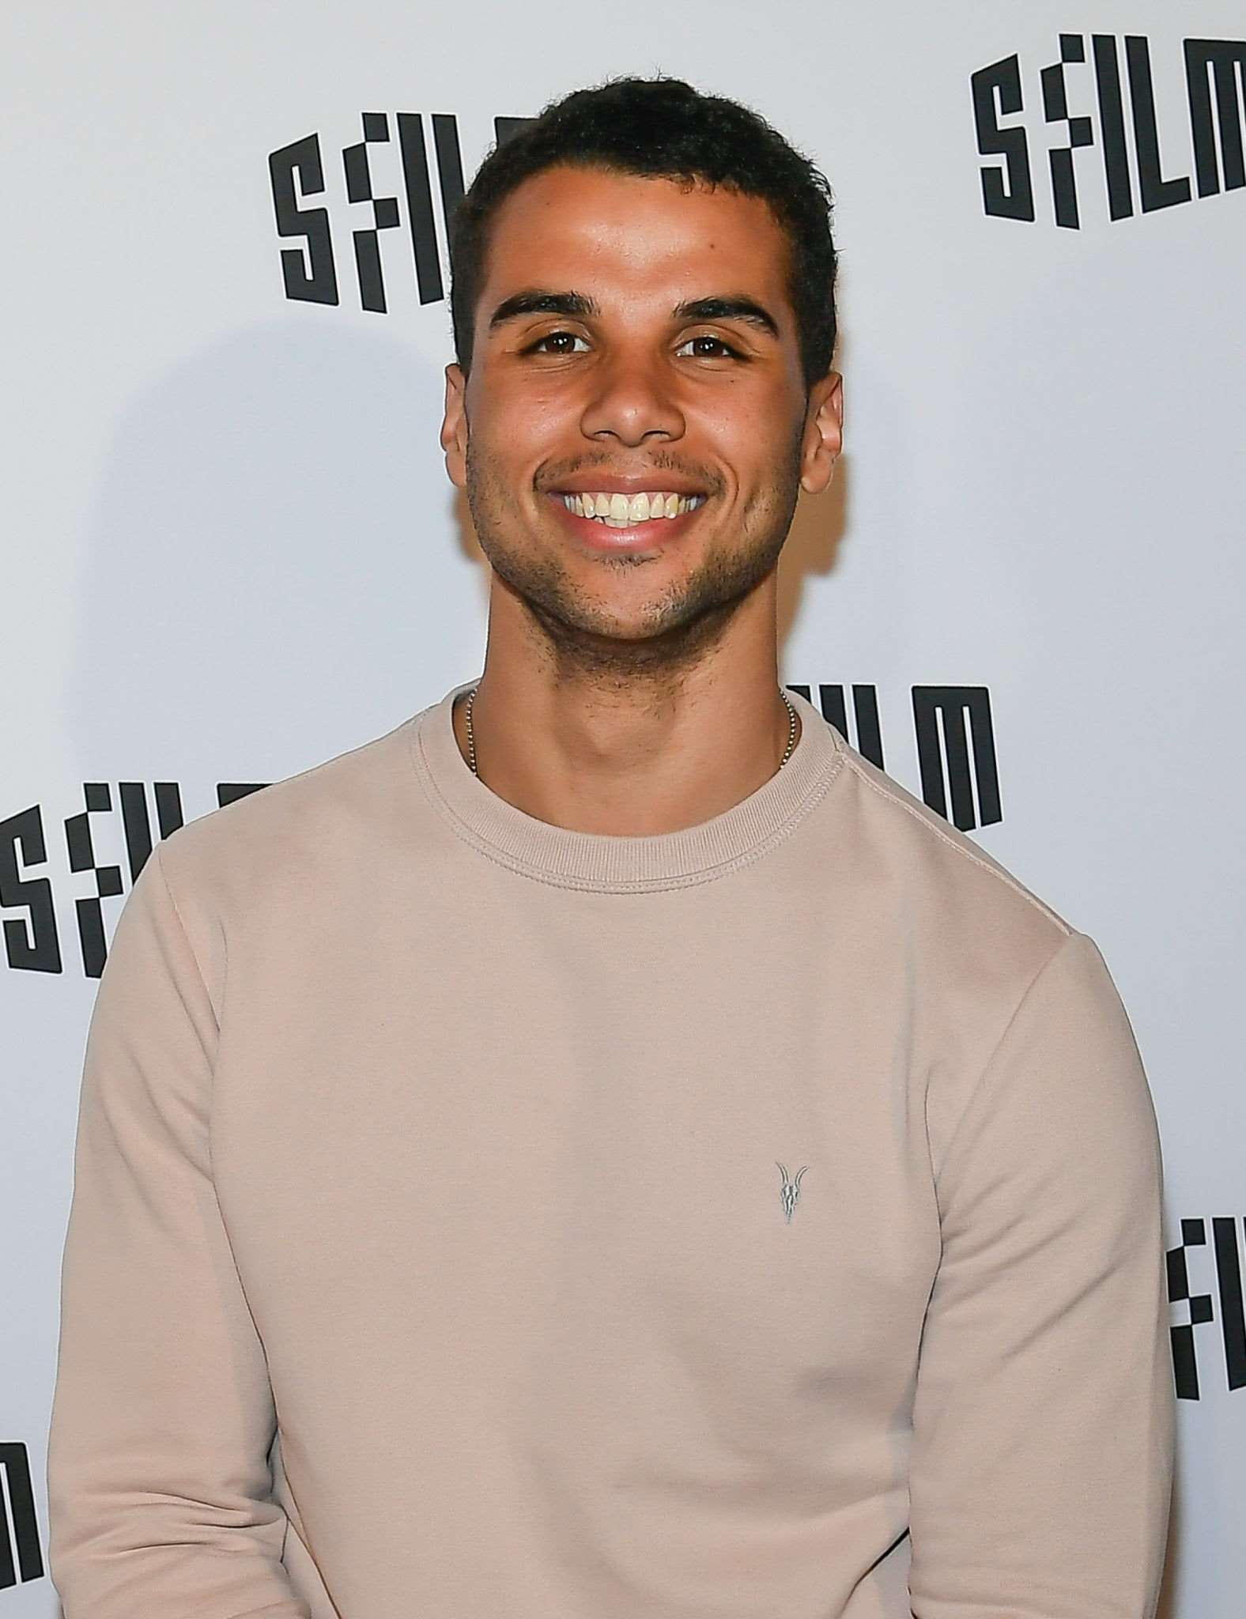
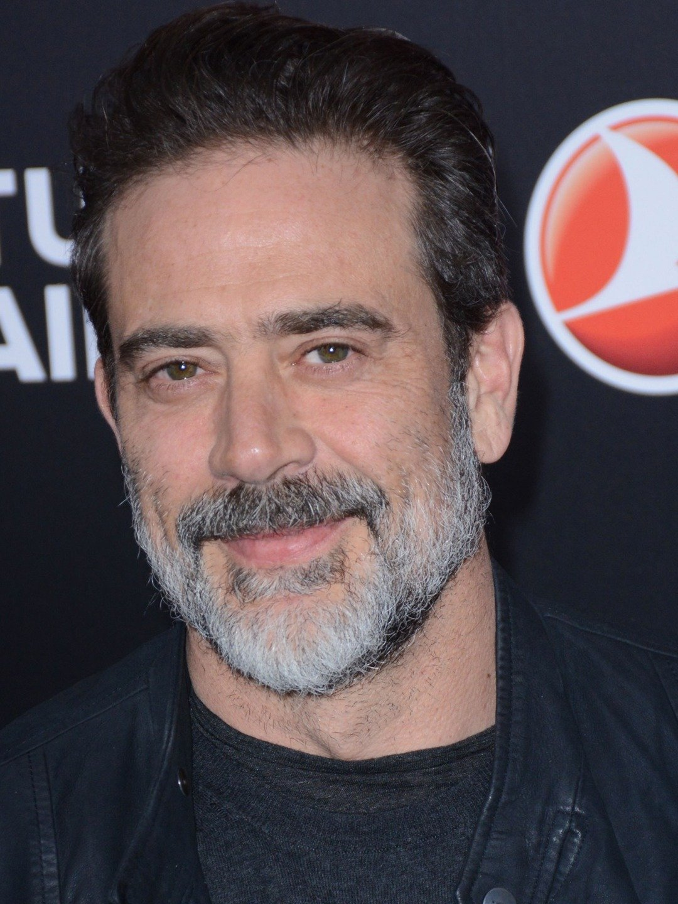
Cast
Grace Caroline Currey as Becky Connor
Virginia Gardner as Shiloh Hunter
Mason Gooding as Danyal ‘Dan’ Zaffar
Jeffrey Dean Morgan as James Connor

Slide 8
Results of the Film MOVIE
Fall was theatrically released in the United States on August 12, 2022, by Lionsgate Films.
The film had grossed $17 million worldwide and received generally positive reviews from critics, who praised Mann's direction, the atmosphere, cinematography, suspense, and the performances of Currey and Gardner, but criticized its screenplay, special effects and pacing.

Slide 9
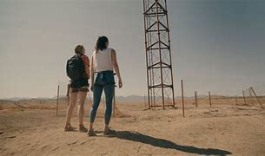
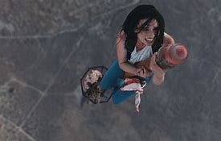
My opinion
Indeed I like to watch such movies that are suspense and adventurous.
This film has had a huge impact on me, as they teach that nothing is impossible and to push my limits further.
It can be seen by young and old.

Slide 10
THANK YOU!

