Slide 1

Elona homes
By Natalie sahouri

Slide 2
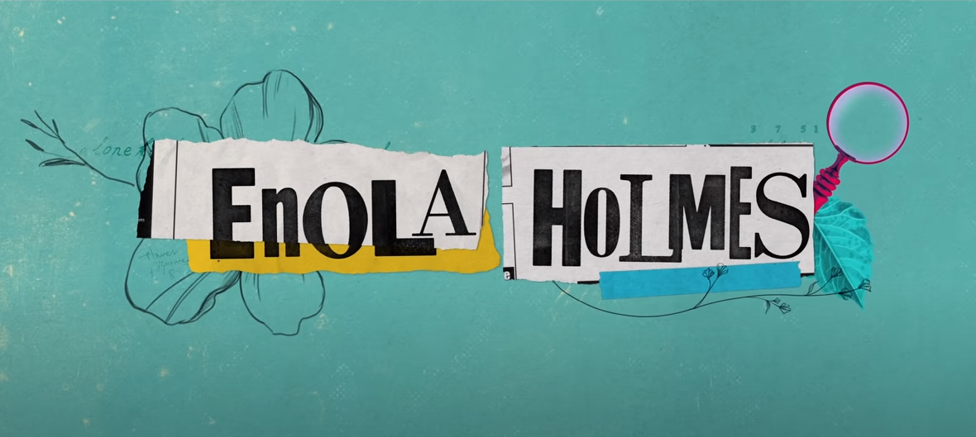

Enola homes.
I bet you’ve heard of Sherlock homes the famous detective, but have you heard of Enola homes this movie talks about Sherlock’s sister Enola, and her adventure in the real world trying to find her mom who has gone missing by solving mysteries along the way.

Slide 3
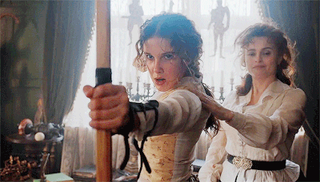

Enola starts telling her tail on her bice explaining
‘’my mom named me Enola she insisted on it in fact ‘’ Enola goes on to explain that her name may seem unordinary but it was because her mother was a fan of word games Enola backward spells alone her mom would always tell her ‘’Enola you will do very well alone’’ and yet they were always together.
She was no ordinary mother she didn’t teach Enola to string seashells or do enbrodori they did different things reading, science, and sports. One day Enola awoke to find her mother gone now she is on her way to meet her brothers Sherlock and Mycroft homes whom she hasn’t met in years

Slide 4


sherlock
Played by :henry Cavill
Who also played superman
Two homes are better than one Sherlock (Enola’s older brother) is shown to be a consulting detective. IN HIS RETURN TO VISIT ENOLA TO VISIT ENOLA HE DOESN’T HAVE MANY MEMORIES OF HER HE REMembered Enola used to pull a decorated pinecone calling it dash. This angered their father and Eudora kept dash under her pillow before her disappearance.
Early life: Sherlock homes is BORN TO MR.HOMES AND EUDORIA HOMES HE IS THE YOUNGER BROTHER OF MYCROFT HOMES AND AN OLDER BROTHER TO ENOLA HOMES .

Slide 5
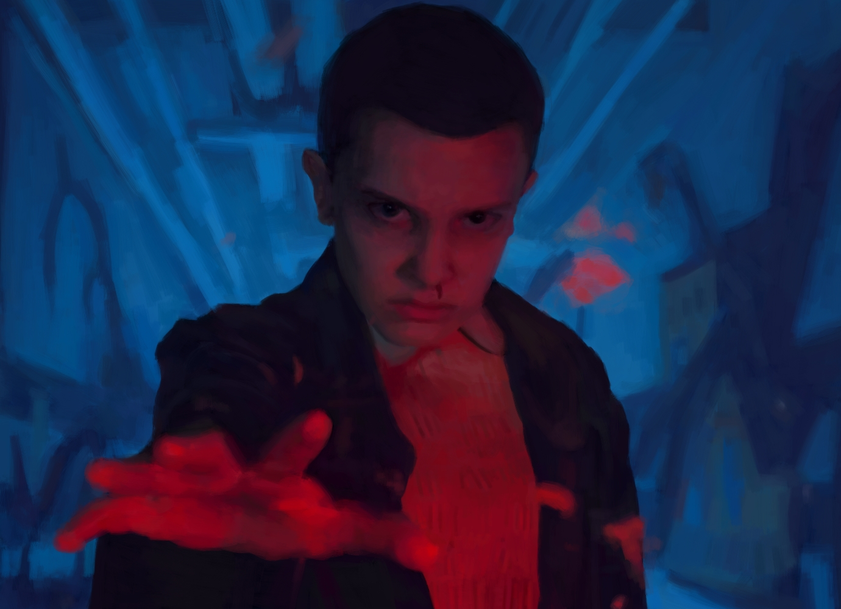
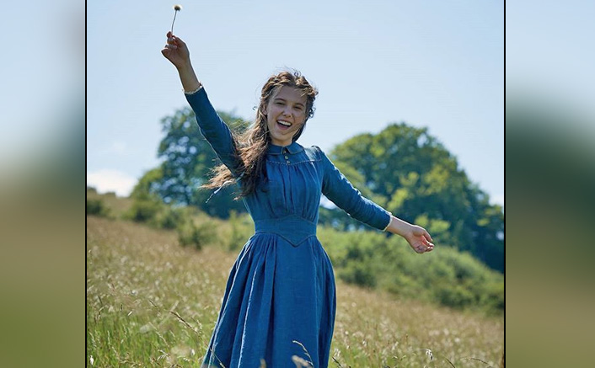
enola
Played by : Milly Bobbie brown
Also played 11 from stranger things
The main character, and a strong young lady, with a lot of smarts

Slide 6

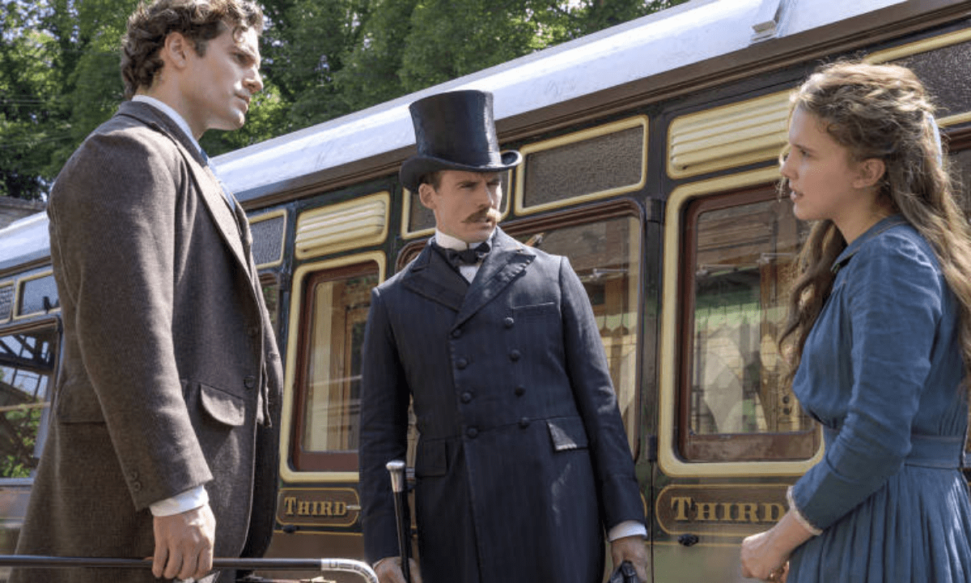
Mycroft played by:sam Claflin who played in pirates of the carabian
Sherlock and Enola’s older brother Mycroft tries to take control of Enola’s life when their mother has gone missing

Slide 7

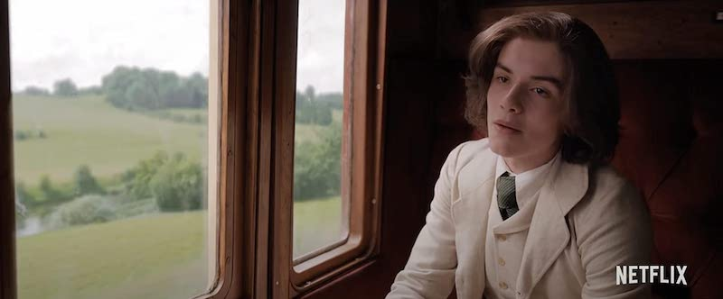
Later on (skipping some details)
Enola in the escape of Mycroft and in the hope to find her mother hops on a train when she heard a sound from the nearby giant bag out came lord Tewksbury after a long conversation they find out Tewksbury is being hunted by a murderer so Enola helps him escape and they jump off the train later they split up but after enola’s long way to find her mother she solves the mystery of lord Tewksbury wich is

Slide 8
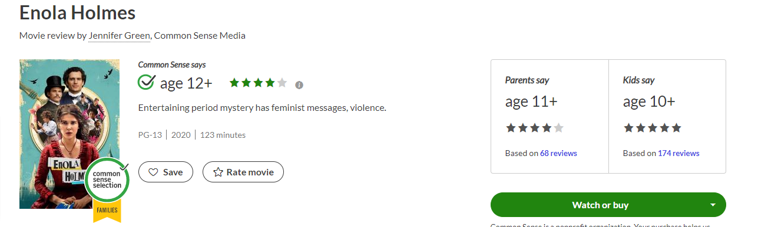
rated

Slide 9
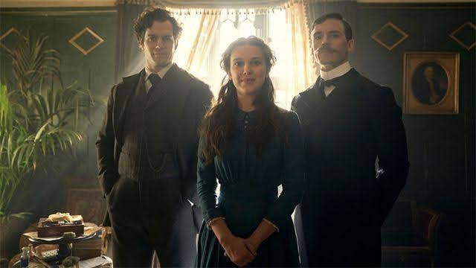

In conclusion
Enola homes is a movie that shows women independents an mystery solving it is my favorite movie because it contains suspense and has a lot of twists that get you thinking what is gonna happen next

Slide 10
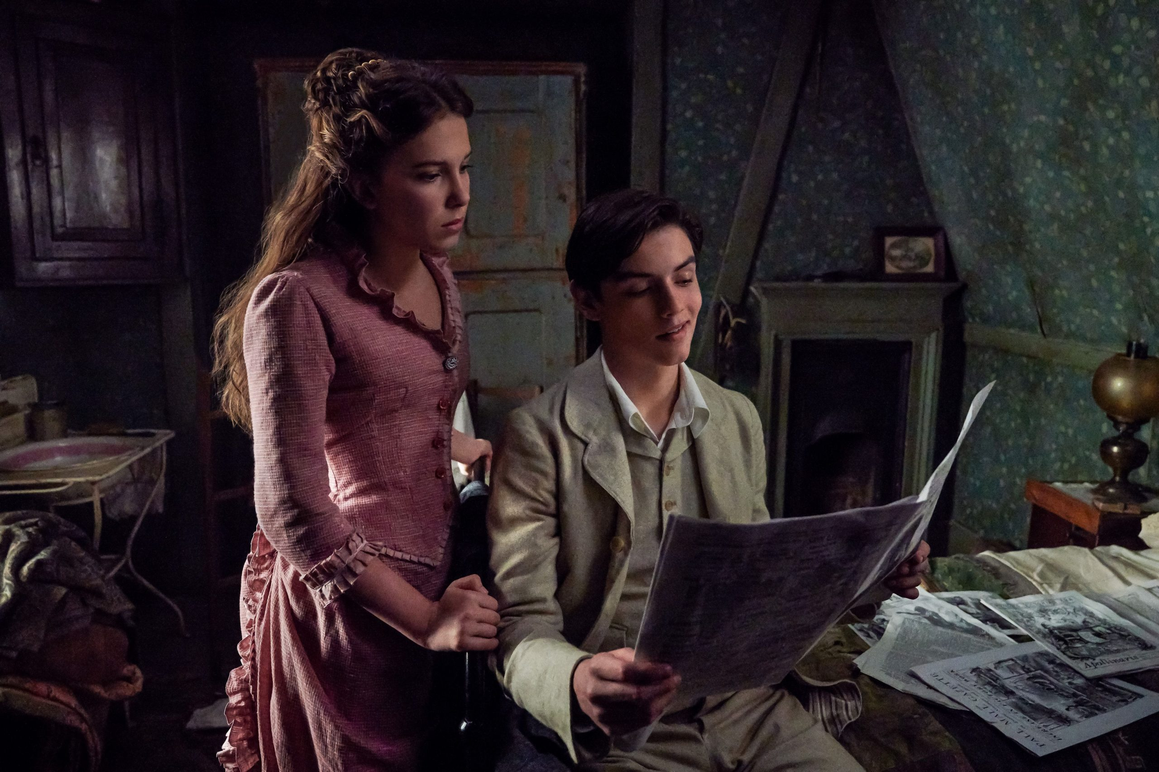
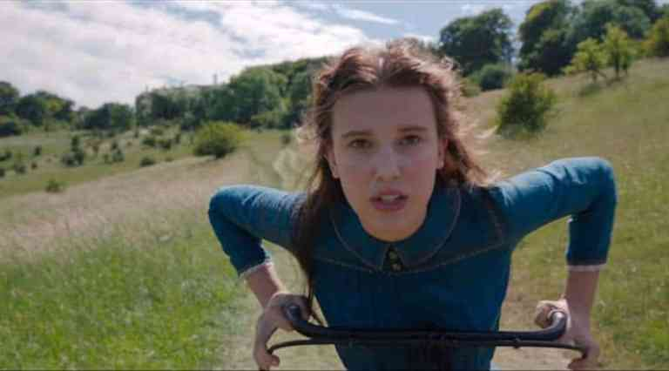
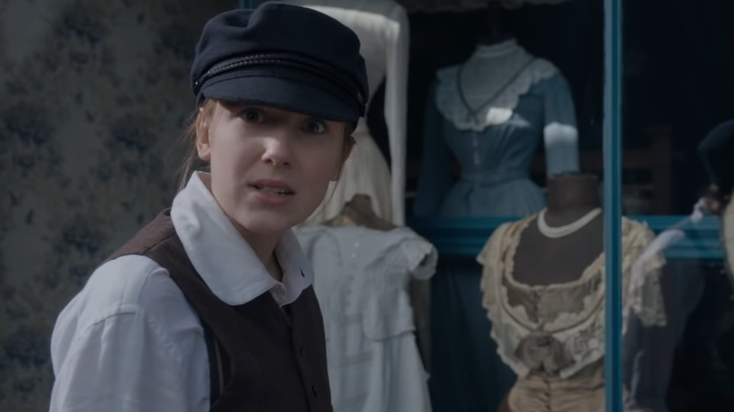
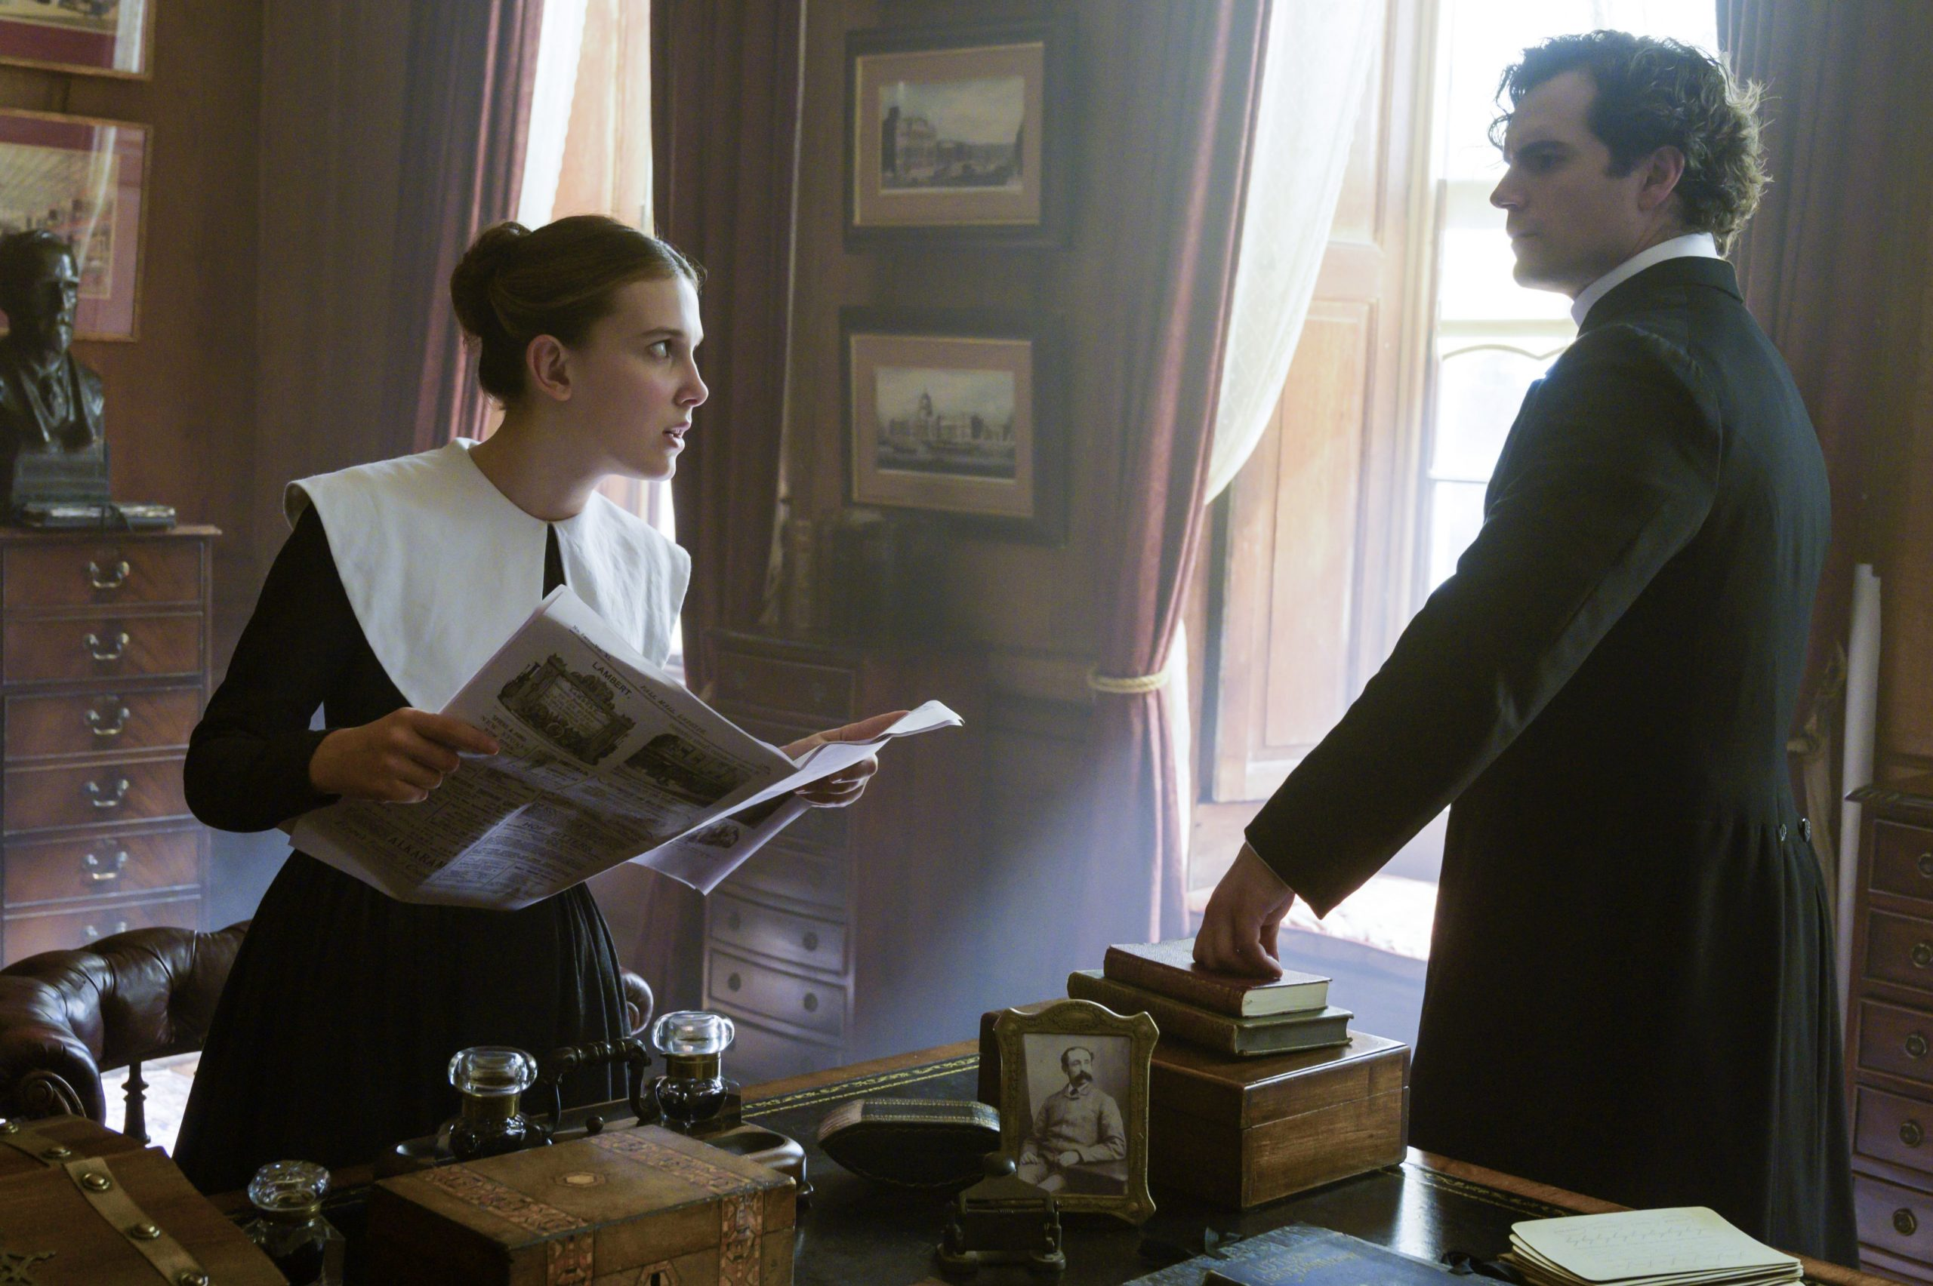
Thank you

