Slide 1
Aladdin
By Alba Lara

Slide 2
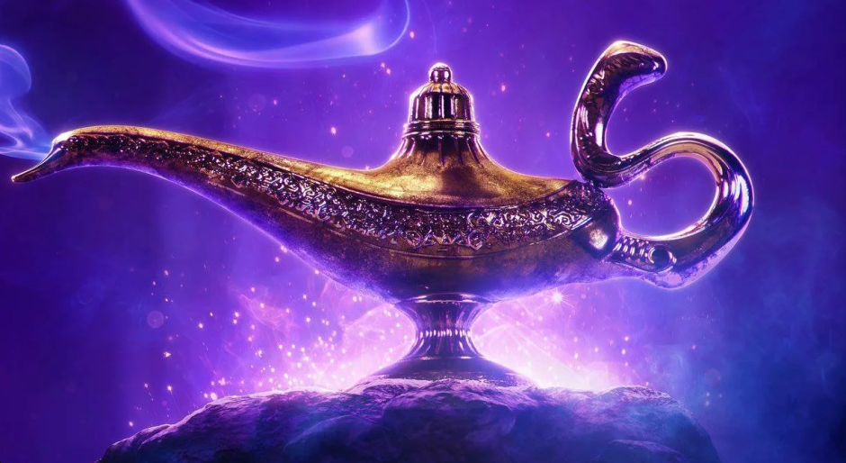
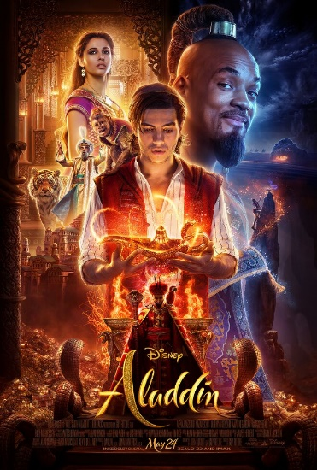
What is Aladdin about?
Aladdin is a music fantasy film that was directed by Guy Ritchie.
it is a live-action adaptation of Disney's 1992 animated film of the same name, which itself is based on the eponymous tale from One Thousand and One Nights.
Aladdin, an orphaned street urchin in the Arabian city of Agrabah, and his monkey Abu meet Princess Jasmine, who has snuck away from her sheltered life in the palace. She wishes to succeed her father as Sultan, but is instead expected to marry one of her royal suitors. Jafar, the grand vizier, schemes to overthrow the Sultan and seeks a magic lamp that only "the diamond in the rough" can retrieve.

Slide 3
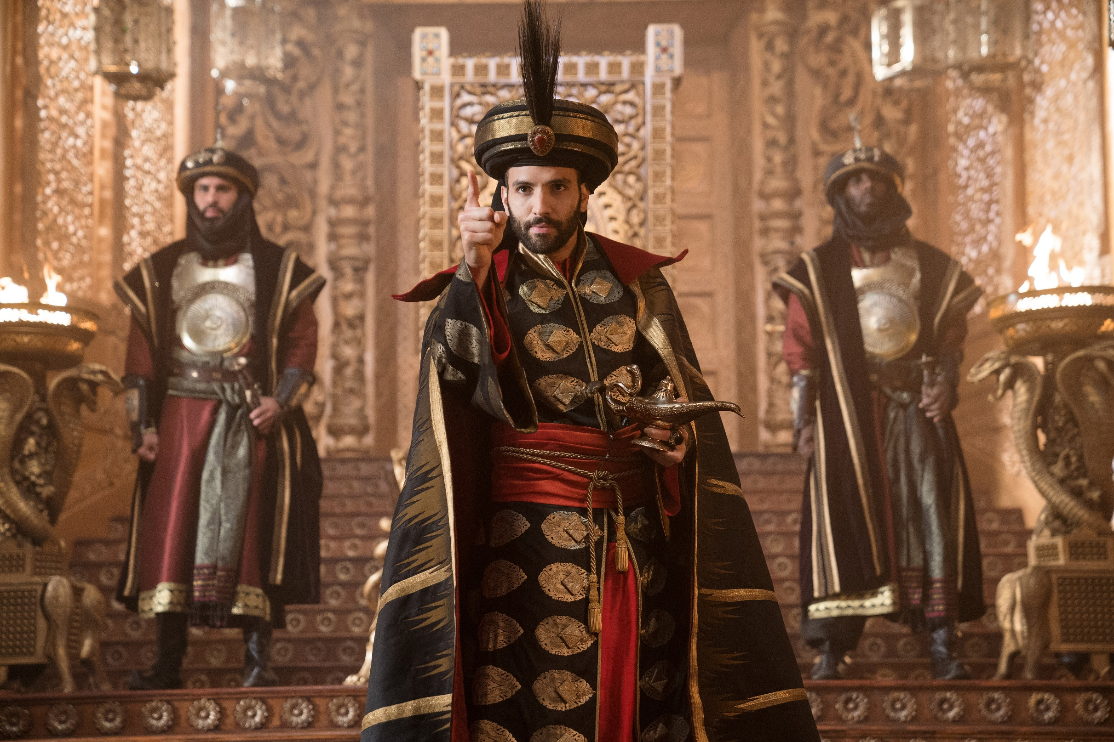
Who are the main characters in the story ?
Aladdin : Mena Massoud
Jasmine: Naomi Scott
Genie: Will Smith
Jafar: Marwan Kenzari

Slide 4
Thank you for listening ☺

