Slide 1
Yes Day
By Joury Bader

Slide 2
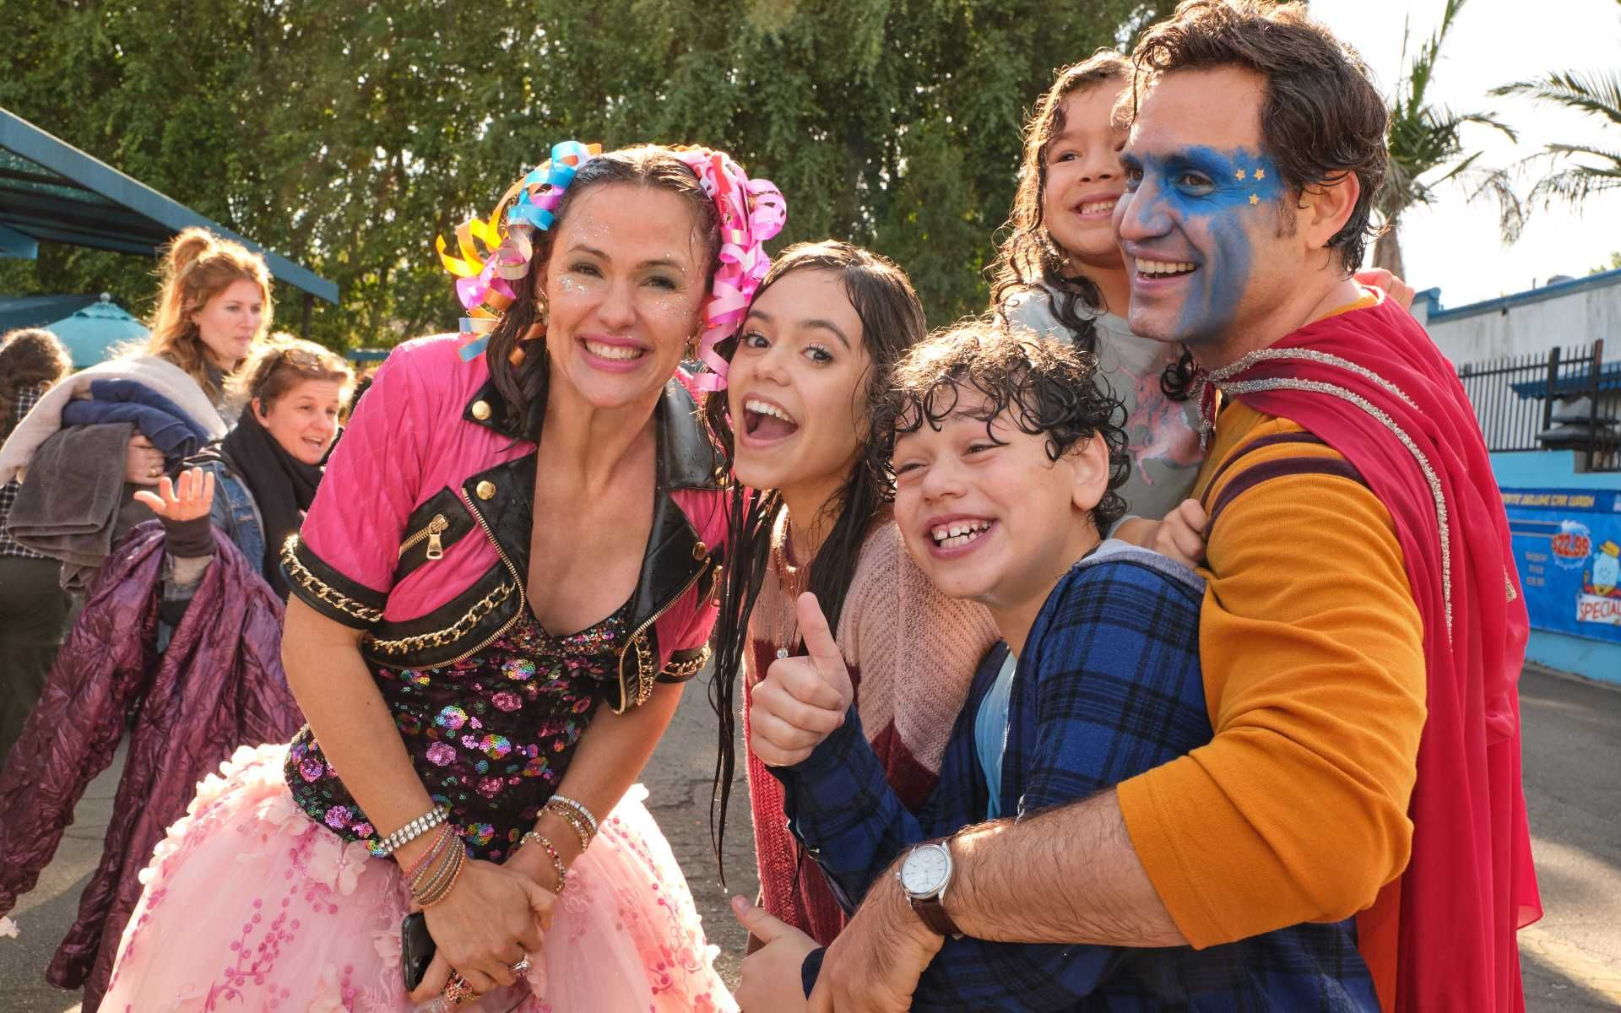
What is yes day about
Yes day is an American comedy movie targeted for children, about two parents that get bored of always saying no to their children. They were recommended to have a yes day challenge by other parents but it doesn’t go very well

Slide 3
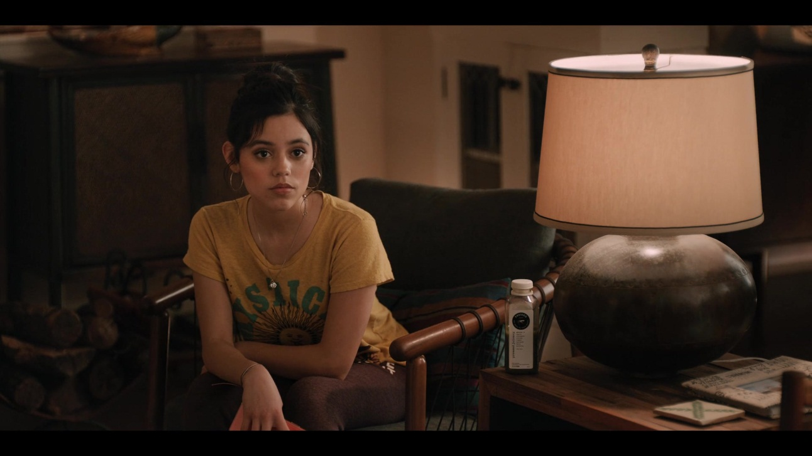
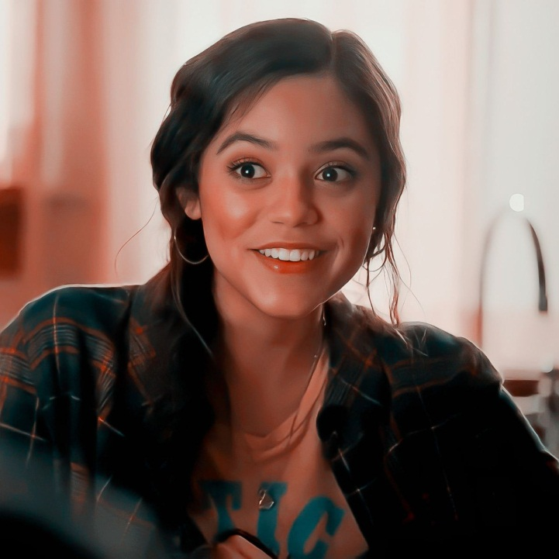
Katie Torres
Katrina Torres who likes to go by Katie is a kind teenage girl. She is the oldest sibling in the family, and is usually out with her friends or on her phone. She likes to dance and is a social smart selfless girl

Slide 4
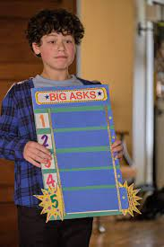
Evan Torres
Evan Torres is the middle child.
He seems to be very
crazy and immature
sometimes, he loves
playing all day and
breaking rules, so he
really enjoyed yes day.
He is mischievous and
sarcastic.

Slide 5
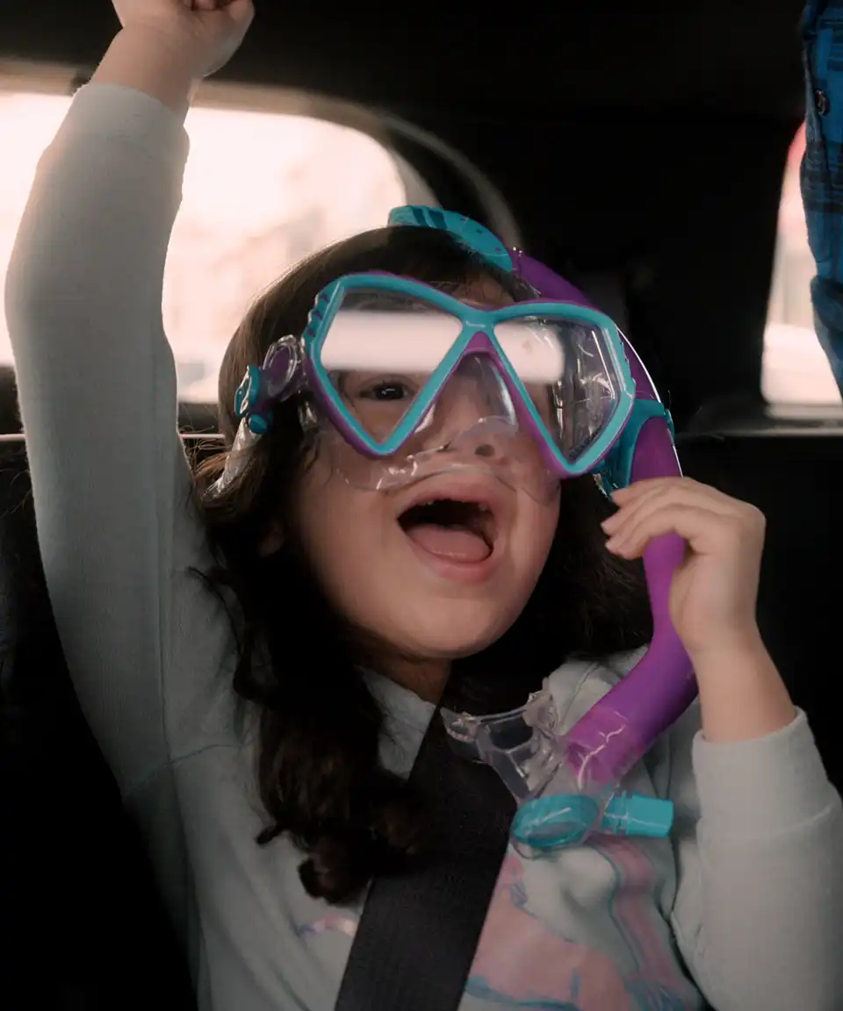
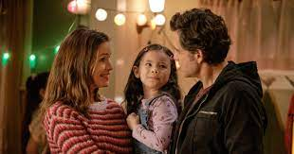
Ellie Torres
Ellie Torres is the youngest and cutest. She is very sweet and playful, she loves to sing and dance, and is very creative for her age. Ellie gets along with everyone she meets.

Slide 6
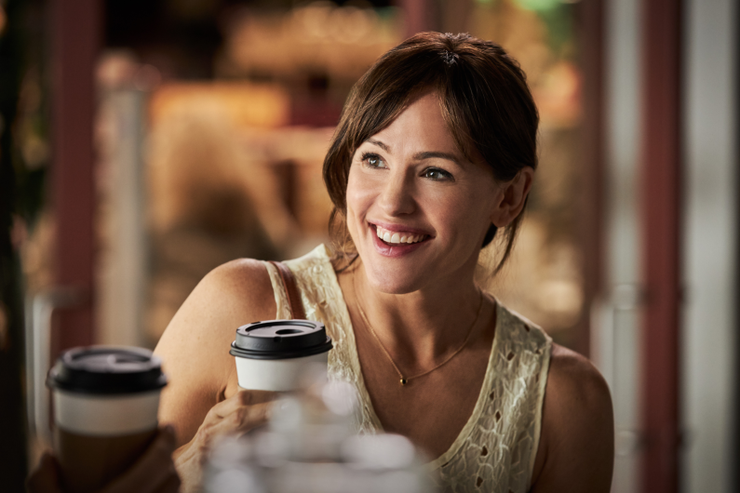
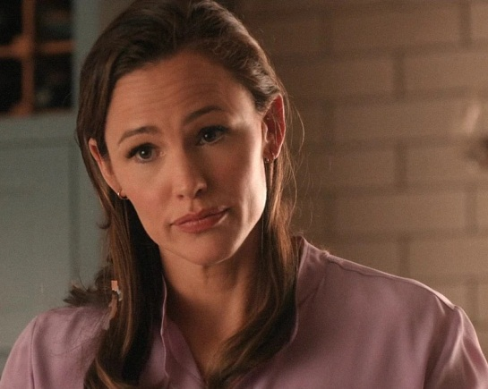
Alison Torres
Alison Torres is the mother of Katie Evan, and Ellie. She is very caring and sweet. She used to be very crazy, and she would enjoy everything, no matter what the situation was the first thing she’ll answer with is yes. Ever since she became a parent she was strict and overprotective, so it took her a lot of persuading to have a yes day. After she finally agreed she realized she regretted every time she said no to her kids.

Slide 7
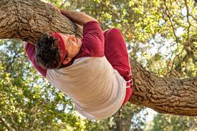
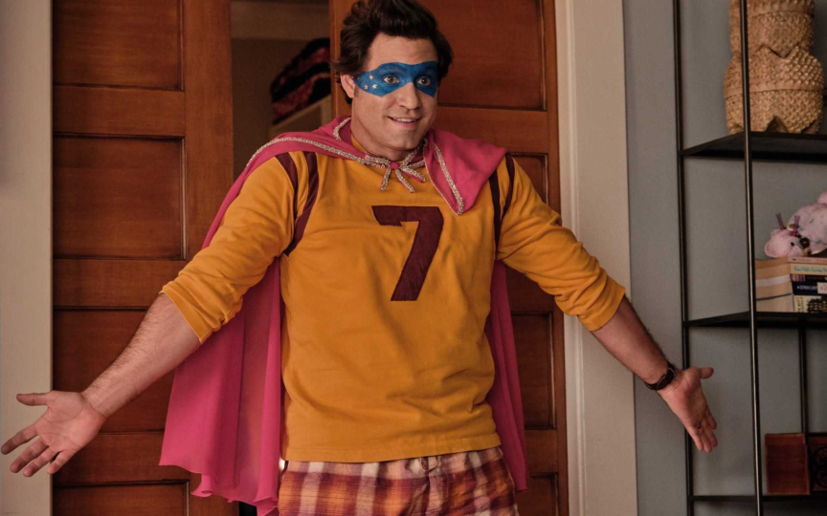
Carlos Torres
Carlos Torres is the crazy father of Katie Evan and Ellie. He always finds a way to have fun, and is very supportive to his children. He’s always been very humorous and sarcastic similar to his son Evan.

Slide 8
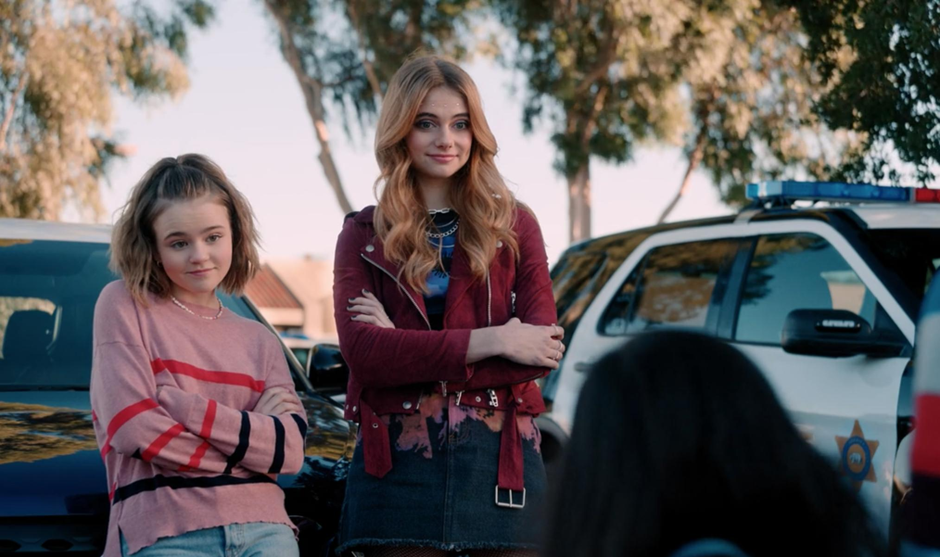
Layla
Layla is the best friend of Katie. She is very popular and differently a rule breaker after she tried sneaking into a concert with her best friend Katie. Layla is very selfish and not the nicest.

Slide 9
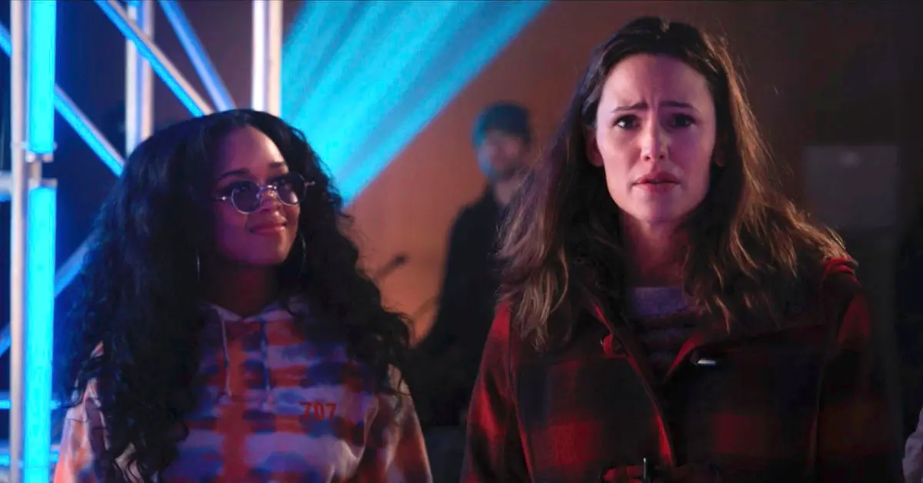
H.E.R
H.E.R is a singer in and outside the movie. She helps Alison find her daughter Katie after realizing her daughter was missing. H.E.R is a very kind and helpful person.

Slide 10
I recommend you watch yes day since it’s a very funny and entertaining movie for all age
Thank you

