Slide 1
Pacific Ocean
By Kareem, Adam alsafadi, Rayan, Saif gamoh,Khalil saba

Slide 2
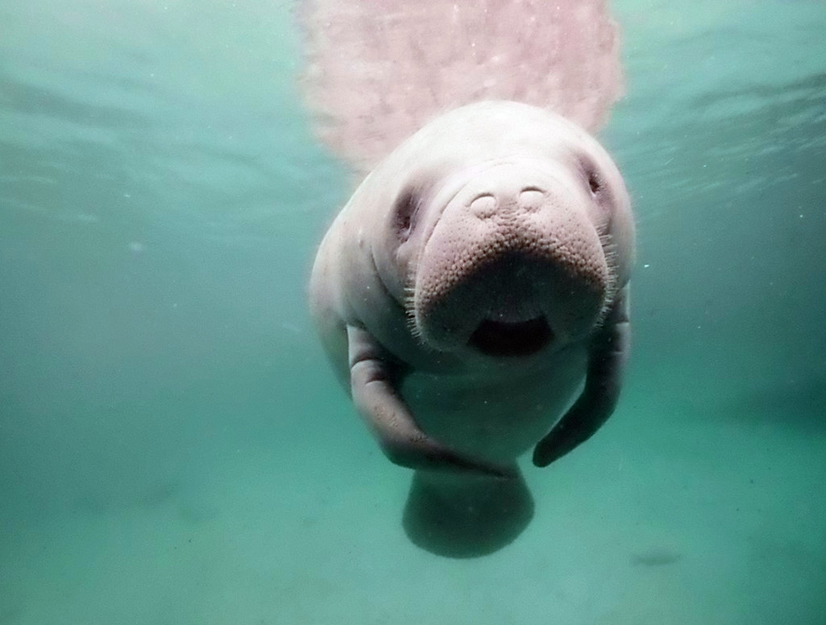
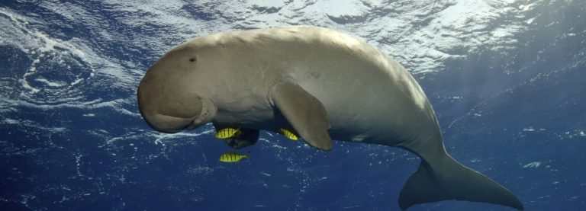
Dugong
The dugong is a endangered marine animal. The dugong is an omnivore and feeds on mostly seagrass and sometimes invertebrates such as: jellyfish, sea squirts, and shellfish.
The dugong is also nicknamed “sea cow” as it eats lots of sea grass.
The dugong has an important purpose that their constant browsing of seagrass encourages regrowth - ensuring critical habitat and feeding sites for a host of other marine species, including turtles, dolphins and sawfish. We can save the dugongs by not littering .
This Photo by Unknown Author is licensed under CC BY-SA-NC

Slide 3
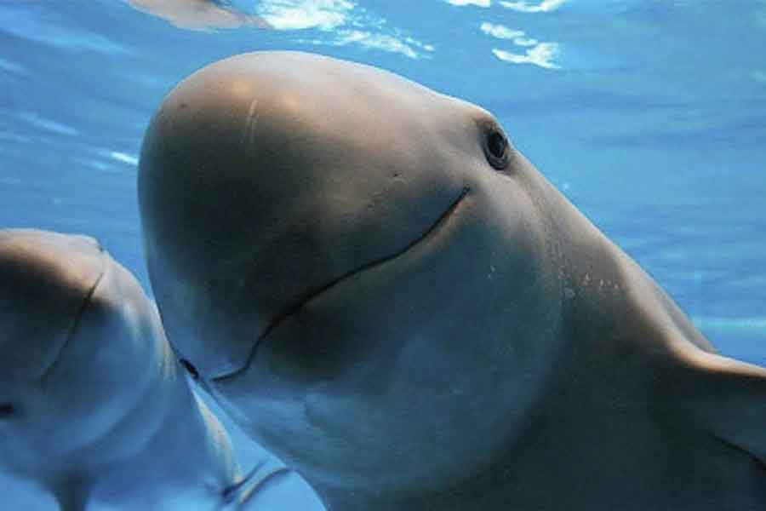
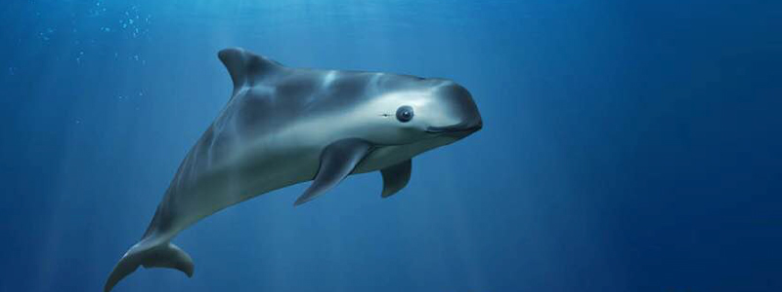
Vaquita
Vaquita, the world's rarest marine mammal, is on the edge of extinction. The vaquita has a large dark ring around its eyes and dark patches on its lips that form a thin line from the mouth to the pectoral fins. the vaquita is a marine mammal. The vaquita is the most endangered animal in the ocean as there are believed that there are 10 vaquitas left IN THE WORLD. We can lower the risk of them going extinct by stopping to look for them and to not litter in the ocean.

Slide 4
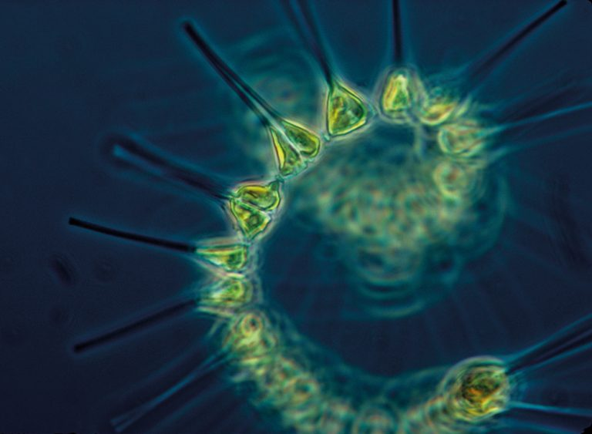
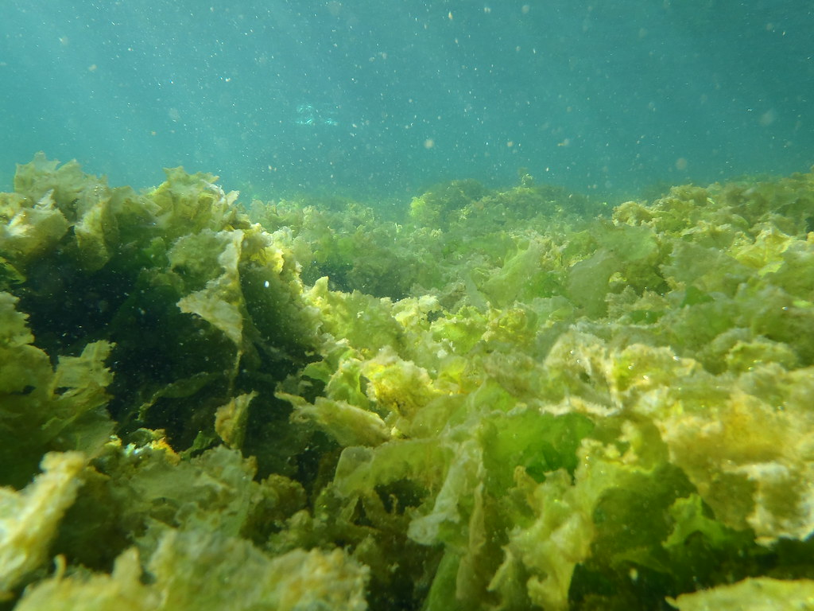
phytoplankton
Phytoplankton, also known as microalgae, are similar to terrestrial plants in that they contain chlorophyll and require sunlight in order to live and grow. Most phytoplankton are buoyant and float in the upper part of the ocean, where sunlight penetrates the water.

Slide 5
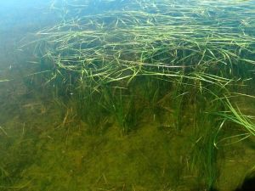
Phyllospadix japonicus
Phyllospadix japonicus, known as Asian surfgrass, is a plant species found along the seacoasts of Japan, Korea, China (Hebei, Liaoning, Shandong). It occurs in the intertidal zone along the shore.
Since the establishment of extensive kelp algal aquaculture, a large proportion of this seagrass species has been permanently removed, sometimes as a result of dynamite fishing in Japan. Shoreline hardening is also a major threat for Asian Surf Grass.
This Photo by Unknown Author is licensed under CC BY-NC

Slide 6
Thank you!

