Slide 1
Biology Assignment
By Luna Ababneh , Maria Janho and Saba Siam

Slide 2
Tropical Rainforest
There are many endangered animals in the tropical rainforest. One of the endangered animals is the jaguar.

Slide 3
Information about Tropical rainforest
Tropical rainforests are the most biologically diverse terrestrial ecosystems in the world. The Amazon rainforest is the world’s largest tropical rainforest. It is home to around 40,000 plant species , nearly 1,300 bird species , 3,000 types of fish, 427 species of mammals , and 2.5 million different insects . There is a lot of rain , a lot of sunlight and high biodiversity .
Tropical rainforests cover less than 3% of the planet , yet they are home to more than half our planet’s terrestrial animal species.

Slide 5
The adaptations that the jaguars have to live in the tropical rainforest
Jaguars have adapted to the wet environment of the tropical rainforest . They are excellent swimmers , and unlike other cats, they seek out water for bathing and swimming. The jaguars fur keeps it camouflaged in the tropical rainforest.

Slide 6
Information about jaguars
The word jaguar comes from the indigenous word yaguar which means
(He who kills with one leap.)
There are around 173,000 jaguars left in the whole world today , and most of these big cats are found in the Amazon rainforest and the Pantanal , the largest tropical wetland.
Their stronghold is in Brazil –it may hold around half of the estimated wild numbers.
The jaguar is the third biggest cat in the world-after the tiger and the lion-and is the largest cat in the Americas.
They can grow up to 170cm long , not including their impressive tails which can be up to 80 cm .
They are good swimmers.
Jaguars are larger and stronger than cheetahs.
Jaguars can hit a blazing speed of 50mph , but cheetahs are an absolute blur, running at 70mph or more to take down their prey.

Slide 7
Population of jaguars
The population began at approximately 300,000 jaguars and has now decreased to an estimated 15,000.

Slide 8
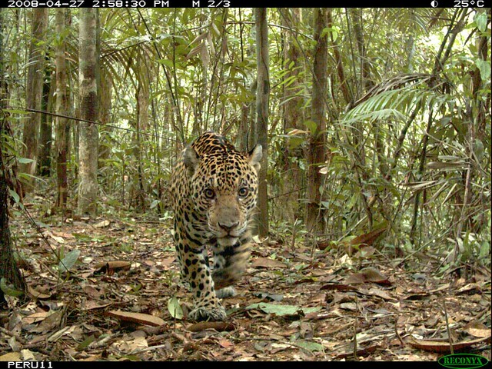
Reason of extinction
Sadly , they have lost half of their historic range mainly due to habitat loss. Today , this majestic animal is mostly restricted to the tropical rainforests of the Amazon and in the nearby Pantanal wetlands.
This Photo by Unknown Author is licensed under CC BY-NC-ND

Slide 9
What is being done now to preserve?
Controlling access to and the use of natural resources.
Monitoring jaguar populations and prey populations across the spectrum of land.
Developing local capacity to manage and protect natural areas

Slide 10
We hope you like it
This Photo by Unknown Author is licensed under CC BY
This Photo by Unknown Author is licensed under CC BY-NC

