Slide 1
WEDNESDAY
Saama Dababneh 6b
English third month project

Slide 2
What is the show about?
This Netflix show follows WEDNESDAY ADDAMS and her journey at a new school called nevermore filled with outcasts, but ever since she has entered this school all bad things start revolving around her. Although this has never been a problem she struggles with she does not seem to enjoy the murders or injuries of her friends.

Slide 3
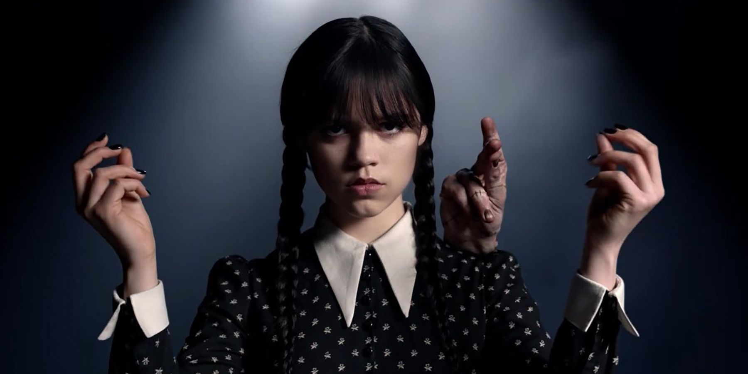
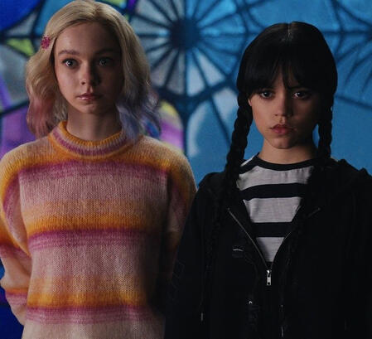
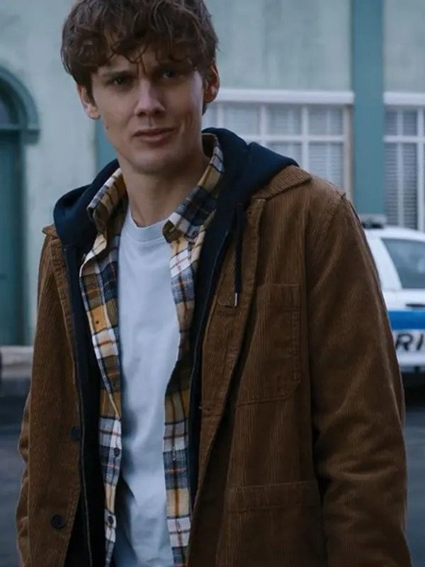
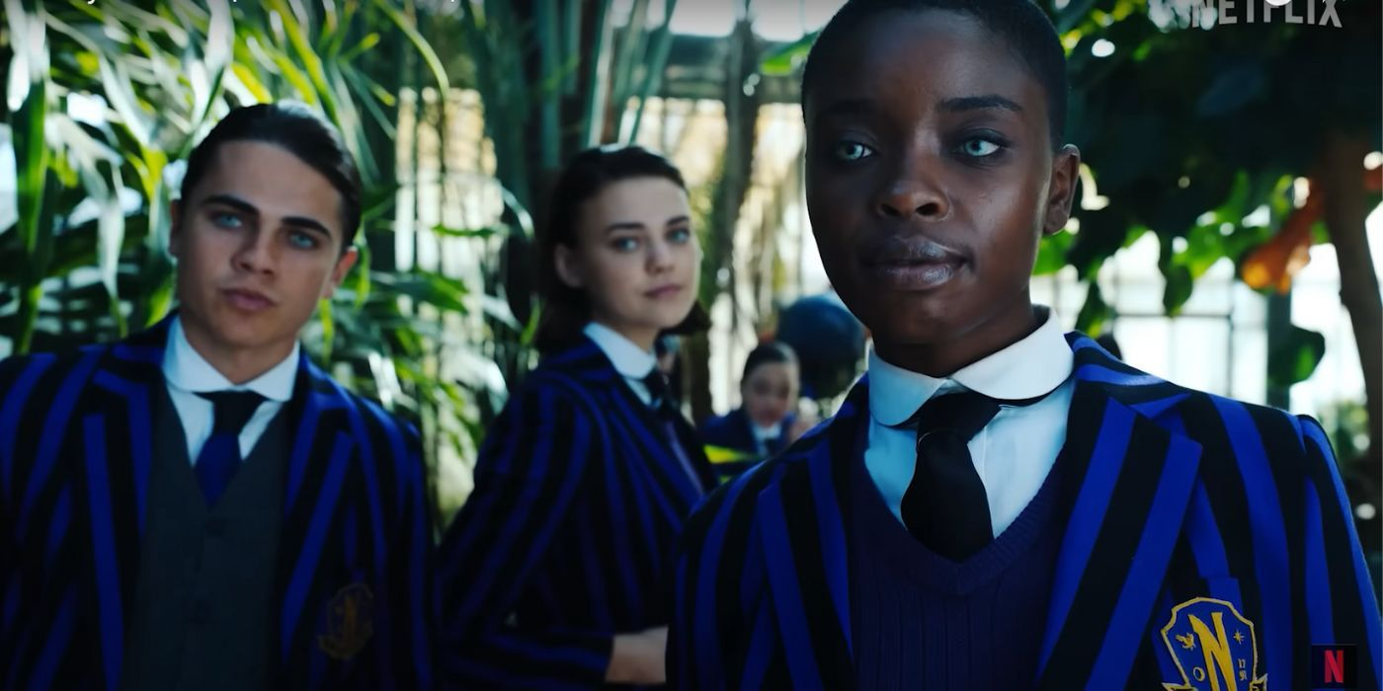
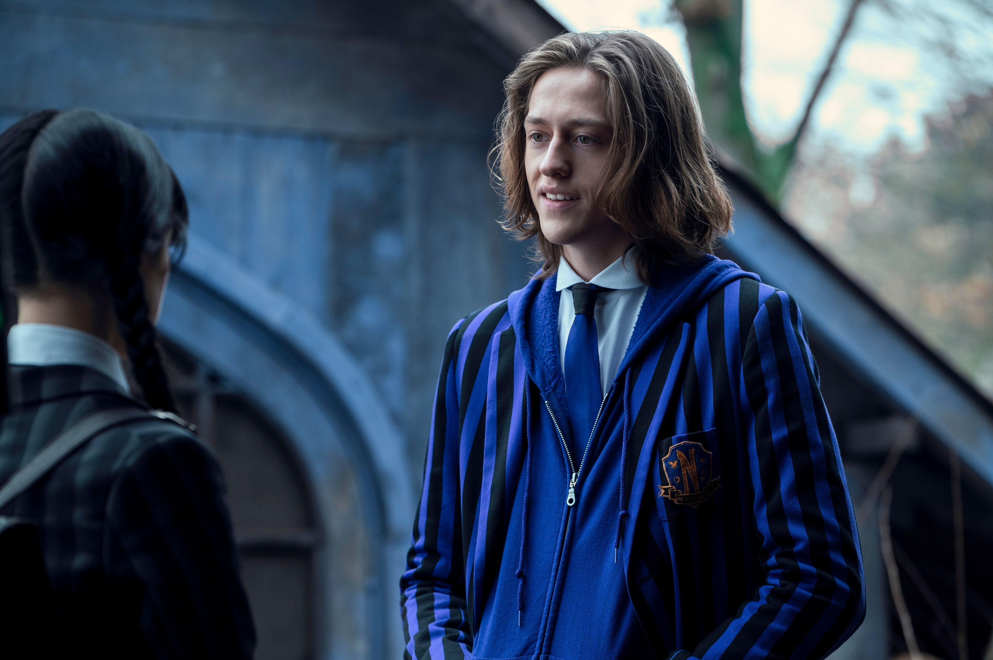
Main characters.
The main character is Wednesday Addams the character that originated from the Addams family movie in 1964. further along her journey at nevermore she meets ENID SINCLAIR her roommate and also a very important character in her story. Next person she meets is Bianca Barclay who they are both enemies for a while they seem to get along as we move deeper into the story. Next we meet Xavier Thorpe and we later find out that he is an extremely interesting character. Then lastly we meet Tyler Galpin who is a bigger surprise than you would expect.

Slide 4
Why this is my favorite show?
This is my favorite show because of its suspense and nerve recking plot twist, and of course the amazing cast and their roles. My favorite character of all time is Xavier Thorpe, because I feel that he was very misunderstood and heartbroken and he had a deeper personality than you’d expect. And I also like ‘Thing’ and Uncle Fester because they always had a way of getting to Wednesdays real personality. And of course Enid Sinclair also played apart in helping Wednesday open up to the school and most importantly herself.

Slide 5
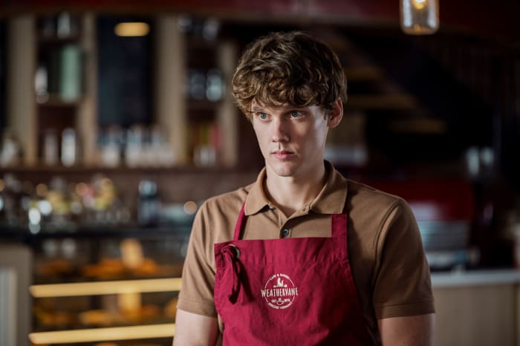
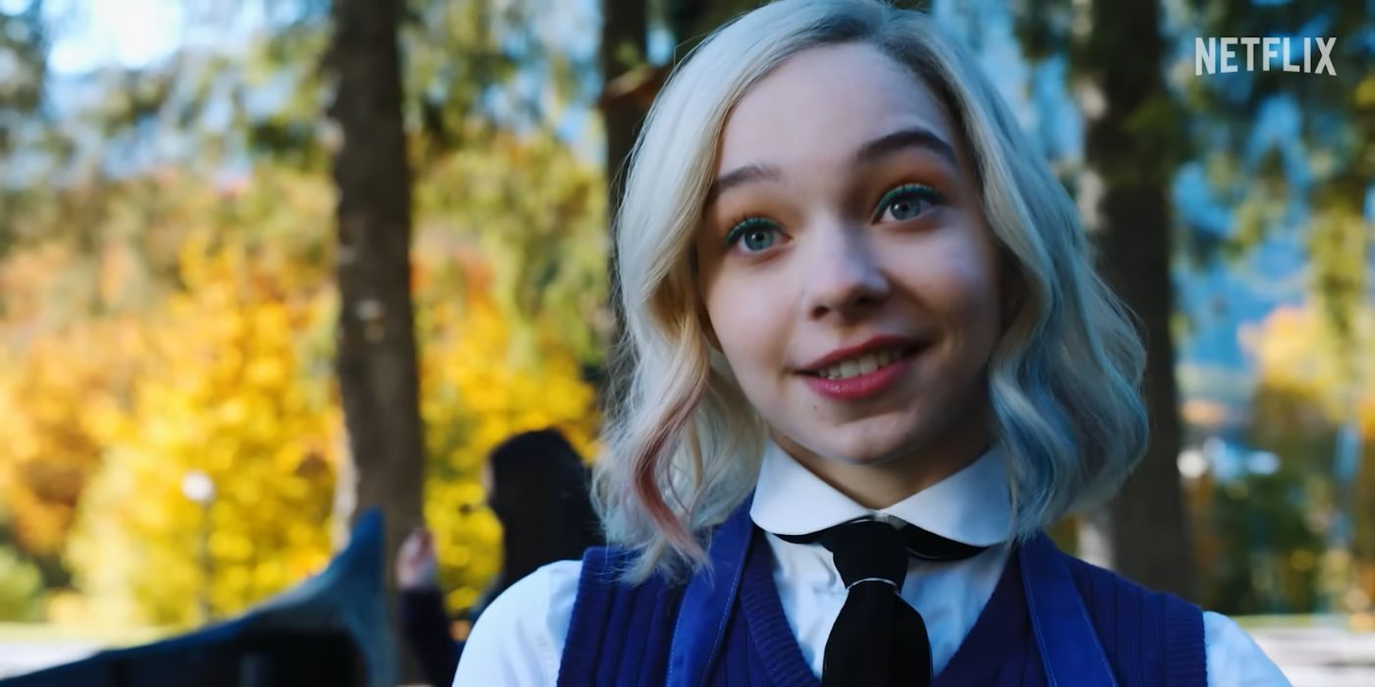
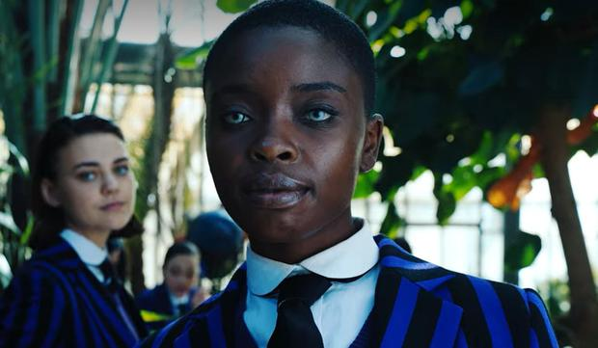
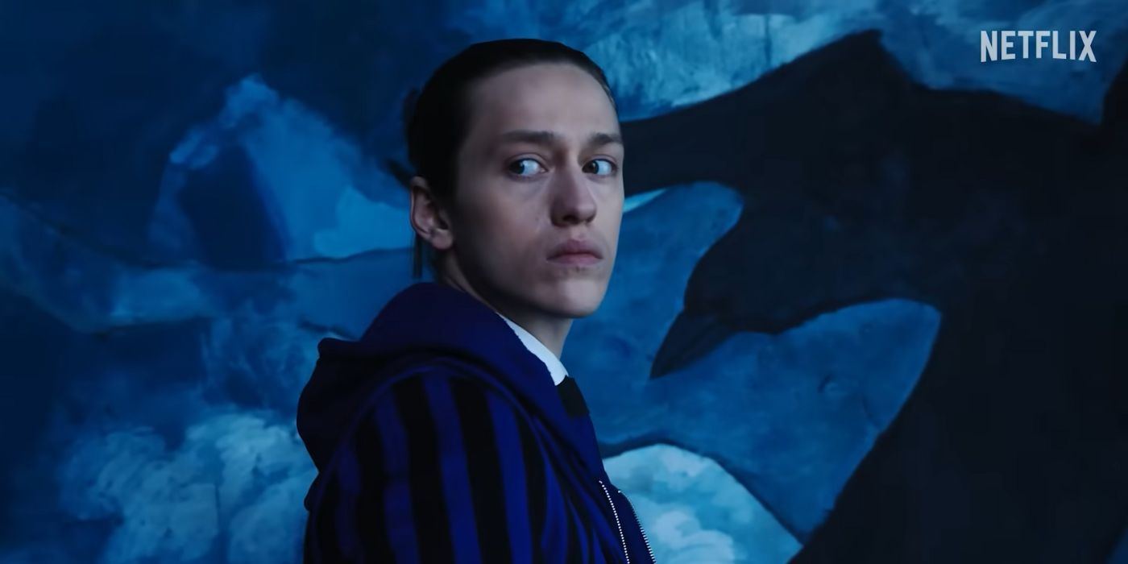
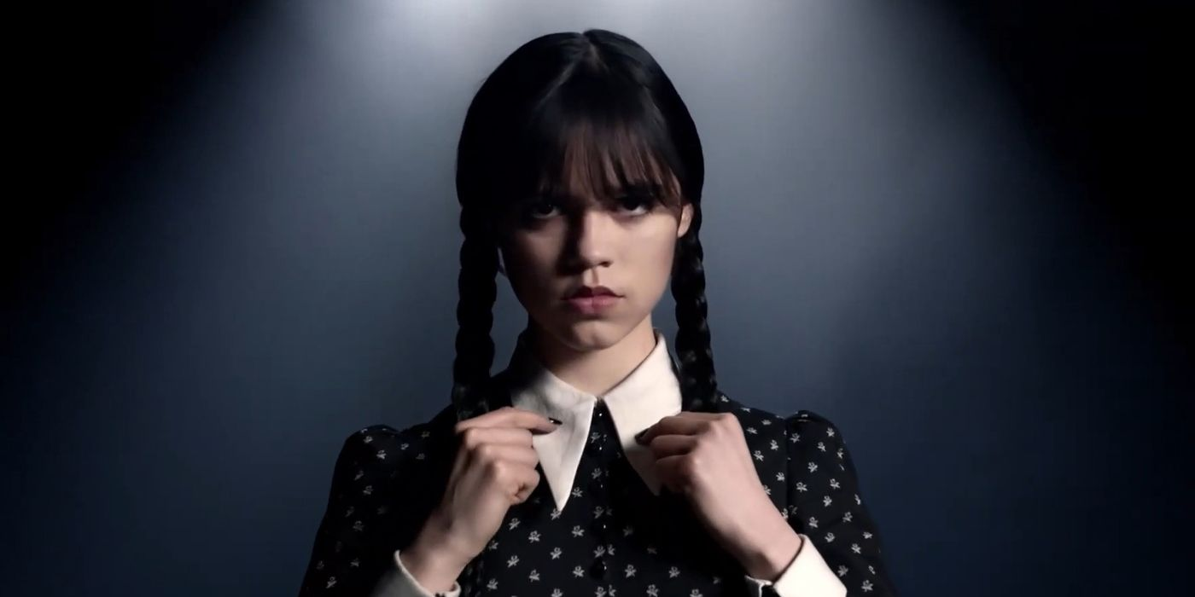
Thank you for listening !!!!!!!!

