Slide 1
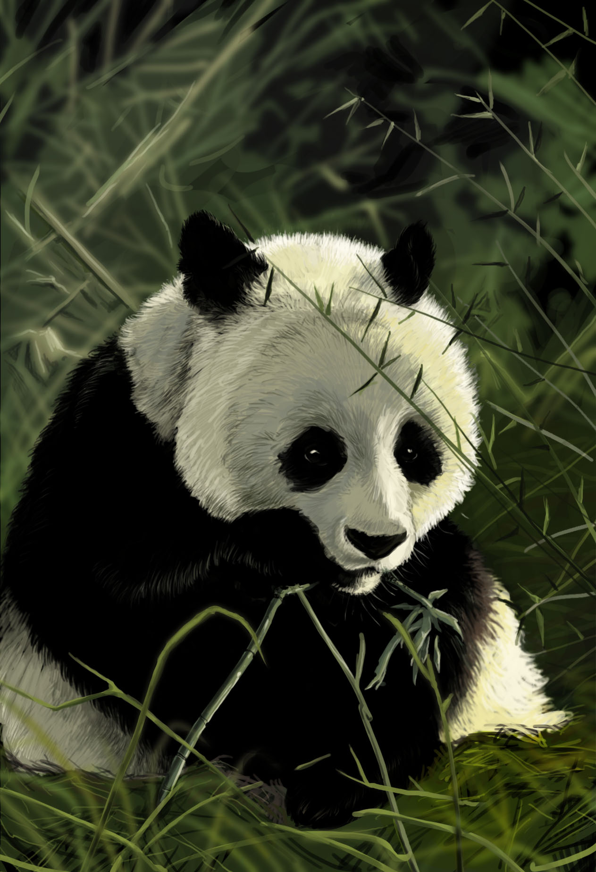
Endangered Animal Giant Panda
Biology powerpoint
Prepared by:
Laith Batshoun Michael Said
This Photo by Unknown Author is licensed under CC BY-NC-ND

Slide 2
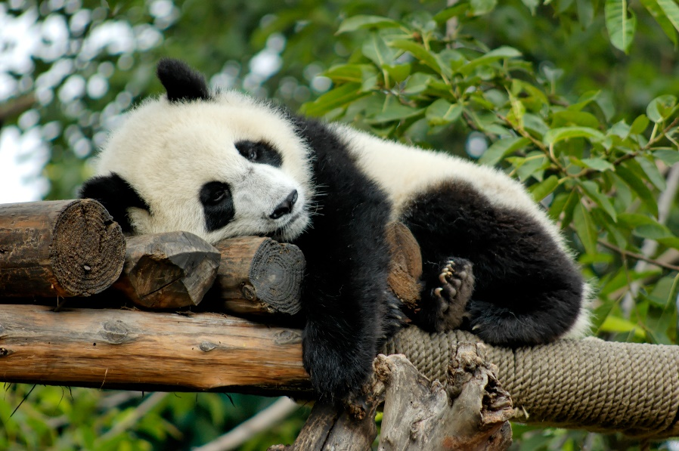
Giant Pandas life now and then
Facts. Despite their exalted status and relative lack of natural predators, pandas are still at risk. Severe threats from humans have left just over 1,800 pandas in the wild.
This Photo by Unknown Author is licensed under CC BY

Slide 3
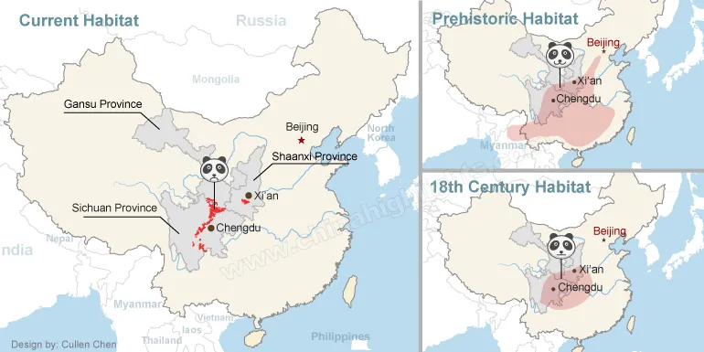
Giant Pandas life before and after
1,864 Pandas are living in the wild in China. And 100 Pandas live around the world in zoos.
Panda Habitat Climate
Pandas require bamboo trees to feed and live, they are found in bamboo forests.
Bamboo requires a wet and cool climate to grow, so the climate of a Panda’s habitat is wet and cool.
High in dense bamboo forests in the misty, rainy mountains of southwestern China lives one of the world's rarest mammals: the giant panda, also called the panda. Only about 1,500 of these black-and-white bears survive in the wild.
Habitats Temperate broadleaf and mixed forests of southwest China

Slide 4
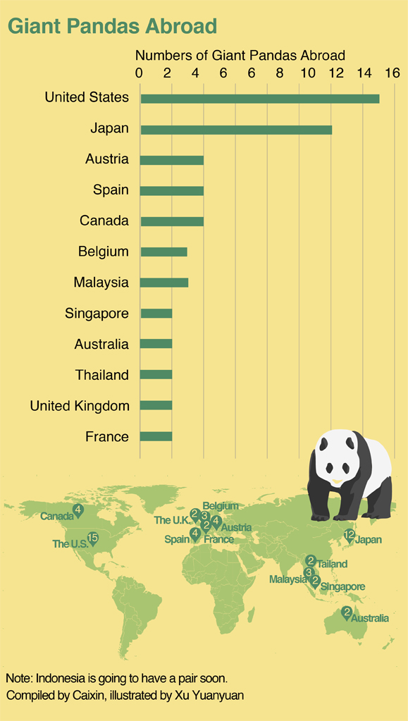
Reasons behind Giant Pandas Endangerment
Why Pandas are Endangered? – Giant Panda Threats
The main reason behind the endangerment of Pandas is habitat destruction.
The forests in China are being replaced by developmental projects due to the growth of the human population.
This is destroying the bamboo forests and pushing the Pandas into smaller and smaller habitats.
We must stop destroying the forests, otherwise, there will be no bamboo forests left and ultimately Pandas will go extinct due to lack of food.

Slide 5
How to preserve Giant Pandas
Protecting Panda Living conditions:
Pandas eat almost nothing but bamboo shoots and leaves. Occasionally they eat other vegetation, fish, or small mammals, but bamboo accounts for 99 percent of their diets.
Giant Panda Conservation – Giant Panda Protection
Pandas species are eight million old as compared to humans which are only two million years old, this makes them living fossils.
Giant Pandas have been recognized as an international treasure and have been under protection since the 1950s.
It is protected by China’s Wildlife Protection Law at national, provincial, and local levels.
Under this law, poachers and smugglers of Giant Panda are rewarded with the death penalty or life imprisonment.
Many natural reserves are now protecting giant pandas and The Wolong National Nature Reserve located in China, is the most famous giant panda reserve.
It has been recognized as China’s largest panda research institution that has been very successful in protecting pandas.

Slide 6
References:
https://www.worldwildlife.org/species/giant-panda
Giant Panda Facts and Pictures (nationalgeographic.com)
imgurl:https://image.slidesharecdn.com/project1-giantpandas-final-111109035607-phpapp02/95/giant-pandas-4-728.jpg?cb=1320811053 – Bing
Giant Panda Facts For Kids - Learn All About Pandas (kidzfeed.com)
http://Kidzfeed.com

