Slide 1
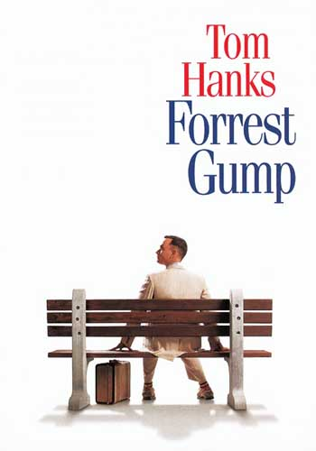
Forrest Gump
By: Adam Nemeh 6D

Slide 2
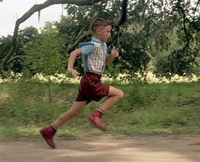
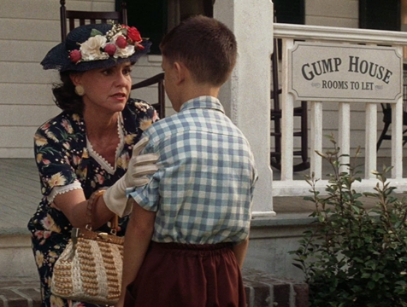
WHO IS FORREST GUMP?
Forrest, an innocent and kind-hearted Alabama boy, has been dealing with other people's unkindness nearly all his life. He was an only child. His mother raised him up alone the best she could and taught him everything she knew. Forrest yearns to learn all about the ways of the world and embarks on a mission to find his true purpose in life..

Slide 3
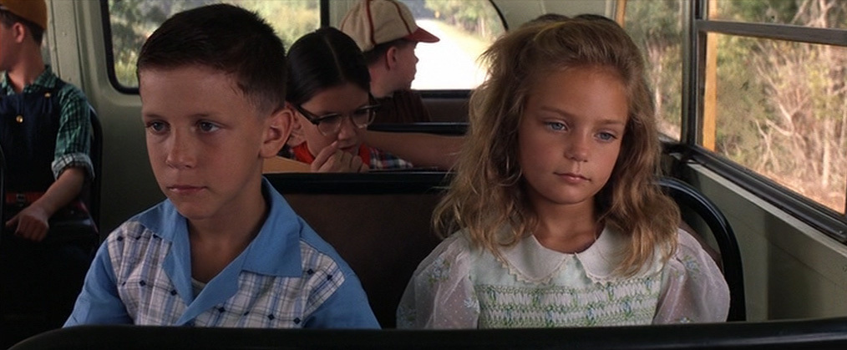
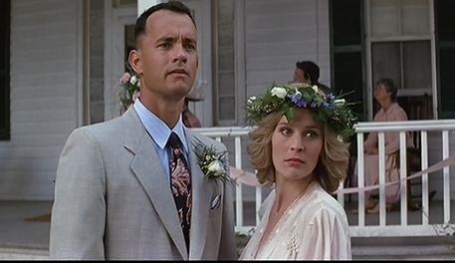
WHO IS JENNY CURRAN?
Jenny was the childhood friend and later wife of Forrest Gump, and the mother of Little Forrest. She had a rough childhood. When she met Forrest, she was a troubled girl who came from a broken home. She also was a beautiful person who cared about Forrest since the day they met.

Slide 4
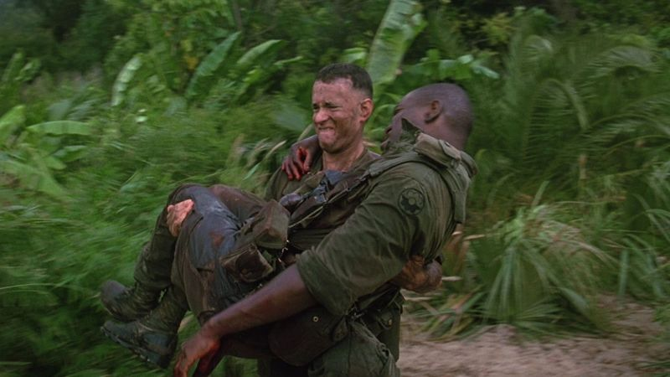
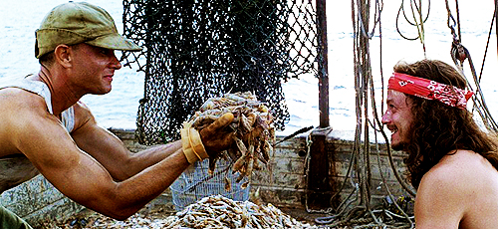
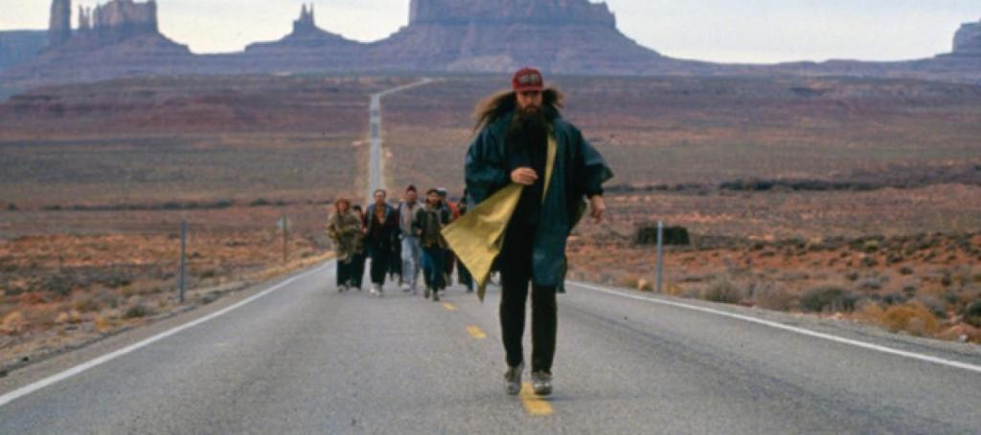
THE PLOT
Though many bullied Forrest at school and made fun of his legs, Forrest managed to join the football team and later joined the army. He serve his country well and saved many lives including his best friend’s, Lieutenant Dan, who later became his partner in the shrimp business. He also ran across the country for more than 3 years without stopping and many joined him before he decided to go back home.

Slide 5
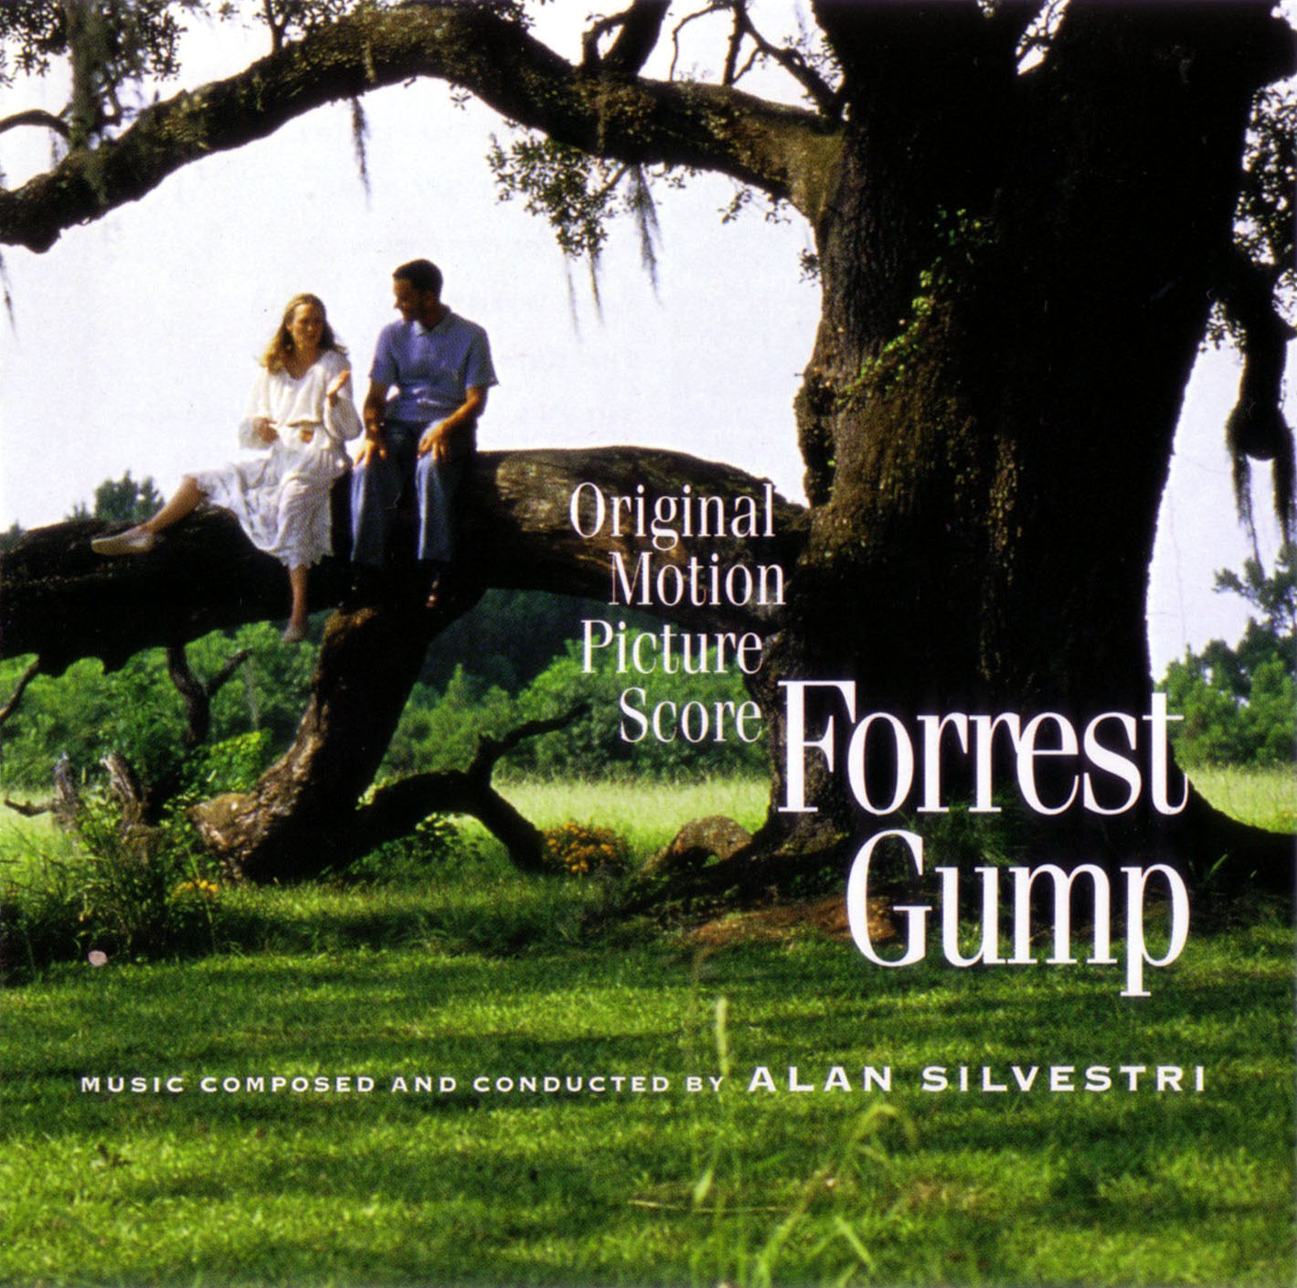
The End

