Slide 1
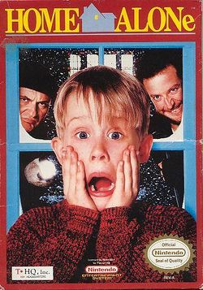
Home Alone
Presented By: Nabeel Ammari
6E

Slide 2
Home Alone
Home Alone: is a 1990 American Christmas comedy film directed by Chris Columbus and written and produced by John Hughes. The first film in the Home Alone franchise, the film stars Macaulay Culkin, Joe Pesci, Daniel Stern, John Heard, and Catherine O'Hara. Culkin plays Kevin McCallister, a boy who defends his suburban Chicago home from burglars after his family accidentally leaves him behind on their Christmas vacation to Paris.

Slide 3
Summary
The McCallister family is preparing to spend Christmas in Paris, gathering at Peter and Kate's home in a Chicago suburb on the night before their departure. Peter and Kate's youngest son, Kevin, is the subject of ridicule by his older siblings and cousins. Kevin inadvertently ruins the family dinner after a brief scuffle with his oldest brother Buzz, resulting in Kate sending him up to the attic. Kevin berates his mother for allowing the rest of the family to pick on him and wishes that his family would disappear. During the night, heavy winds create a power outage, disabling the alarm clocks and causing the family to oversleep. In the confusion and rush to get to the airport, Kevin is accidentally left behind.

Slide 4
Kevin overhears some burglars discussing plans to break into the house that night, Kevin rigs the house with booby traps.
The burglars break in, spring the traps, and suffer various injuries. While they pursue Kevin around the house, he calls the police and lures the duo into a neighboring house which they had previously broken into.
The burglars ambush Kevin and prepare to get their revenge, but the police arrive and arrest them, having identified all the houses that they broke into due to one of the burglars having destructive habits of flooding them

Slide 5
Thank you!

