Slide 1
spongebob
By Raad Atiyat

Slide 2
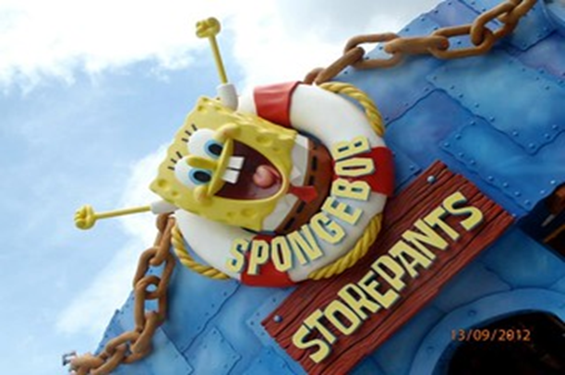
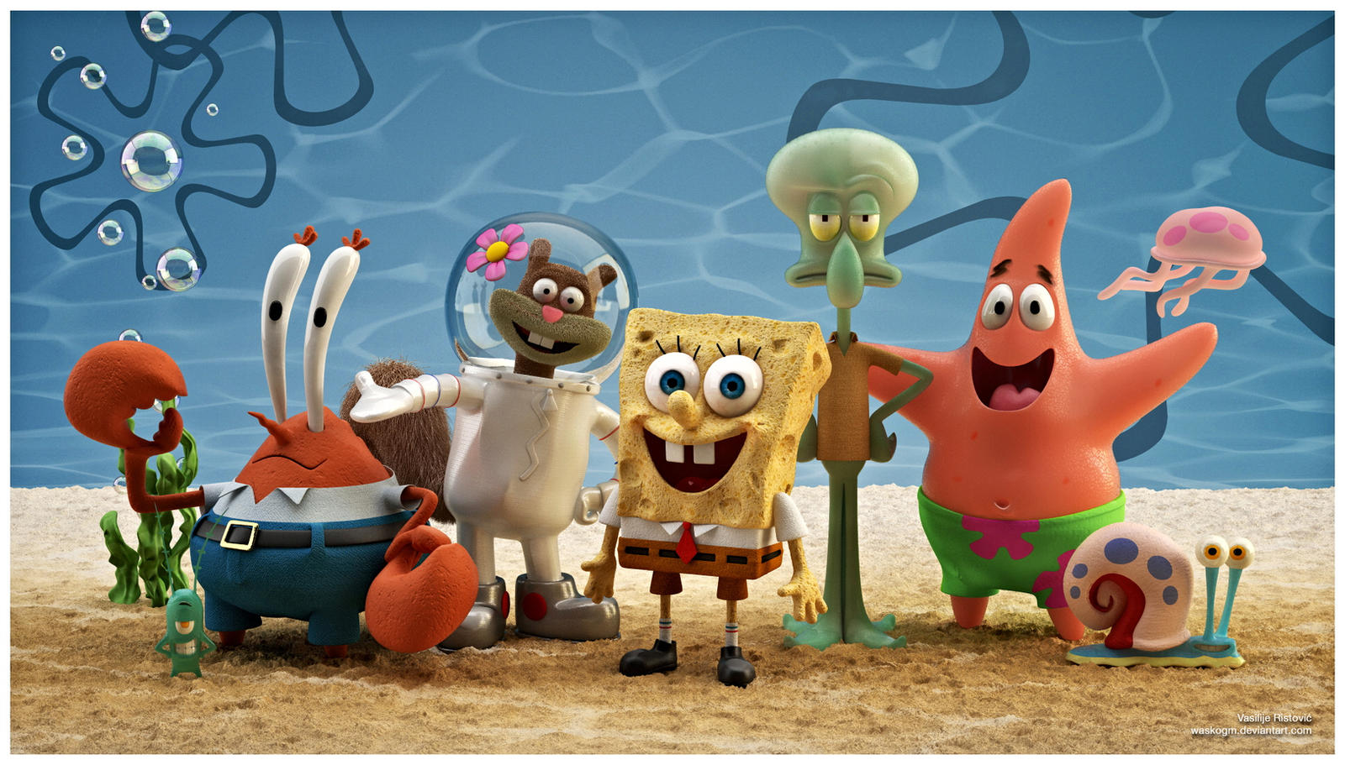
The story
The series chronicles the adventures and endeavors of the title character and his aquatic friends in the fictional underwater city of Bikini Bottom.

Slide 3
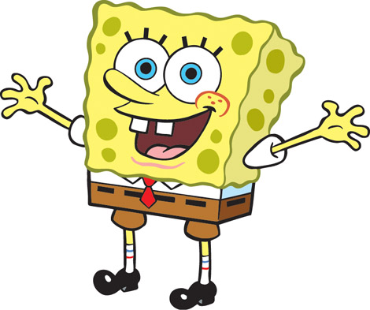
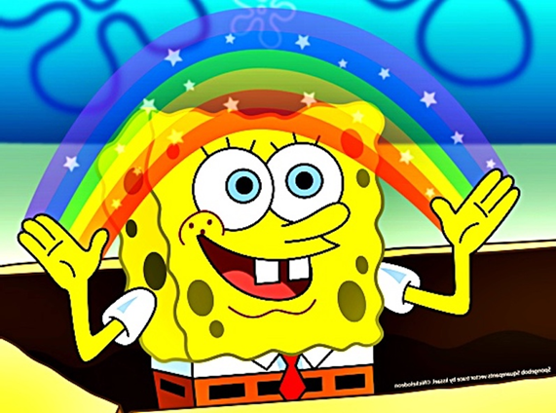
Spongebob
SpongeBob is a yellow sea sponge. He is outgoing, optimistic, and passionate about life. He lives in a fully-furnished pineapple house. He loves his job as a fry cook at a fast-food restaurant called the Krusty Krab. His greatest goal in life is to earn his boat-driving license. And often goes on adventures with his friends.

Slide 4
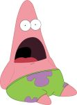
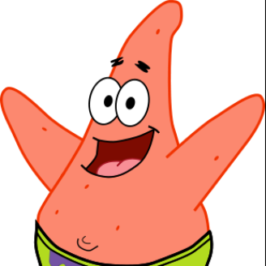
Patrick star
Patrick is the ignorant but humorous best friend of SpongeBob SquarePants. He is portrayed as an overweight pink starfish, who serves as the village idiot of the underwater city of Bikini Bottom.

Slide 5
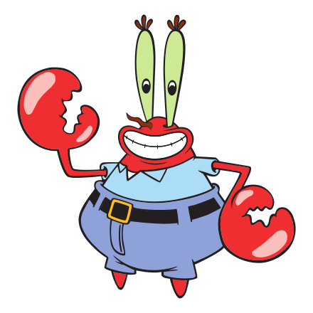
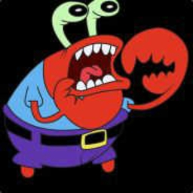
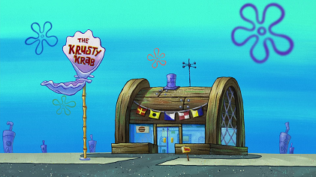
Mr.Krabs
Mr. Krabs is commonly known as the greedy founder and owner of the Krusty Krab restaurant, where SpongeBob works as a fry cook and Squidward works as a Cashier. The restaurant's success is built on little competition and the popularity of the Krusty Krab's signature sandwich, the Krabby Patty, the formula is a closely guarded trade secret. Mr. Krabs frequently exploits his restaurant's popularity, engaging in price gouging and charging his own employees for use of the building's services.

Slide 6
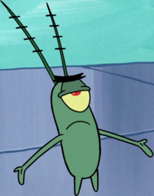
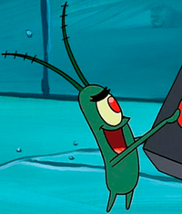
Plankton
Plankton is the nemesis and the former best friend of Mr. Krabs. He operates the Chum Bucket, located directly across the street from Krabs' restaurant.

Slide 7
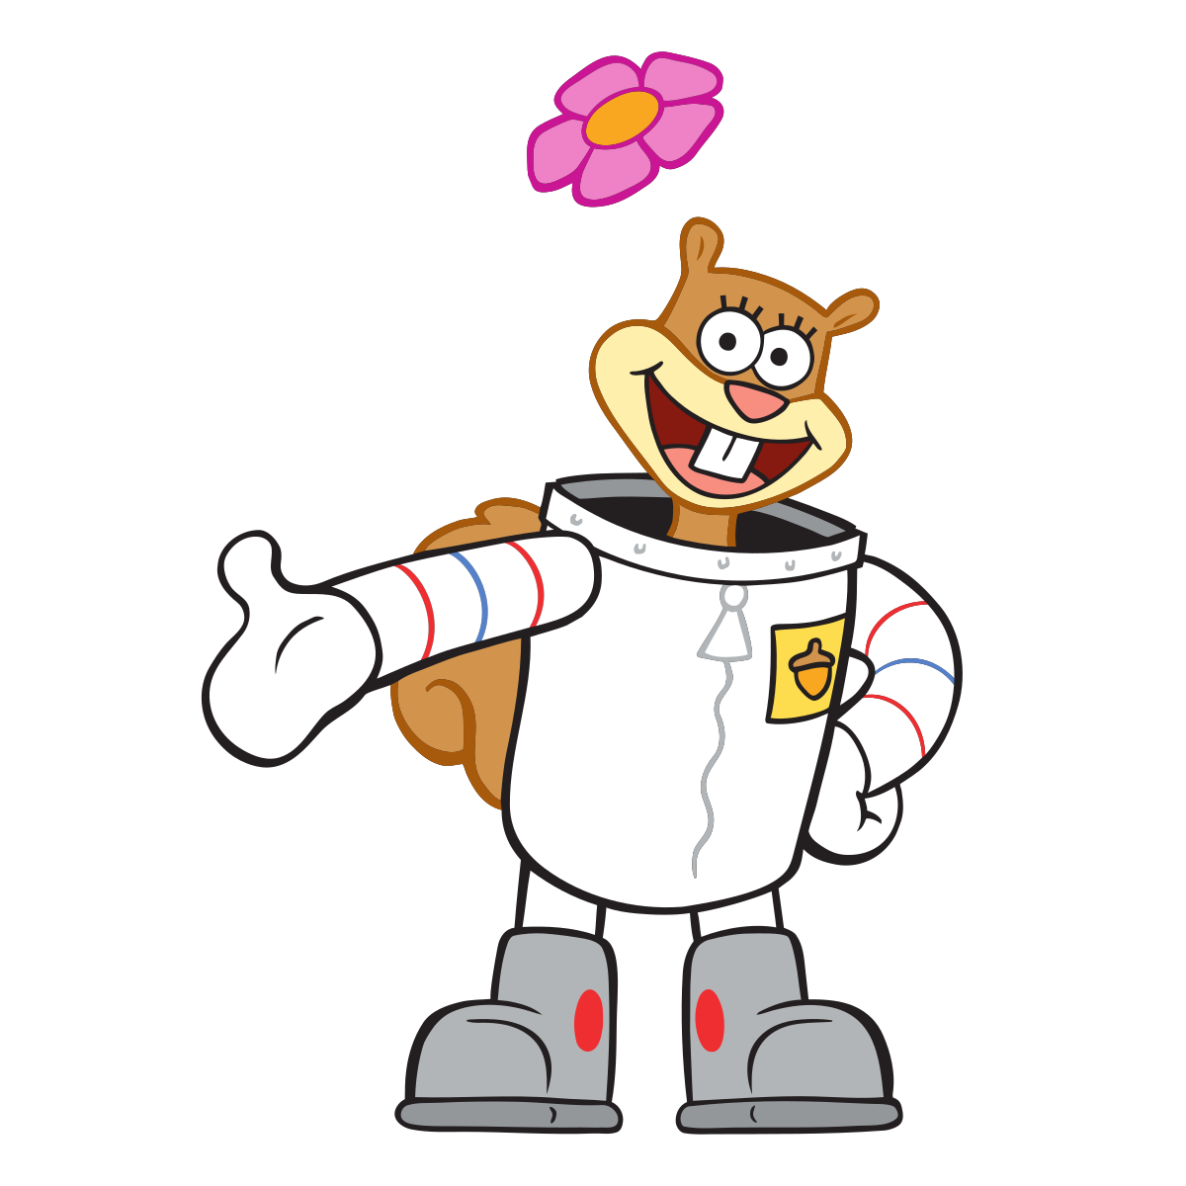
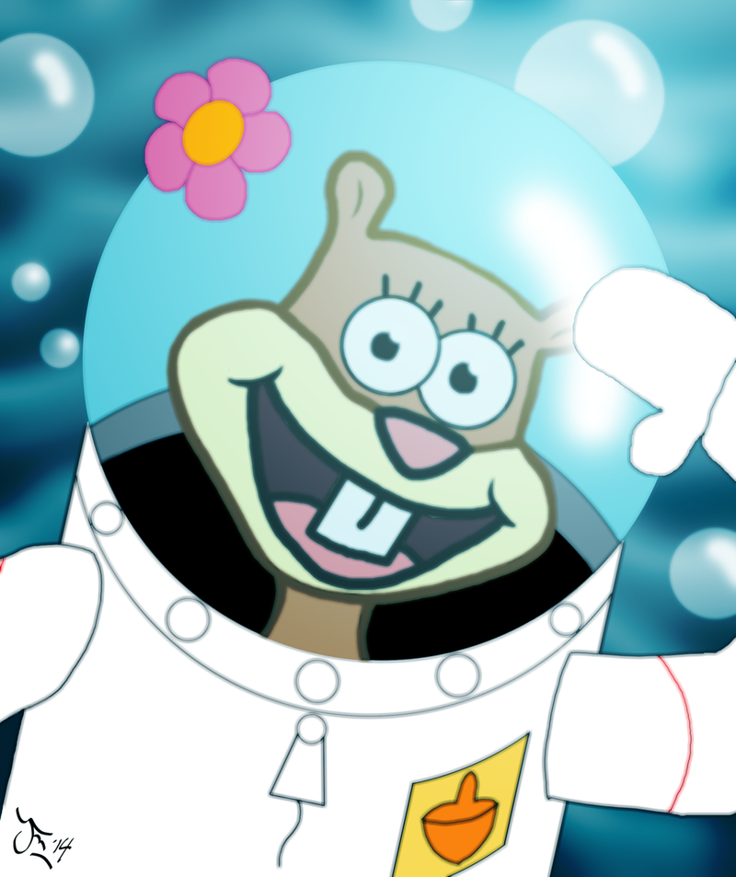
Sandy cheeks
Sandy cheeks is an American squirrel from the surface who wears a diving suit and lives in an air-filled glass dome with a tree to survive underwater.

Slide 8
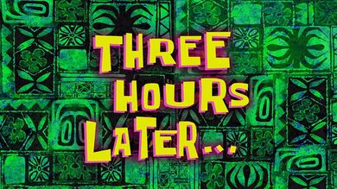
The end

