Slide 1
Raising Dion
By kareem.k

Slide 2
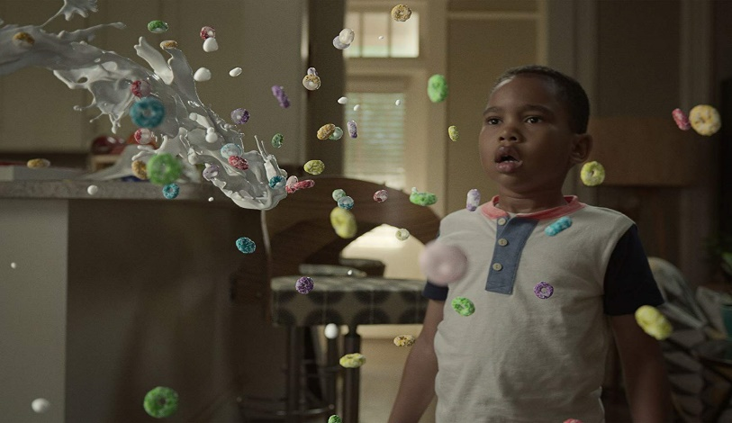
Raising Dion
Raising Dion is a very interesting series in my
Opinion. It is about a little kid called Dion.
He and his mom find out that he has
superpowers and that his father also had them.
He got killed by someone who also
had superpowers but didn’t use them for good.

Slide 3
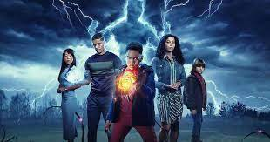
The description of the series
Raising Dion is an American superhero drama streaming television series and his powers is Telekinesis: Dion is able to control objects and move matter with his mind.
He can teleport into random places with using his mind.
He is the main character of the whole series.He lives with his mom who is struggling to find a job.

Slide 4
The good characters
Dions mom known as Necole Reese.
Esperenza also known as his best friend.
Tevin his coach.
Kat Reese known as Dions aunt.

Slide 5
The evil characters
Pat Rollins is the evil character in the series
also known as the croocked man.

Slide 6
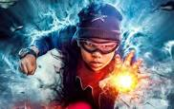
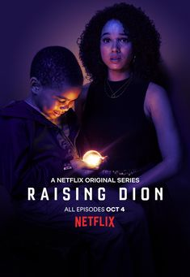
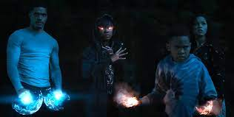
Why is it my favorite series?
Raising Dion is my favorite series It is very
interesting and it really inspires me into not
giving up on my dreams.It also taught me to always
stand up for myself and to work harder to achieve
what I dream to do.

