Slide 1
Physics project
By:
Adam Khoury
Hashem Daoudi
Kareem Karadsheh

Slide 2
Where does the energy go when it is gone…

Slide 3
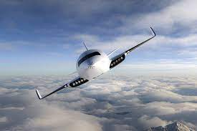
Using air friction to generate power
A designer based in Warsaw named Michal Bonikowski came up with a revolutionary concept.
The concept is to use friction between the air and the air jet to produce energy.
This air jet designed for this concept was named EATHER ONE.

Slide 4
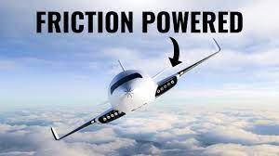
EATHER ONE…
Is an extra ordinary air jet.
Is not powered by fuel or large battery banks.
The air friction across its wings and airframe is used to generate renewable energy.
Air friction→Energy

Slide 5
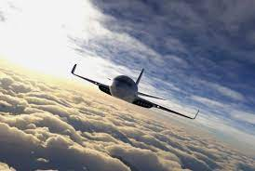
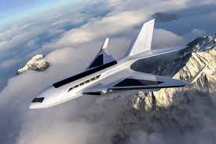
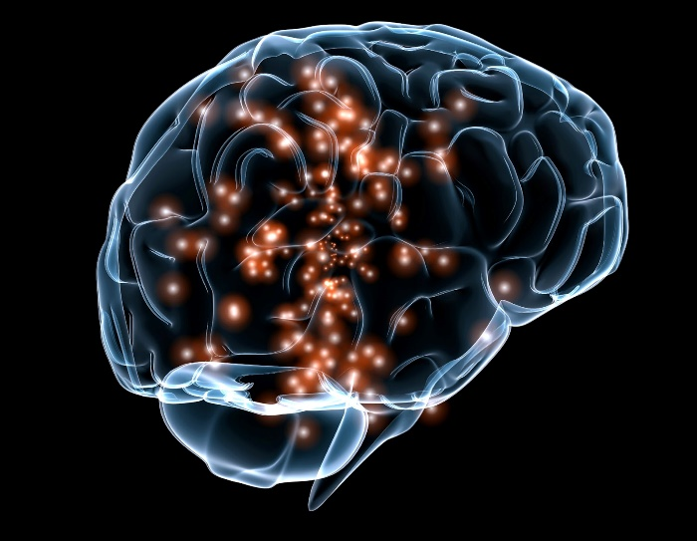
Why is Eather One unique?
Eather One has nanogenerators in its wings.
These genenrators convert mechanical energy into electrical energy which the jet needs to fly.
Since Eather One travels at high speed the idea is to collect the friction generated from the vibrations in the frame of the air jet and its wings.

Slide 6
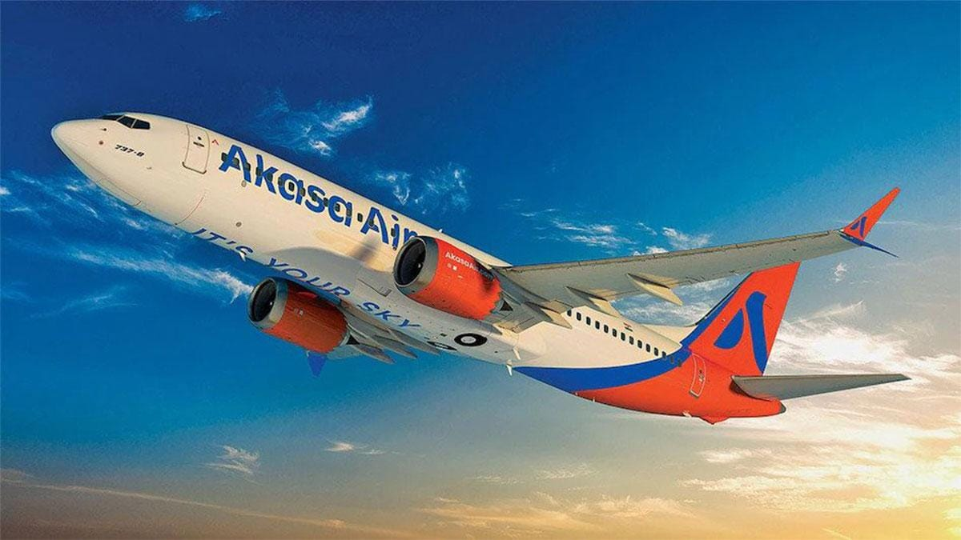
Eather one made a revolutionary concept.
The concept is four or five generations ahead of the current mode of thinking.
It will take the field of air business into a hole new level.

