Slide 1
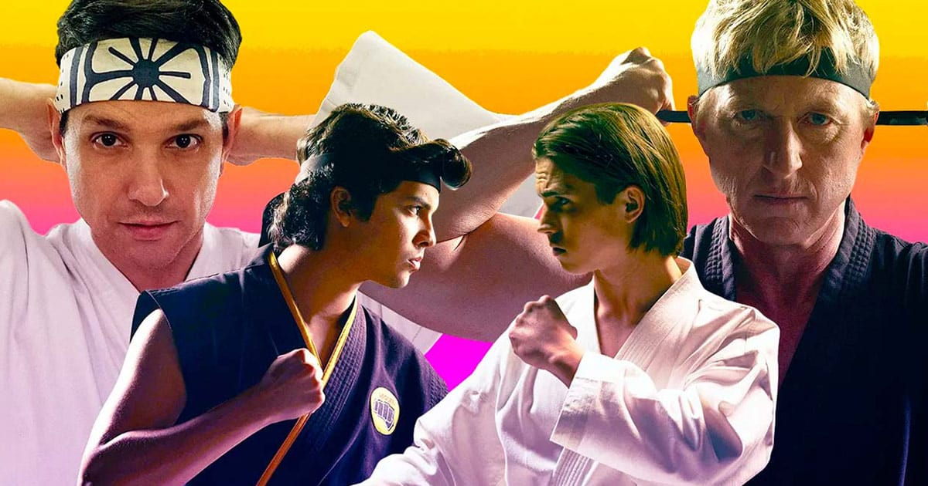
Cobra kai
Hussam Abu Ghattas

Slide 2
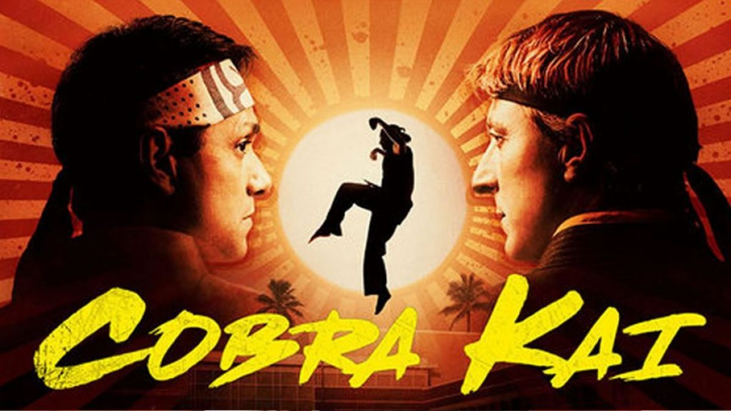
Writers:
Jon Hurwitz , Robert Mark , Josh Heald

Slide 3
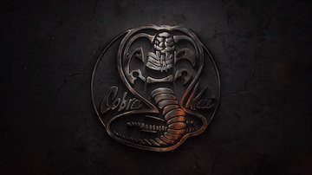
What is the story behind Cobra kai
Karate Tournament, Johnny Lawrence is at rock-bottom as an unemployed handyman haunted by his wasted life. However, when Johnny rescues bullied kid Miguel from tormentors, he is inspired to restart the notorious Cobra Kai dojo.

Slide 4
What is the message in Cobra kai ?
Cobra Kai 's basic premise is just that: change is possible. It may hurt us and we don't even want to do it at first, but transforming who we are and what we do is possible. What you can learn: Changing what we have been for many years is possible and redemption is always an option.

Slide 5
What makes Cobra Kai so good?
. There isn't a traditional “bad guy” or “good guy.” Every character (and each dojo) has flaws, as well as strengths. Cobra Kai, while a drama, also doesn't take itself too seriously, so the vibe is lighter and even comedic at times. This brings a wonderful balance to the show

Slide 6
This is one of the best series I had ever watched and I really recommend everyone to enjoy their time by watching it.

