Slide 1
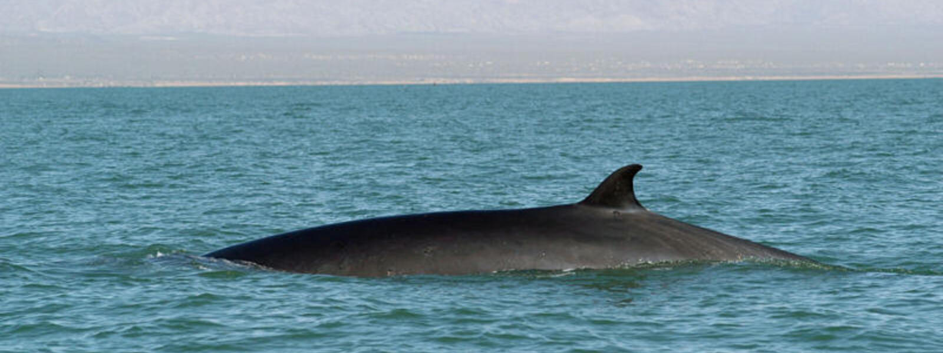
Fin whales
“living things in their environment”.
Choose a habitat/ animals and plants in this habitat and how are they adapted.
Choose endangered animals in this habitat and how to save their population.
Mohammad Younes, Mourad Madain, Nichola Farraj, AlFaisal Thalji

Slide 2
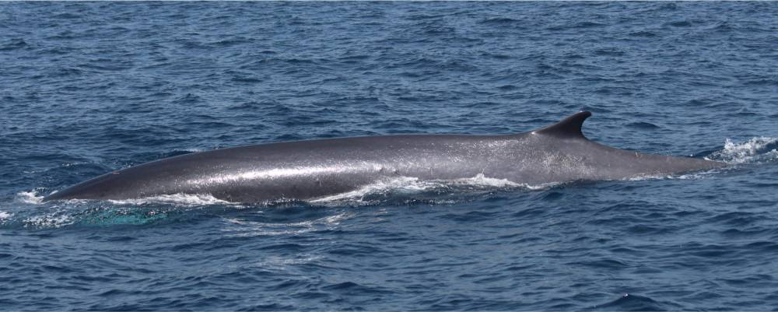
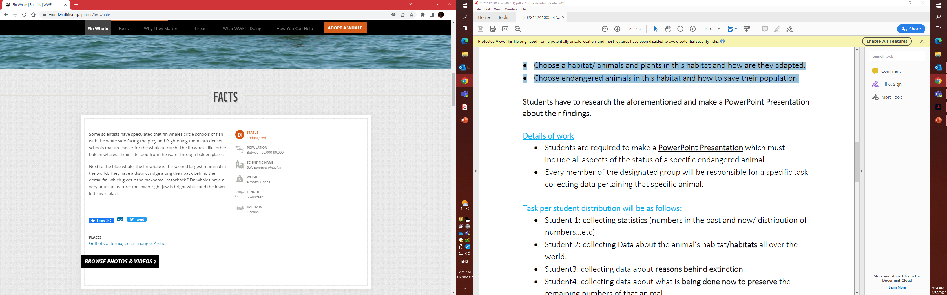
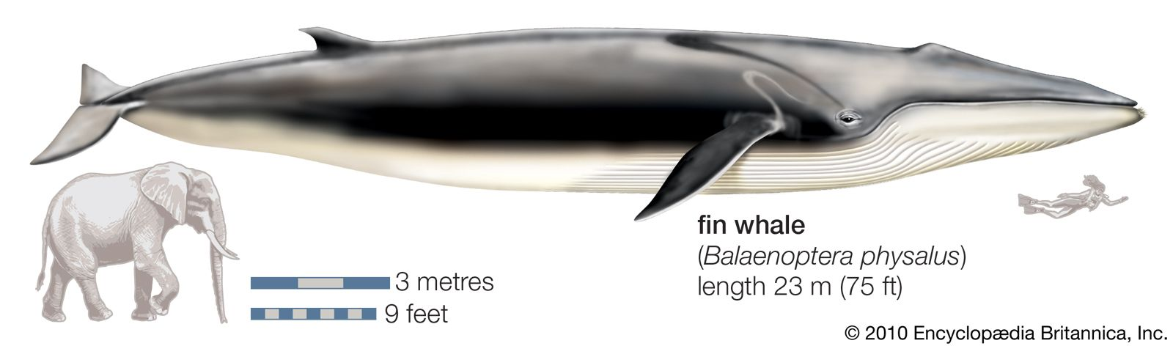
Fin whales Habitat are typically found in deep, offshore waters of all major oceans, primarily in temperate to polar latitudes. They are less common in the tropics. They occur year-round in a wide range of locations, but the density of individuals in any one area changes seasonally.
Fin whales have sleek, streamlined bodies with V-shaped heads.
They have a tall, hooked dorsal fin, about two-thirds of the way back on the body, that rises at a shallow angle from the back. Fin whales have distinctive coloration—black or dark brownish-gray on the back and sides and white on the underside.
Whales generally have four fins: two pectoral fins (instead of arms), a caudal fin (also called the tail) and a dorsal fin. The caudal fin is used for propulsion of the animal, with up-and-down movements created by powerful muscles along the peduncle. The two pectoral fins serve as the whales' rudders and stabilizers.

Slide 3
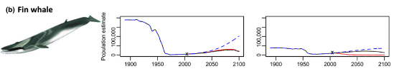
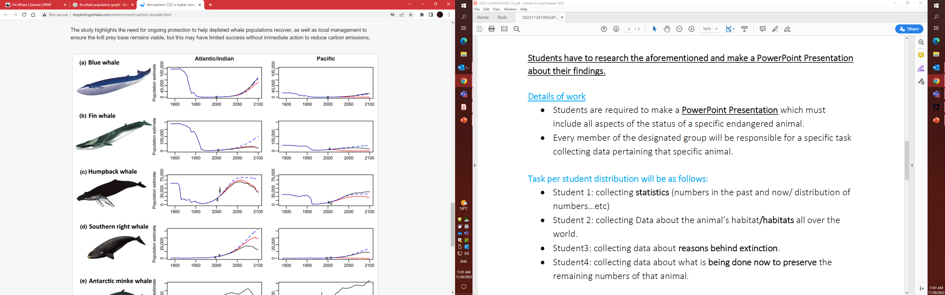

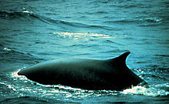
Fin whales were once a common sight around the world. Hundreds of thousands of them roamed the oceans, and hunters largely ignored them because they were hard to catch. But once the appropriate technology was developed, heavy whale hunting in the 20th century greatly depleted their numbers. According to the University of Michigan’s Animal Diversity Web, more than 10,000 whales were hunted every year by the 1950s. Although protection was extended between 1976 and 1990, the whale populations dropped to a low of only 38,000 by 1997, placing it at danger of extinction.
According to the International Union for the Conservation of Nature (IUCN)‘s Red List, the current status of the fin whale is vulnerable. There are now currently about 100,000 mature individuals left in the world, and the population numbers appear to be increasing. However, it may take many more decades of careful conservation before the fin whale returns to its previous numbers.
Current population and its distribution: About 3,200 off California, Oregon, and Washington. Between 14,000 and 18,000 are estimated for the entire North Pacific. In the North Atlantic and the Gulf of Mexico, the population is about 2,700 fin whales and the southern hemisphere has around 82,000.

Slide 4
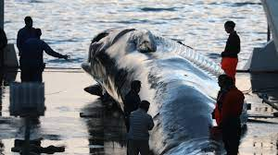
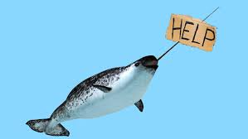
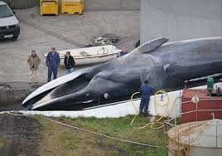
Reasons behind extinction
Vessel Strikes
Because of their large size and the overlap between migration patterns and vessel transit areas, fin whales are one of the most commonly recorded species reported in ship strikes. Since many of the strikes involving large vessels can be difficult to detect (or aren’t reported), it is hard to assess the actual number of fin whale deaths or injuries connected to collisions.
Noise Pollution
It isn’t just vessel collisions that impact fin whales, but the underwater noise that the ships make as well. Fin whales produce a variety of low-frequency sounds to communicate, some of which can be as loud as 196.9 dB—making them one of the loudest animals in the ocean. Increased underwater noise can negatively affect entire fin whale populations by altering their normal behavior, chasing them away from important breeding or feeding areas, and even causing stranding or death.
Fishing Gear Entanglement
When fin whales become entangled in fishing gillnets and other equipment, they may swim off with the gear and become fatigued, restricted from breeding and feeding, or injured under the weight. In more severe situations, they can become completely immobilized by the gear and either starve or drown.
Climate Change
Like all marine animals, the threat to fin whales from climate change and warming oceans is monumental, especially since whales get their cues for important behavior (like navigating and feeding) directly from their environment. Altered ocean conditions and the timing or distribution of sea ice can also disconnect fin whales from their prey, leading to changes in foraging, stress, and even reduced reproduction rates.

Slide 5
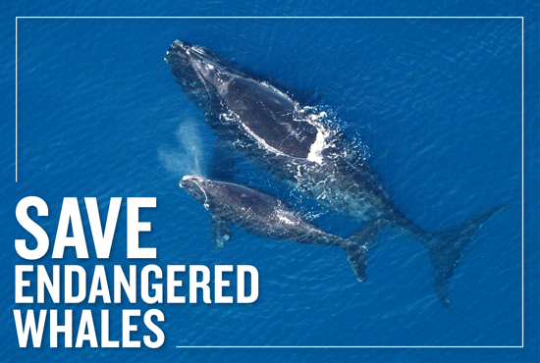
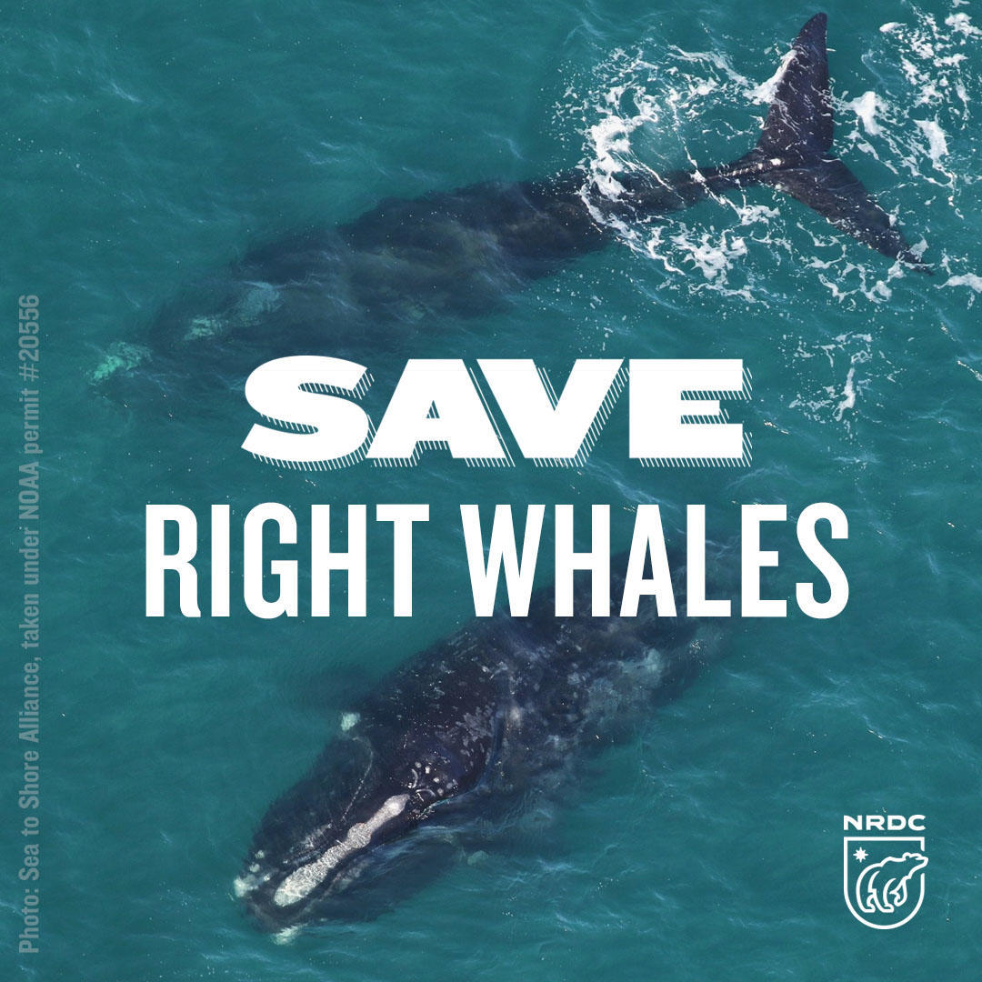
What You Can Do to preserve the remaining numbers of Fin Whales.
Reduce your speed in known areas where fin whales occur, keep a lookout for blows, fins, or tail flukes, and always stay at least 100 yards away.
Report whales that appear to be sick, injured, entangled, stranded, or dead to the closest organizations that are trained to respond to marine animals in distress.
Do your part to reduce ocean pollution by saying no to single-use plastics and switching to reusable products.

