Slide 1
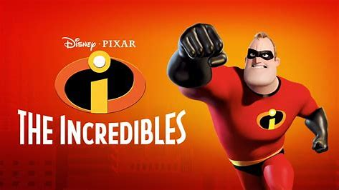
By Adam Safadi

Slide 2
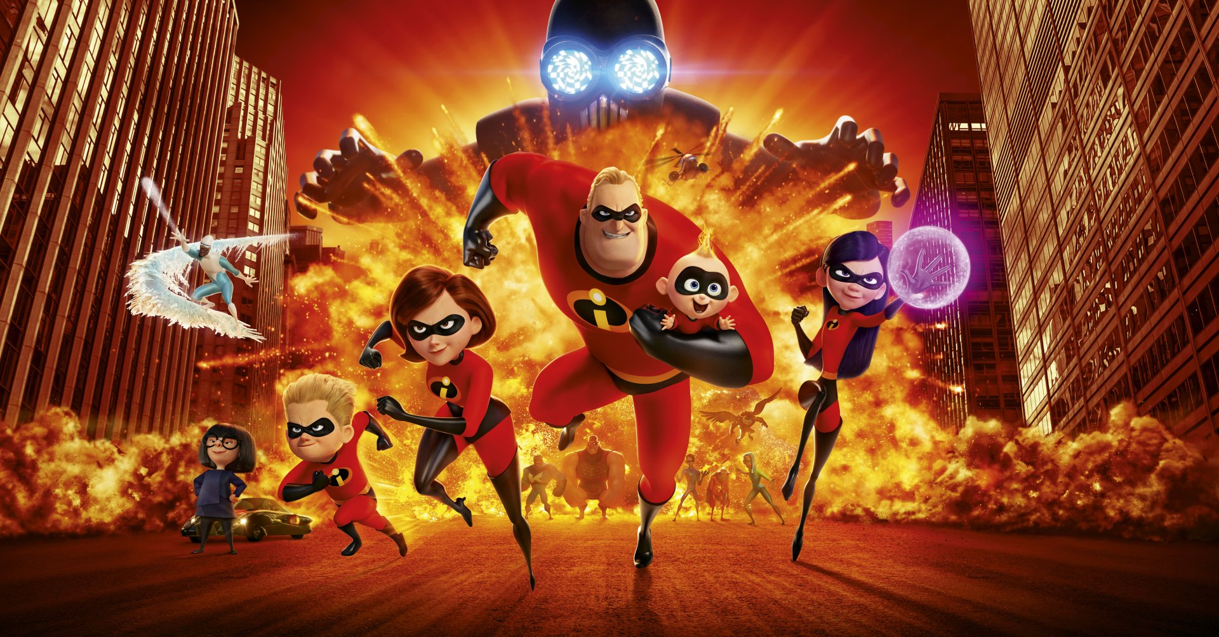
The Incredibles
The Incredibles is a 2004 American computer-animated comedy superhero film about a family of superheroes who are forced to hide their powers after they arouse public concern.

Slide 3
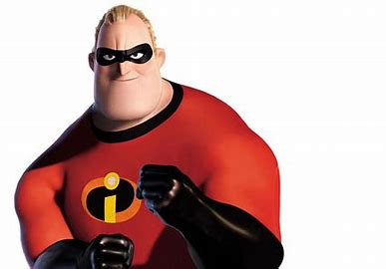
Bob Parr
Robert "Bob" Parr, also known as Mr. Incredible, is a fictional superhero. He is a superhuman that has superhuman strength, durability, and stamina. He loves his family and he does his best to protect them.

Slide 4
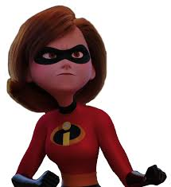
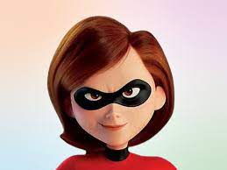
Helen Parr
Helen Parr, also known as Elastic girl and Mrs. Incredible, is a fictional superhero. She is quick-witted, resourceful, talented, passionate, driven, and supportive. Throughout the story, she is the only unwavering character, always sure of herself and always caring for those around her. She is the stronghold in the Parr family and the one that holds them all together, for better or worse.

Slide 5
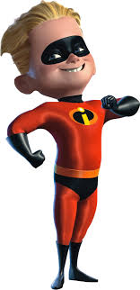
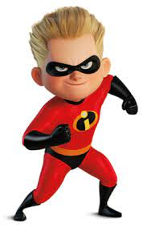
Robert Parr
Robert Parr known as Dash is a "highly competitive boy, and a bit of a showoff". Dash believes that he shouldn't be ashamed of his abilities or need to hide them, believing it makes him special

Slide 6
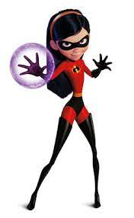
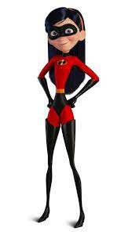
Violet Parr
Violet Parr is a fictional character in Pixar's computer animated superhero film. The eldest child of Bob and Helen Parr, Violet is born with the superhuman ability to render herself invisible, as well as generate force fields. Violet suffers from self-confidence issues. She is fundamentally different from her peers, but is unable to express herself.

Slide 7
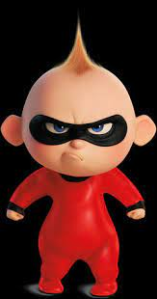
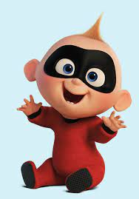
Jack Parr
Jack-Jack acts just like a typical baby. He laughs and giggles a lot but cries whenever he is disturbed. Like many infants, Jack-Jack's emotions are unpredictable; and since his powers are stimulated by them, being with him when the baby uses his powers becomes very difficult when attempting to pacify or restrain him

Slide 8
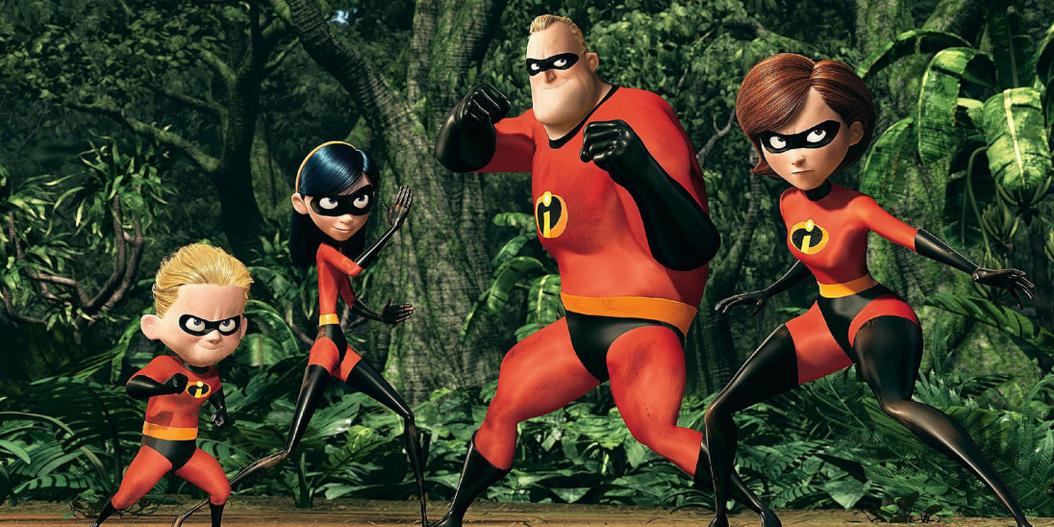
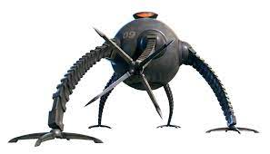
The Plot
After all super-powered activities have been banned by the government. While Mr. Incredible loves his wife and kids, he longs to return to a life of adventure, and he gets a chance when summoned to an island to battle an out-of-control robot. Soon, Mr. Incredible is in trouble, and it's up to his family to save him.

Slide 9
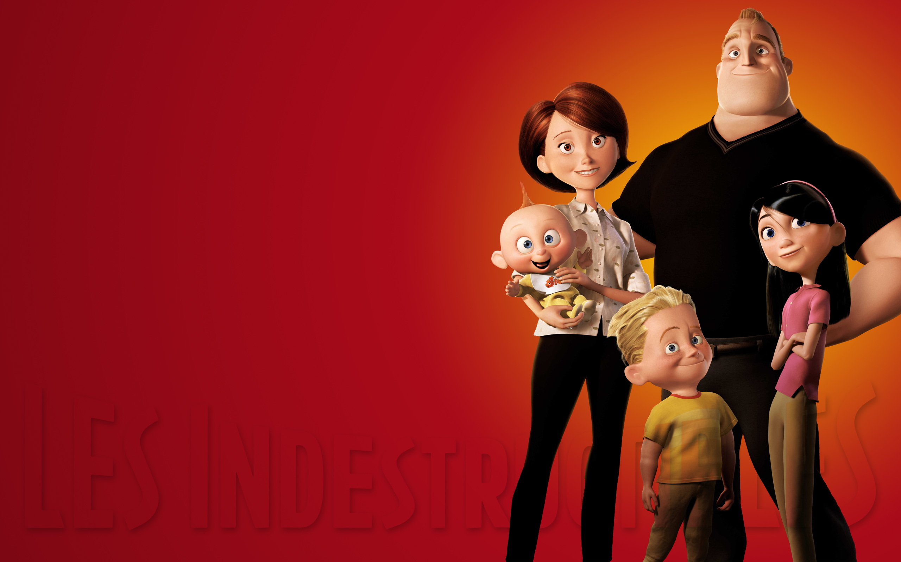
The main message
The main message of The Incredibles is that everyone has special gifts and talents. Rather than hiding these gifts and trying to fit in and be like everyone else, you should be true to yourselves and be happy with who you are.

Slide 10
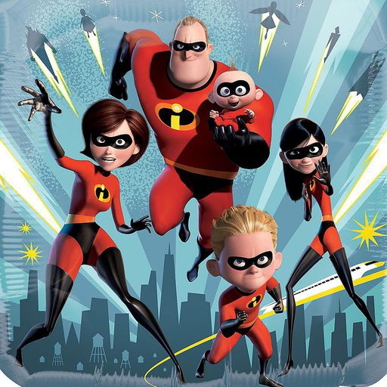
Thank you! I hope you like my presentation

