Slide 1
By Rayan Safadi

Slide 2
About Hotel Transylvania
Hotel Transylvania was released on September 28, 2012, and is about a human named Jonathan, who accidentally stumbles upon the hotel and instantly falls in love with Dracula's teenage daughter, Mavis, and eventually dates her, despite Dracula's attempts to keep Jonathan away from his daughter.

Slide 3
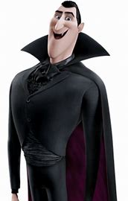
Count Dracula
Count Dracula, better known as Drac, is the main protagonist of the Hotel Transylvania movie series. He is the owner of Hotel Transylvania and oversees all of the events held there. He is the husband of Martha, the father of Mavis, the father-in-law of Johnathan and the maternal grandfather of Dennis. Dracula is very charismatic and funny to his guests and others around him and although he can be over-controlling of what goes on in the hotel and overprotective of his daughter, Mavis. However, despite his flaws, Dracula still cares deeply about his friends and family and only does what he believes his best for them.

Slide 4
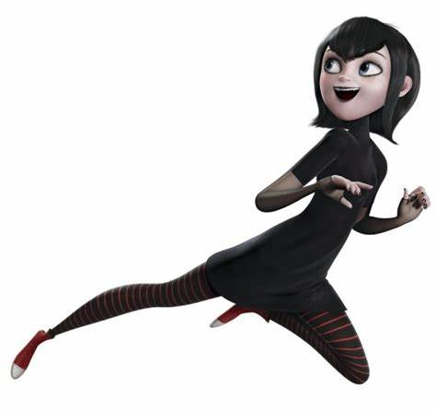
Mavis
Mavis Kate Dracula is an American fictional character of all three Hotel Transylvania movies. She is the main protagonist of the Hotel Transylvania, the series. Mavis is also the love interest and later wife of Jonathan and the mother of Dennis. She wants a little bit of independence and trust from her father and often gets bored. She has dreams of exploring the world and experiencing all the sights and sounds that the world has to offer

Slide 5
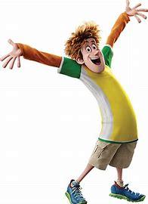
Jonathan
Jonathan is an easy-going, fun-loving and happy-go-lucky young man whose presence breathes new life into the monster world. He is the father of Dennis and husband of Mavis the daughter of count Dracula.

Slide 6
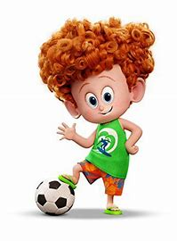
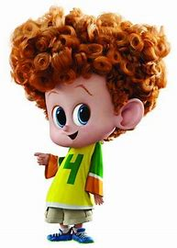
Dennis
Dennis is the half-human/half-vampire son of Jonathan and Mavis Dracula. He is one of the major characters of the Hotel Transylvania sequels. Dennis is seen as a sweet little boy with a love of adventure. He seems to have inherited some of his father's personality. Dennis loves his family very much, and seems to understand what's going on around him more than the grown-ups think,

Slide 7
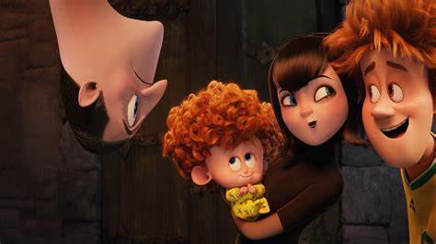
Main idea for Hotel Transylvania
In order for children to become adults, parents have to learn to let go

Slide 8
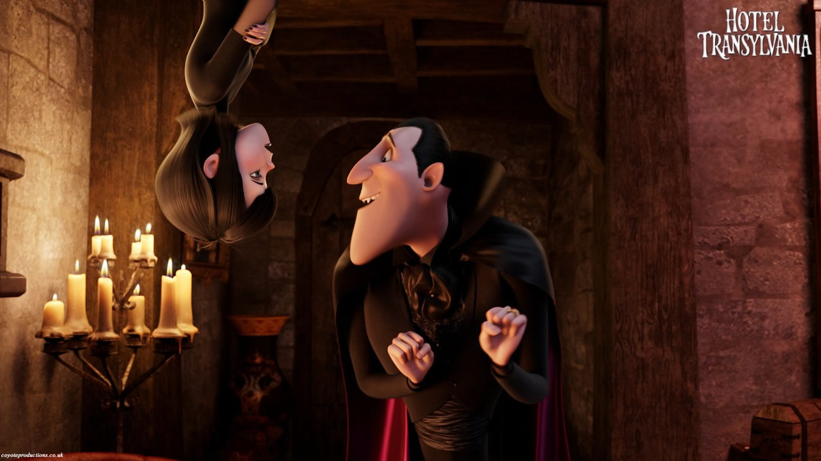
What is the plot?
The story revolves around an overprotective Dad, Count Dracula who believes that humans are dangerous, and as a precaution to save his daughter and other fellow vampires and monsters, they take a refugee in a hotel.

Slide 9
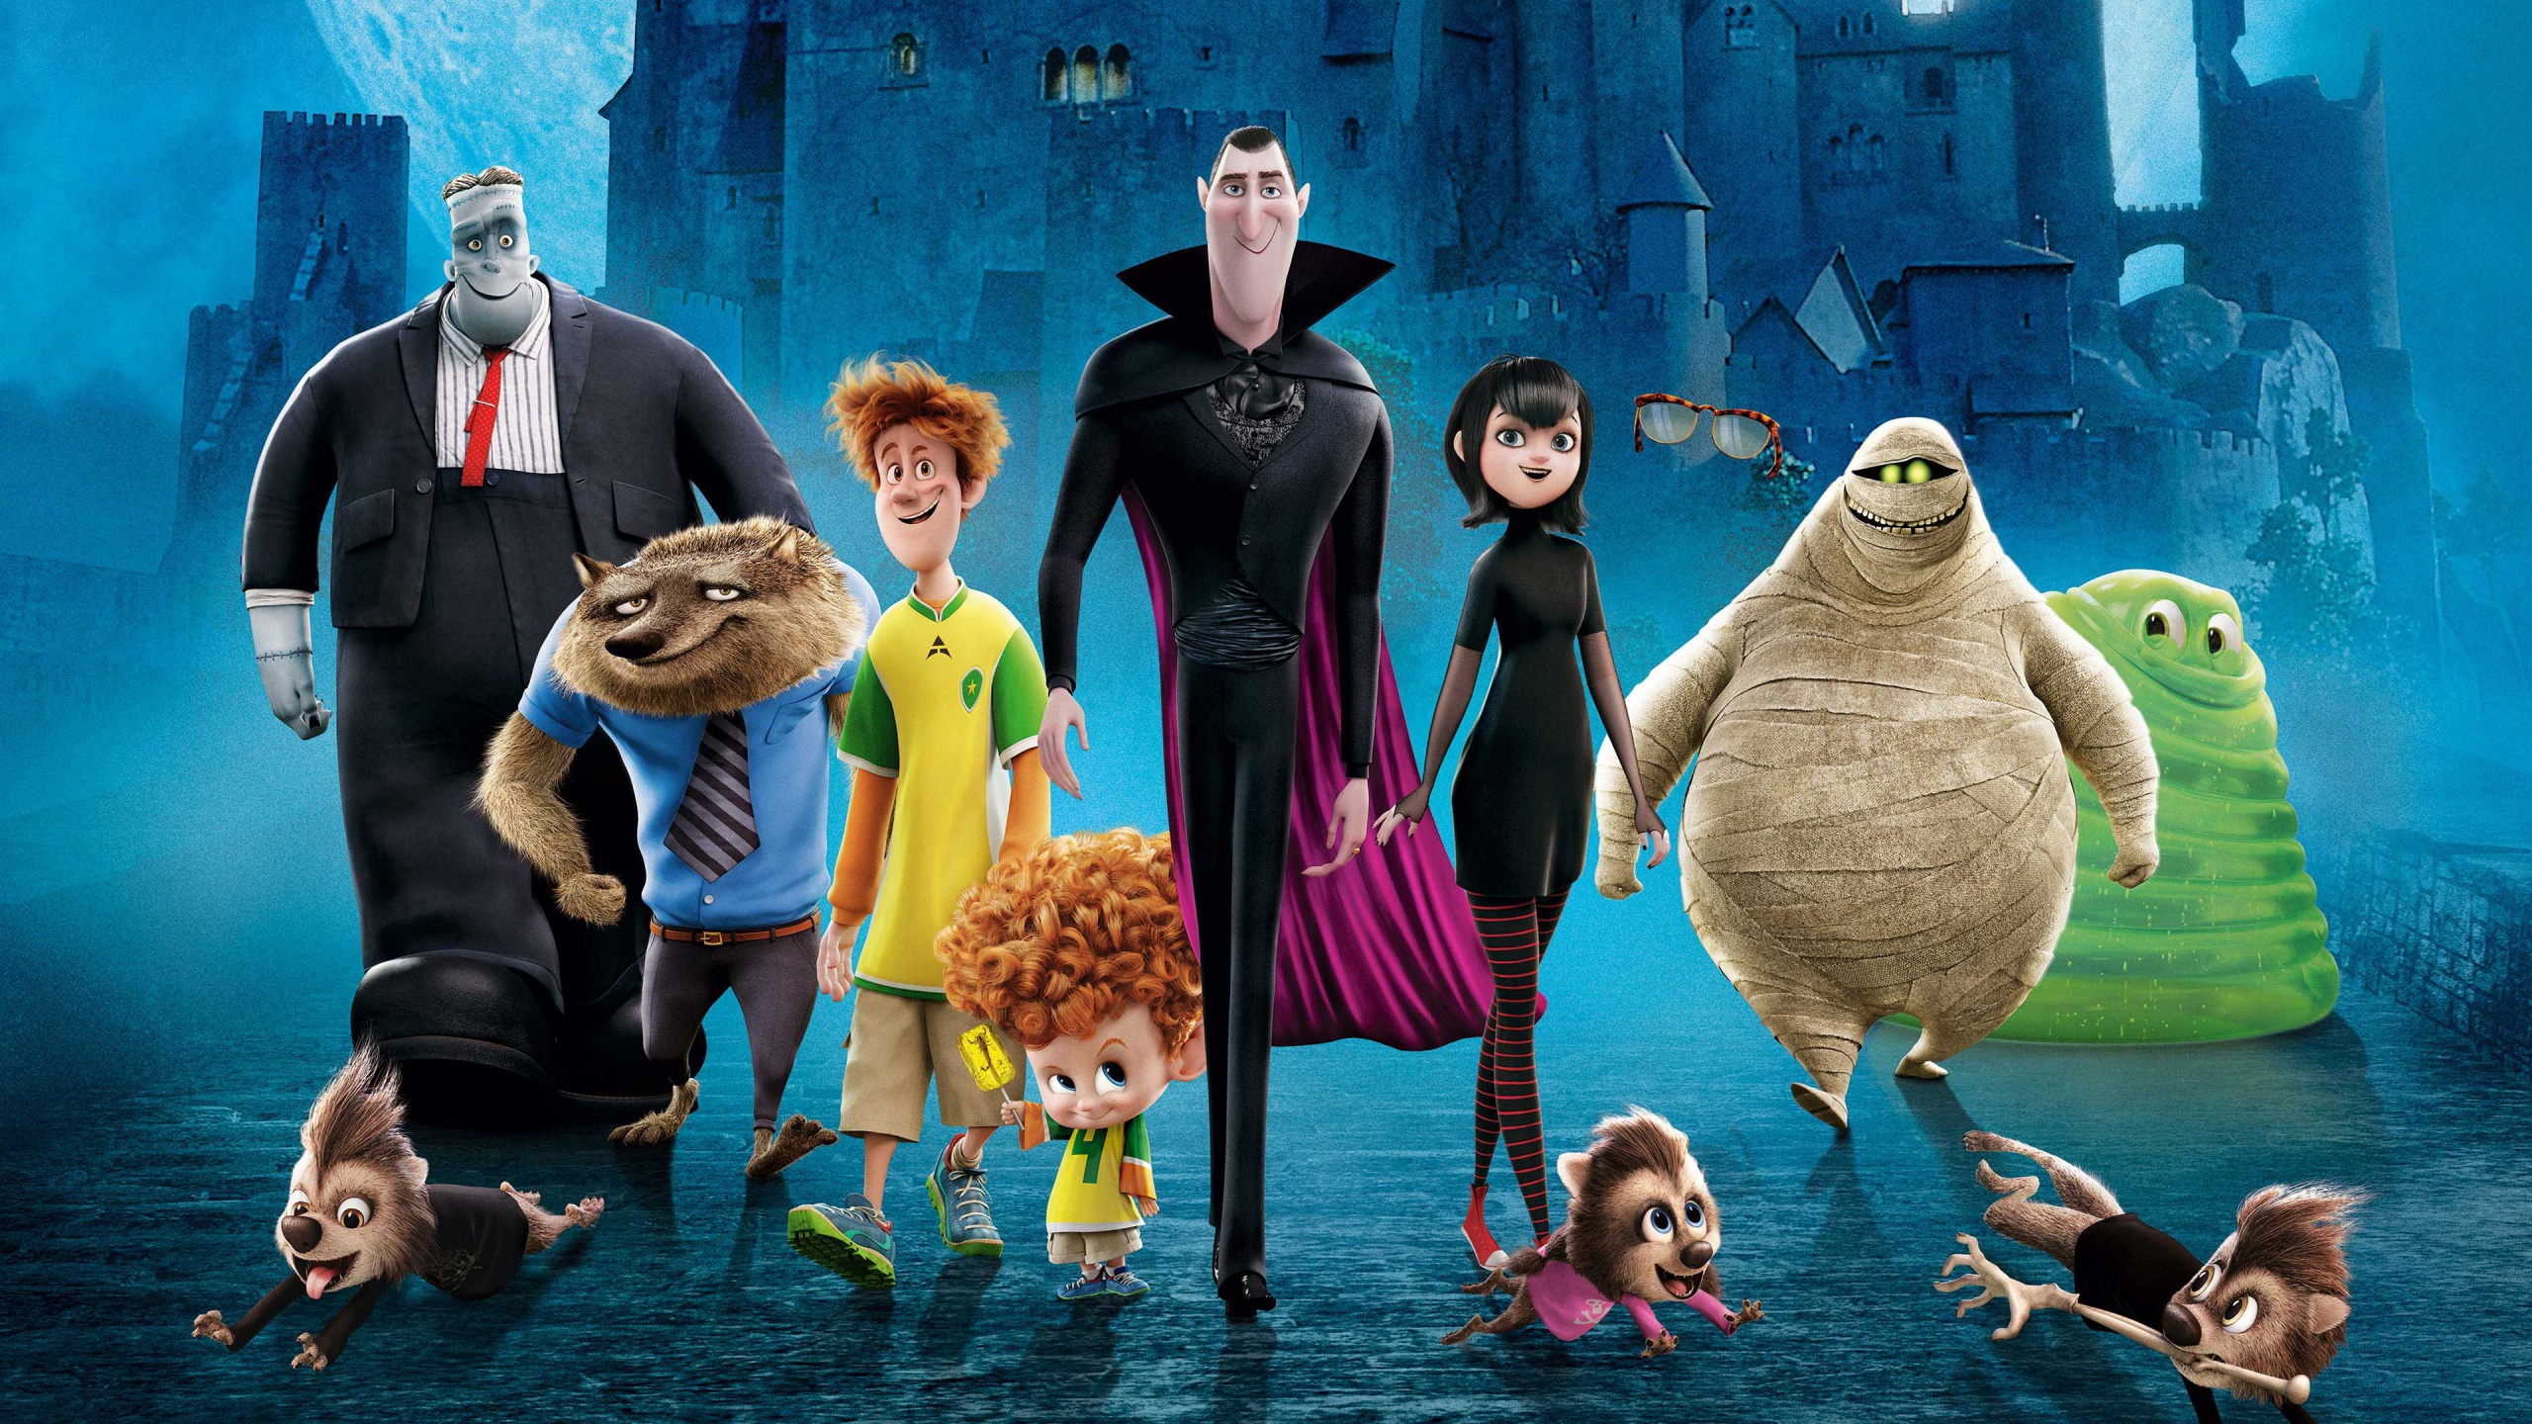
Thank you for your time!
Hope you liked this presentation

